Slide 1
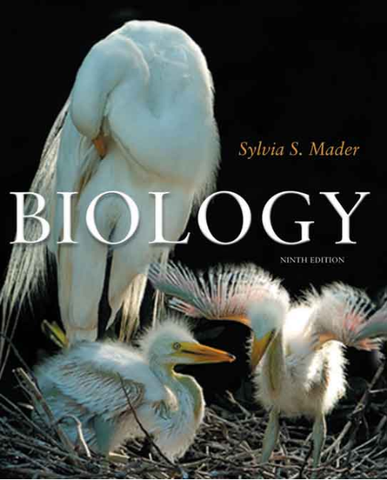
Chapter 10
MEIOSIS
Copyright © The McGraw-Hill Companies, Inc. Permission required for reproduction or display.

Slide 2
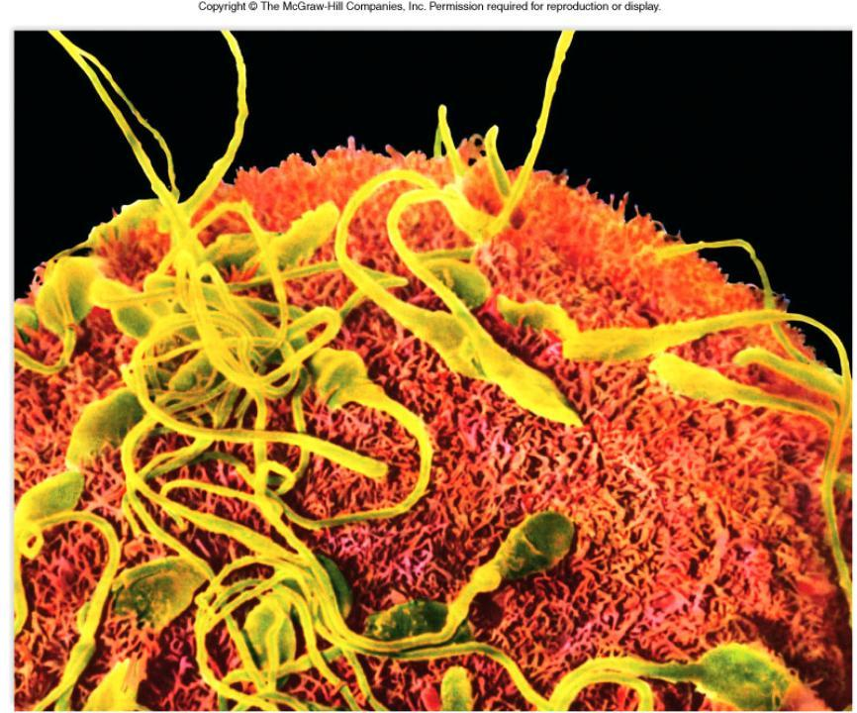
What is it?
Sperm and egg.

Slide 3
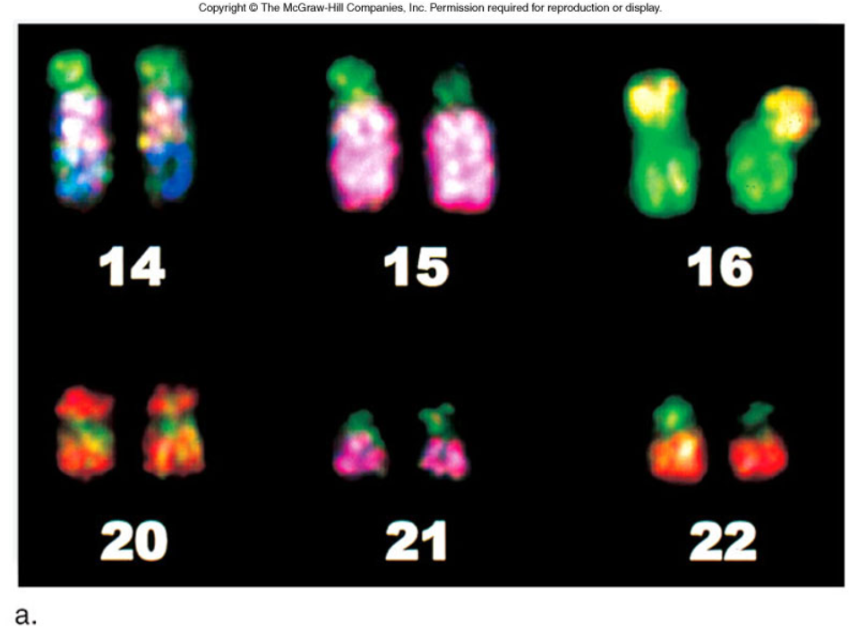
Figure 10.1a
The word chromosome comes from the Greek χρῶμα (chroma, colour) and σῶμα (soma, body) due to their property of being very strongly stained by particular dyes.

Slide 4
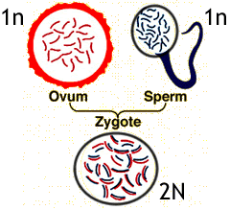
Meiosis
------ the production of haploid cells with unpaired chromosomes - word means "to diminish".

Slide 5
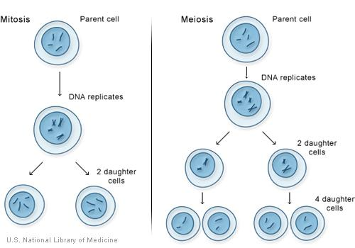
Key points of Meiosis
The process results in 4 daughter cells
Daughter cells are haploid (N)
Daughter cells have unique combinations of chromosomes

Slide 6
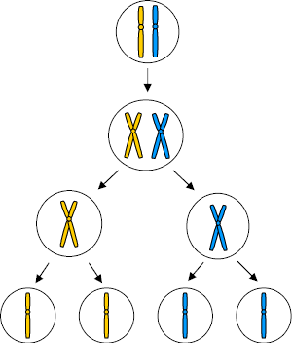
Meiosis creates gametes
(sperm and eggs)
Meiosis ensures variability in offspring
Gametes combine to create a zygote which is diploid (2N) - process of sexual reproduction

Slide 7
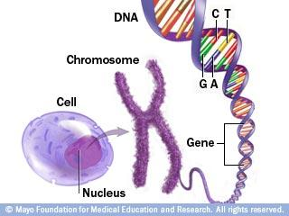
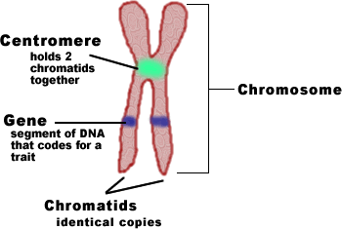
Chromosome Structure
Chromosomes also have banding patterns unique to each one. These bands are caused by certain dyes. Chromosome banding can help to determine homologs on a karyotype.
Each chromosome has mane alleles, or alternate forms of genes

Slide 8
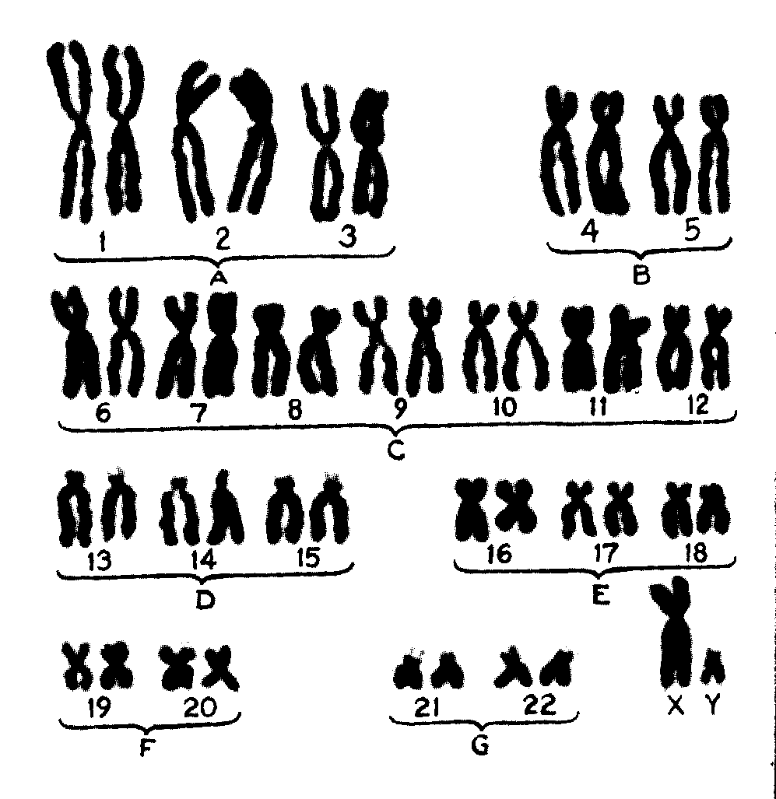
Homologous Chromosomes
- each chromosome has a match, called a homolog.
This is why normal organisms always have an even number of chromosomes.
One homolog you received from your mother, the other you received from your father. They are not exactly alike, but they are the same size, shape, and have the same banding pattern.
Chromosomes are numbered according to their size.
Karyotype showing homologous pairs.

Slide 9
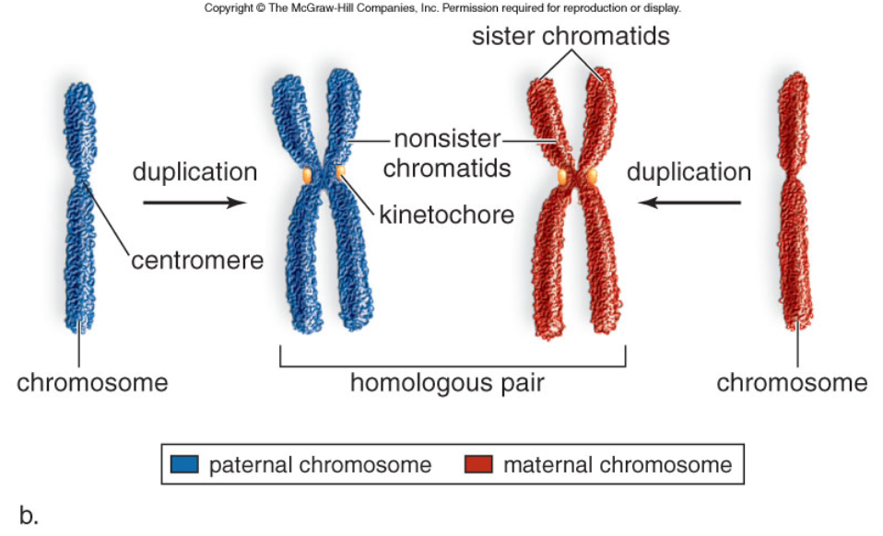
Figure 10.1b

Slide 10
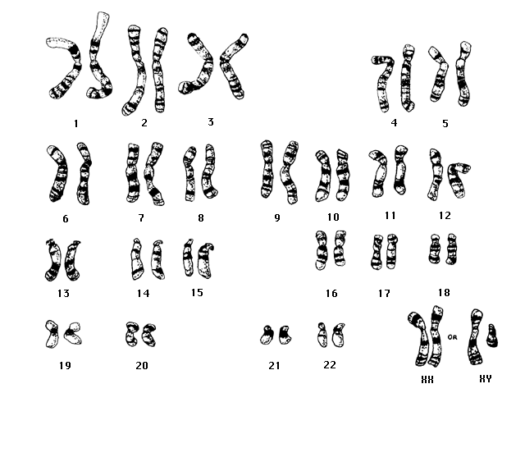
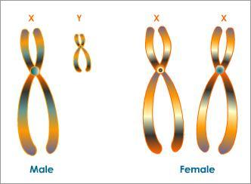
Sex Chromosomes
The last set of chromosomes are the sex chromosomes. In humans...
XX = female
XY = male

Slide 11
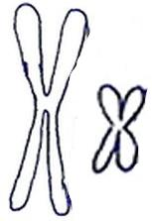


Diploid vs Haploid
Body cells have the full set of chromosomes – they are DIPLOID (In humans, 46)
Sex cells (sperm and eggs) have half a set – they are HAPLOID (In humans, 23)
Diploid = 4
Haploid = 2

Slide 12
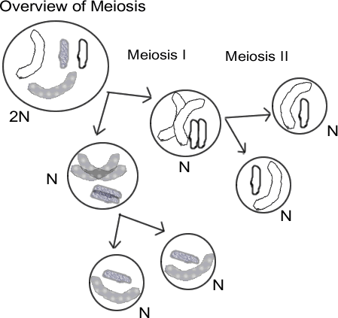
Setting the Stage for Meiosis
Meiosis occurs in two stages - two cell divisions that resemble mitosis.
During interphase - DNA makes a copy, each chromosome consists of two chromatids
Prophase I - homologous chromosomes pair up and exchange DNA. -
this is called CROSSING-OVER

Slide 13
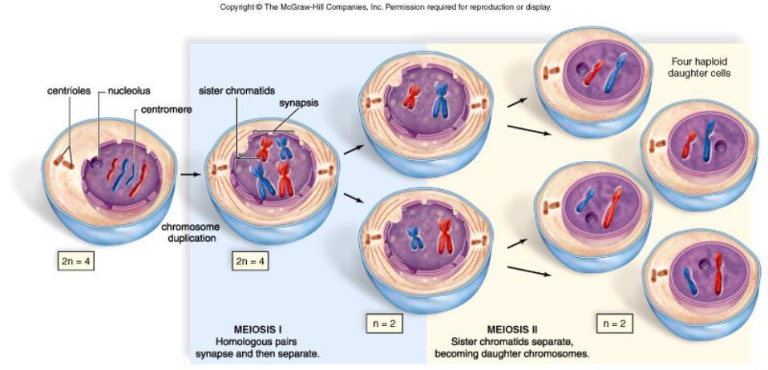
Figure 10.2

Slide 14
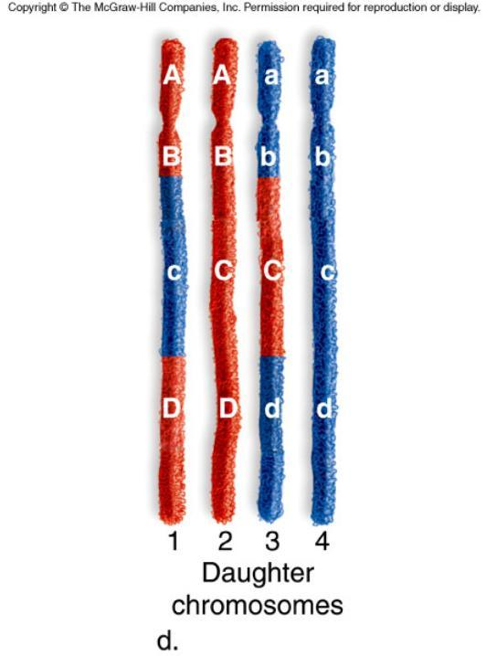
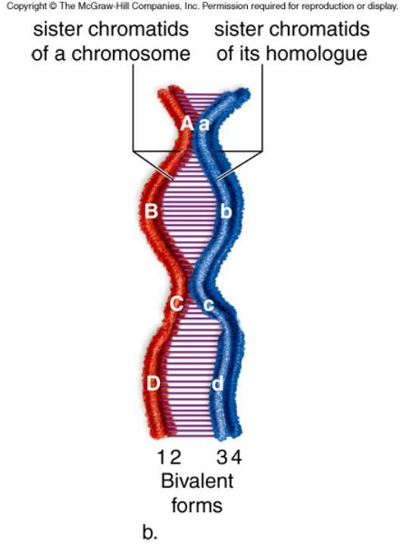
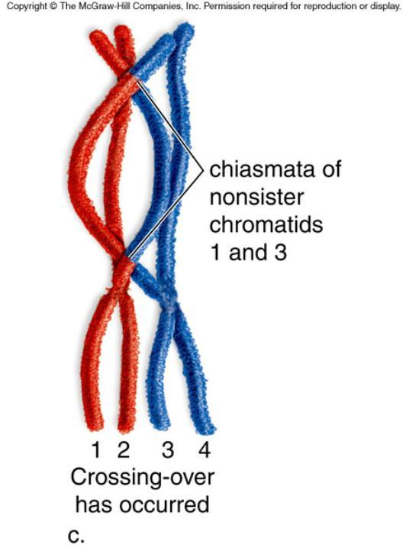
Figure 10.3b
Exchange of DNA during prophase I increases genetic variability. Chromatids are no longer exact duplicates.

Slide 15
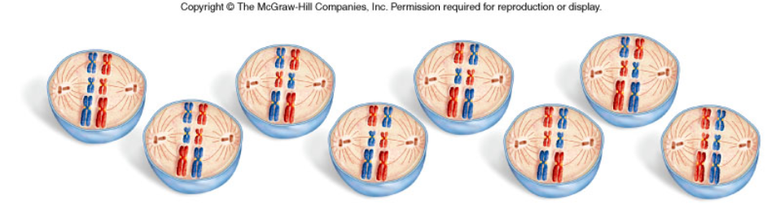
During metaphase, chromosomes line up in PAIRS, but they line up randomly. This picture shows all the different possible arrangements for an organism with 6 chromosomes.
This is called INDEPENDENT ASSORTMENT

Slide 16
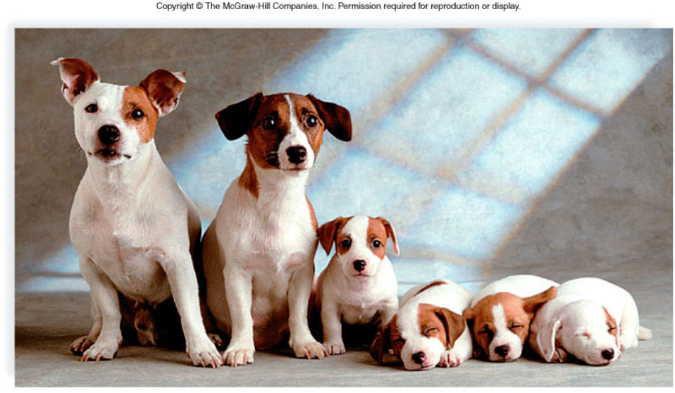
Fertilization = combining the genes of two different parents.
When gametes combine, offspring show variation due to independent assortment and crossing over

Slide 17
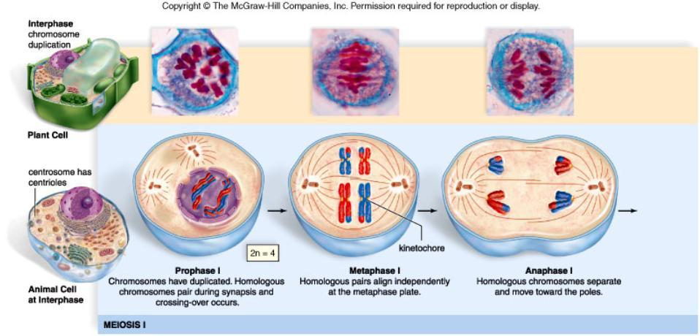
10.3 The Phases of Meiosis
Similar in plants and animals.
Plant cells lack centrioles.

Slide 18
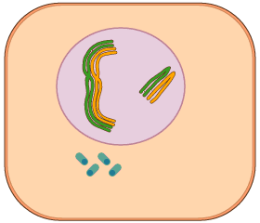
Meiosis is actually TWO divisions, this results in FOUR daughter cells, each with HALF the number of chromosomes.
These cells are HAPLOID!

Slide 19
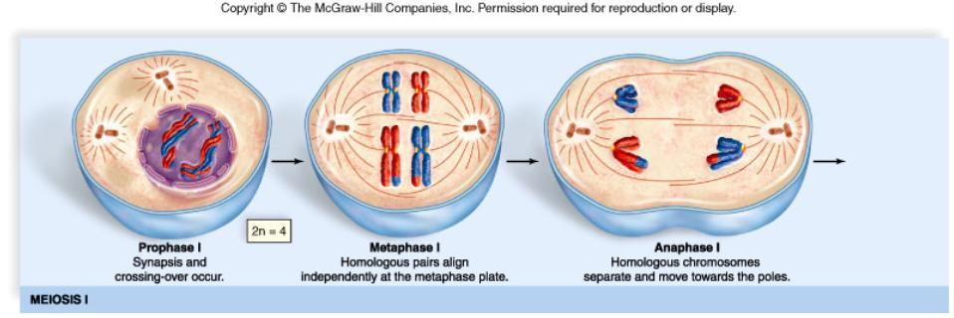
Figure 10.7aa

Slide 20
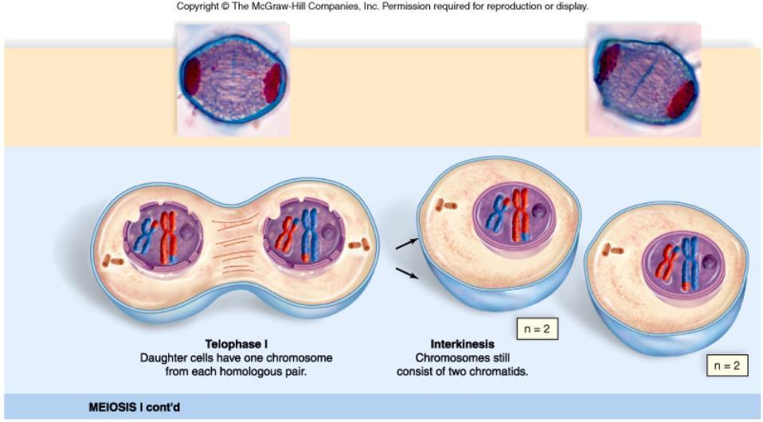
Figure 10.6ab

Slide 21
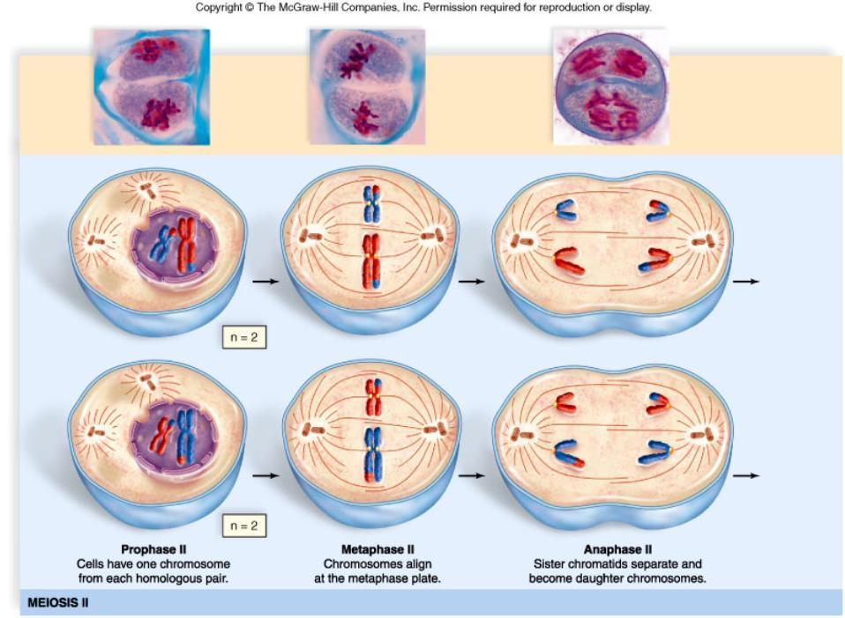
Figure 10.6ba

Slide 22
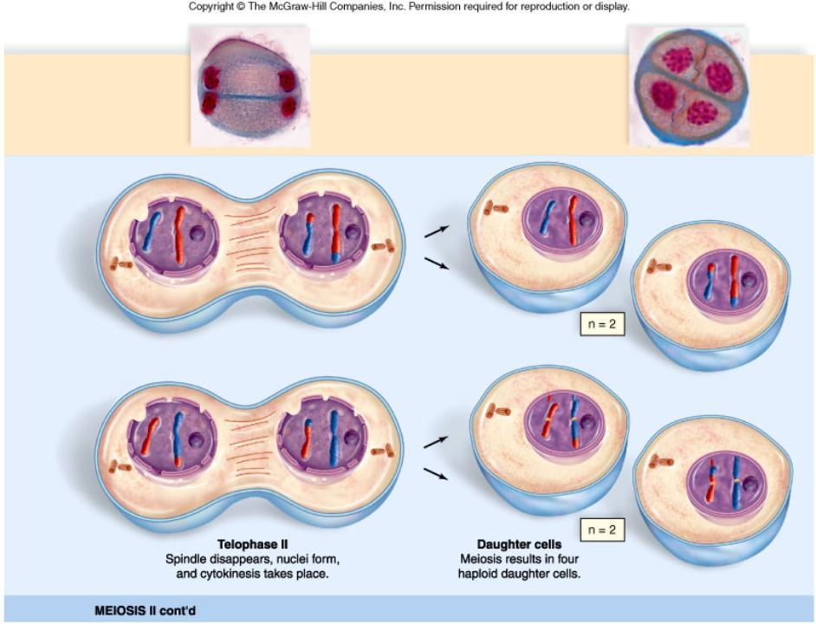
Figure 10.6bb

Slide 23
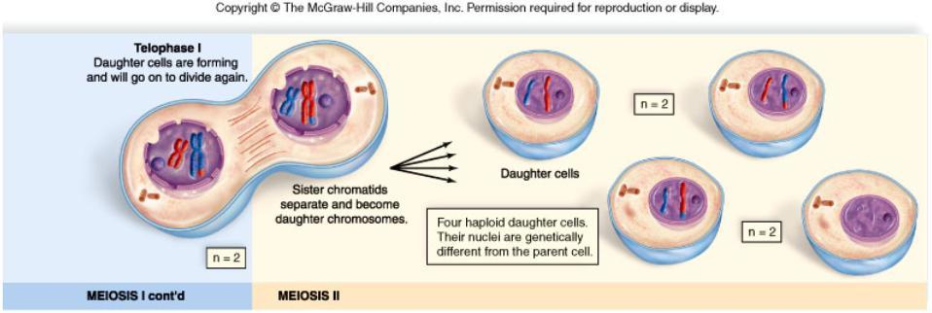
Diploid Number = 4
Haploid Number of Daughter cells = 2
Each daughter cell is unique due to:
Crossing-Over & Independent Assortment

Slide 24
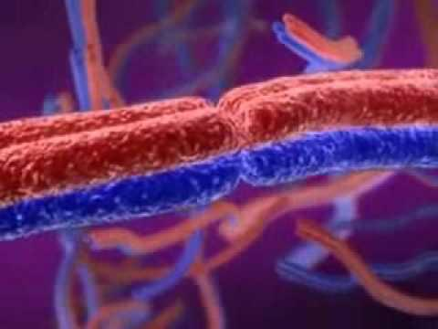

Slide 25
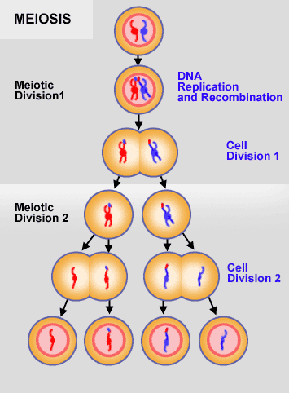
Interphase
Prophase I
Metaphase I
Anaphase I
Telophase (cytokinesis) I
Prophase II
Metaphase II
Anaphase II
Telophase (cytokinesis) II
This is a good time to watch the MEIOSIS SQUARE DANCE.

Slide 26
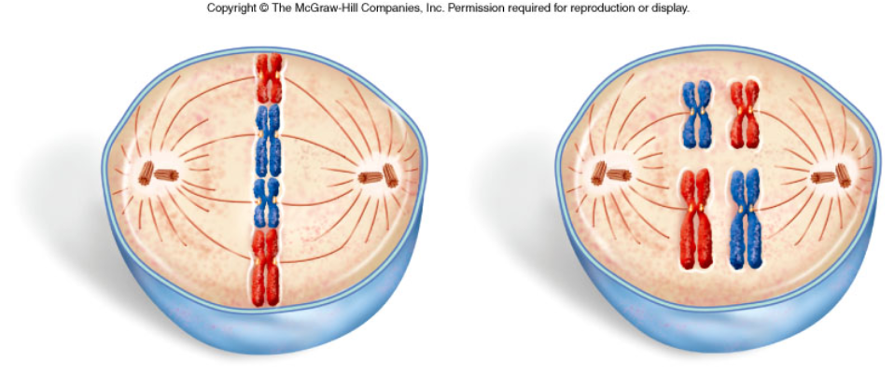
Pg 180
Which of these pictures is metaphase I of MEIOSIS and which is metaphase of MITOSIS?
Mitosis Meiosis

Slide 27
Check for understanding
1. What phase directly follows metaphase I?
2. How many cells are present at the end of meiosis I ?
3. A cell has a diploid number of 60, what is the organism's haploid number?
4. Meiosis occurs in what type of cells?
5. In what phase do homologous chromosomes pair up and crossing-over can occur?
6. In what phase do the CHROMATIDS separate?
anaphase I
2
30
gametes
prophase 1
anaphase 2

Slide 28
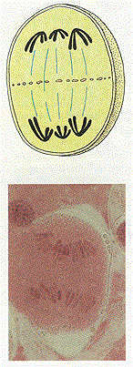
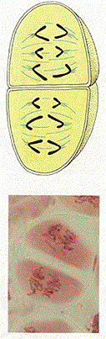
7. Identify the phase:
8. Identify the phase:
anaphase 1
anaphase 2

Slide 29
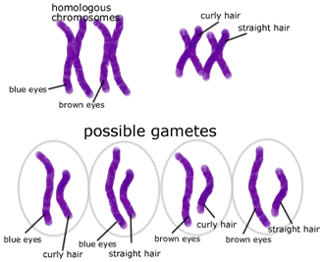
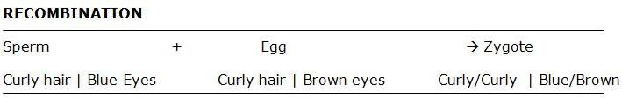
Sexual Reproduction - why is every offspring unique?
This shows how genes are randomly sorted during metaphase. Depending on how the chromosomes line up, the offspring have different combinations of genes.

Slide 30
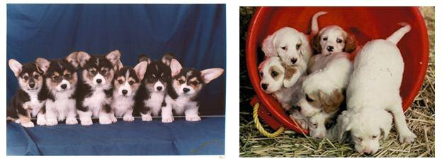
Notice how all the puppies in this litter look different, despite having the same parents.
Why Did Sex Evolve?
There are other methods of reproduction, such as asexual reproduction and parthenogenesis. All in all it may be easier for an organism to divide and create offspring without sex.
Sex can be risky - exposure to predation, disease, energy required to find a mate... so why bother at all?

Slide 31
With all that trouble, its a wonder why organisms started to sexually reproduce in the first place. There are several hypotheses to explain the origin of sex:1. DNA Repair Hypothesis
diploid cells can repair damaged DNA, two chromosomes mean a spare set of genes
some single celled protists join together to form a diploid cell when they are stressed by radiation
2. Contagion Hypothesis
Infection of mobile genetic elements - transposons
transposons may have promoted chromosome pairing in order to copy themselves and "infect" other chromosomes
**The Mariner transposon of Drosophila (fruit fly) is responsible for a disorder in humans called Charcot-Marietooth Disease, which causes withering of the legs and feet. No one knows how a Drosophila transposon got into the human genome.

Slide 32
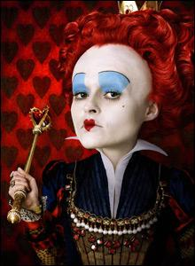
3. The Red Queen Hypothesis
Sex allows populations to "store" recessive alleles.sexual species cannot get rid of these hidden alleles, even if they cause bad effects.this may be nature's way of storing alleles that may have a future use if the environment changes.
.
also referred to as Red Queen, Red Queen's race or Red Queen Effect, is an evolutionary hypothesis. The term is taken from the Red Queen's race in Lewis Carroll's Through the Looking-Glass. The Red Queen said, "It takes all the running you can do, to keep in the same place." The Red Queen Principle can be stated thus:
For an evolutionary system, continuing development is needed just in order to maintain its fitness relative to the systems it is co-evolving with.

Slide 33
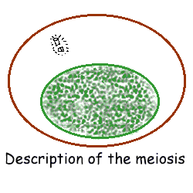
See also: Meiosis animation at http://www.johnkyrk.com/meiosis.html
Videos: http://www.youtube.com/watch?v=D1_-mQS_FZ0
Meiosis Square Dance at http://www.youtube.com/watch?v=eaf4j19_3Zg

Slide 34
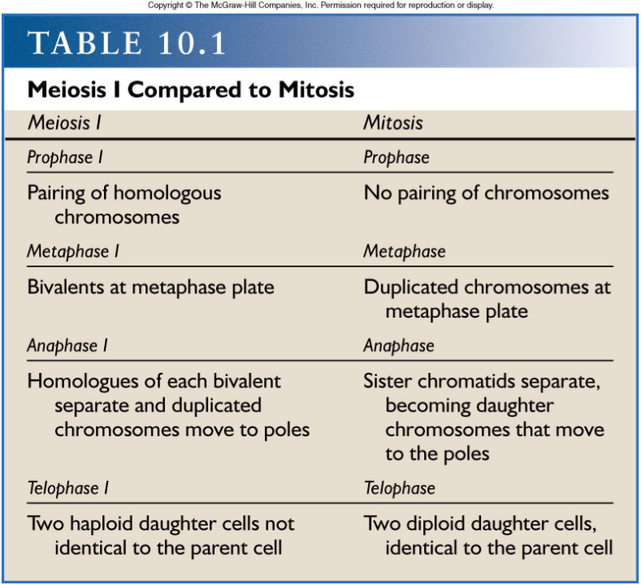
Table 10.1

Slide 35
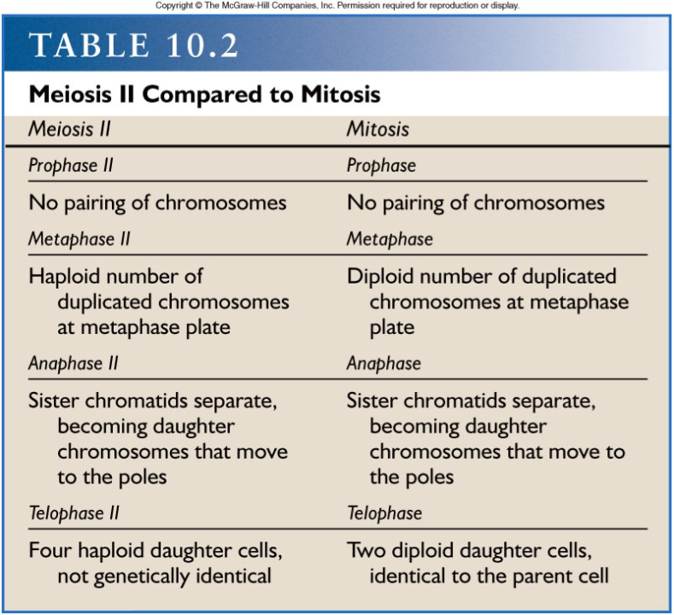
Table 10.2

Slide 36
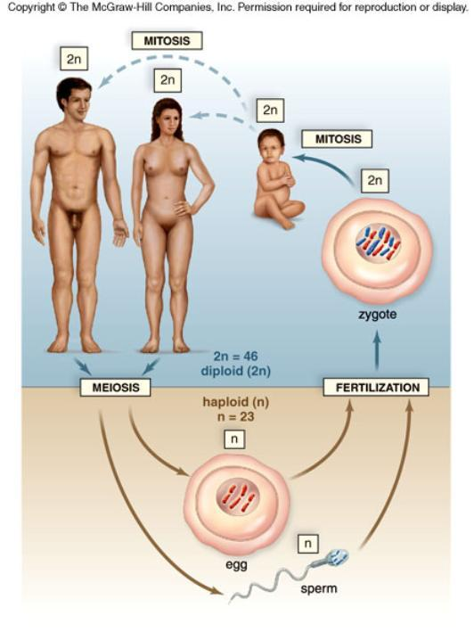
Figure 10.8
Gametogenesis - creating gametes (sperm & egg)

Slide 37
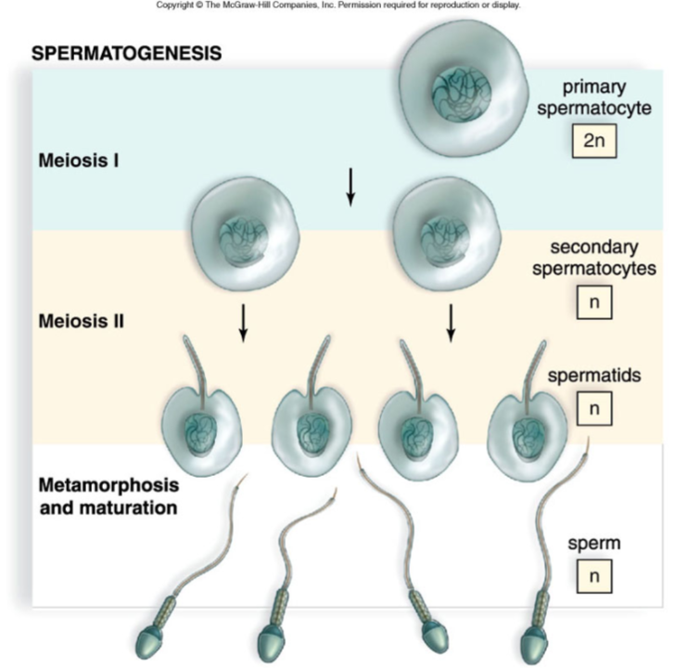
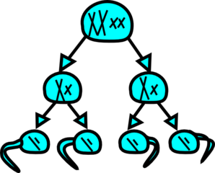
Figure 10.9a

Slide 38
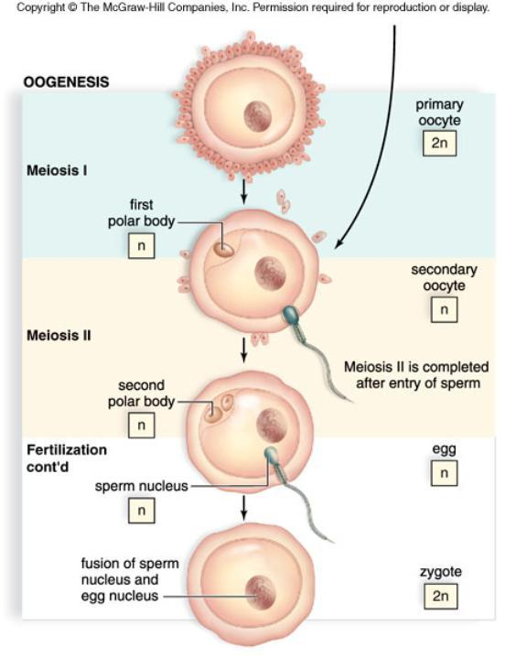
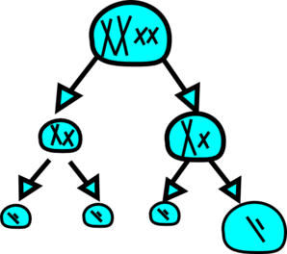
During OOGENESIS, cytoplasm divides unevenly during each cytokinesis, resulting in only ONE viable egg cell.
3 small polar bodies are formed
1 large OOCYTE has potential to be fertilized

Slide 39
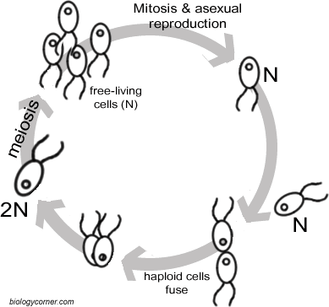
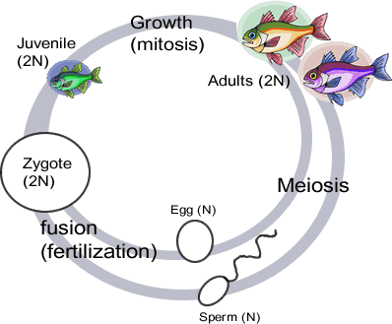
Haploid vs Diploid Life Cycles

Slide 40
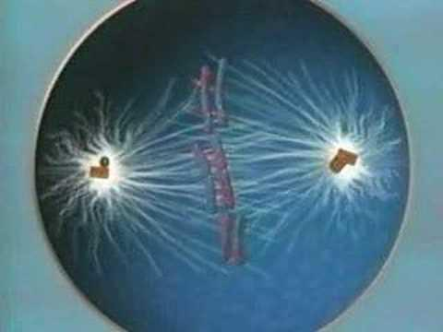
Review Meiosis

