Slide 1
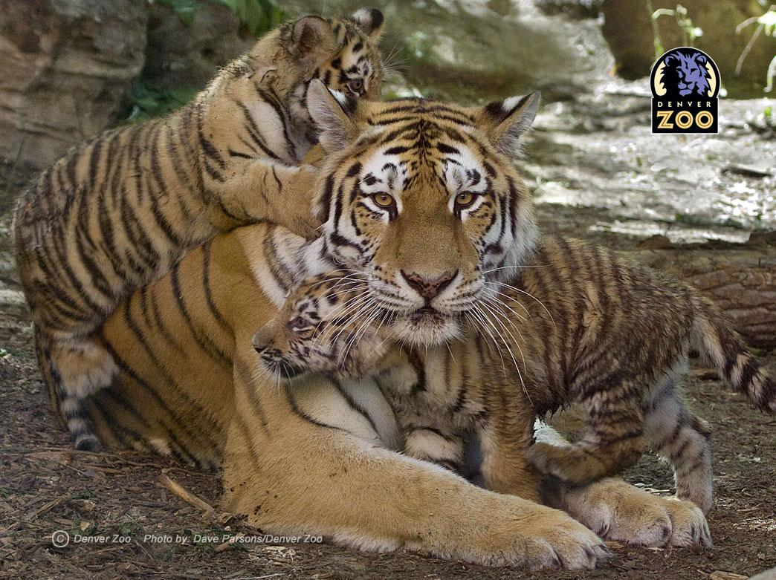
Genetics and Statistics
A Tale of Two Hypotheses

Slide 2
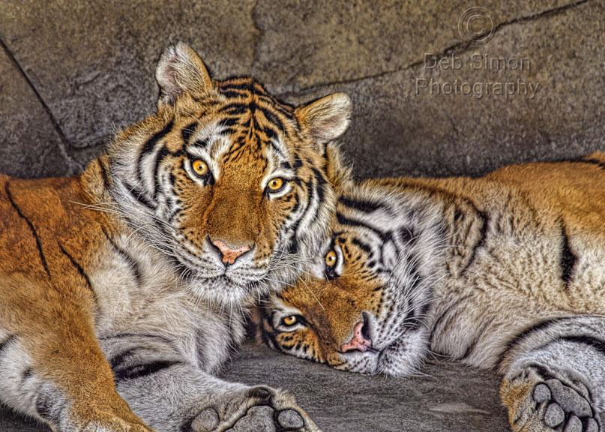
Consider this story....
Two tigers at a zoo are bred together and they have four cubs.

Slide 3
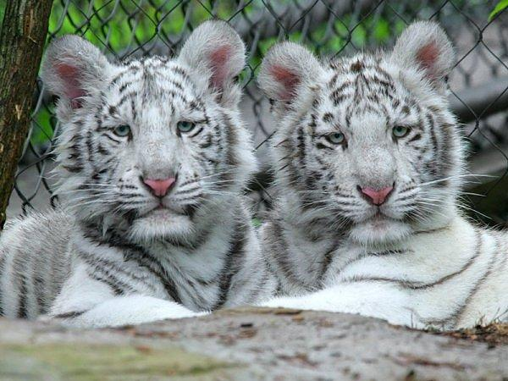
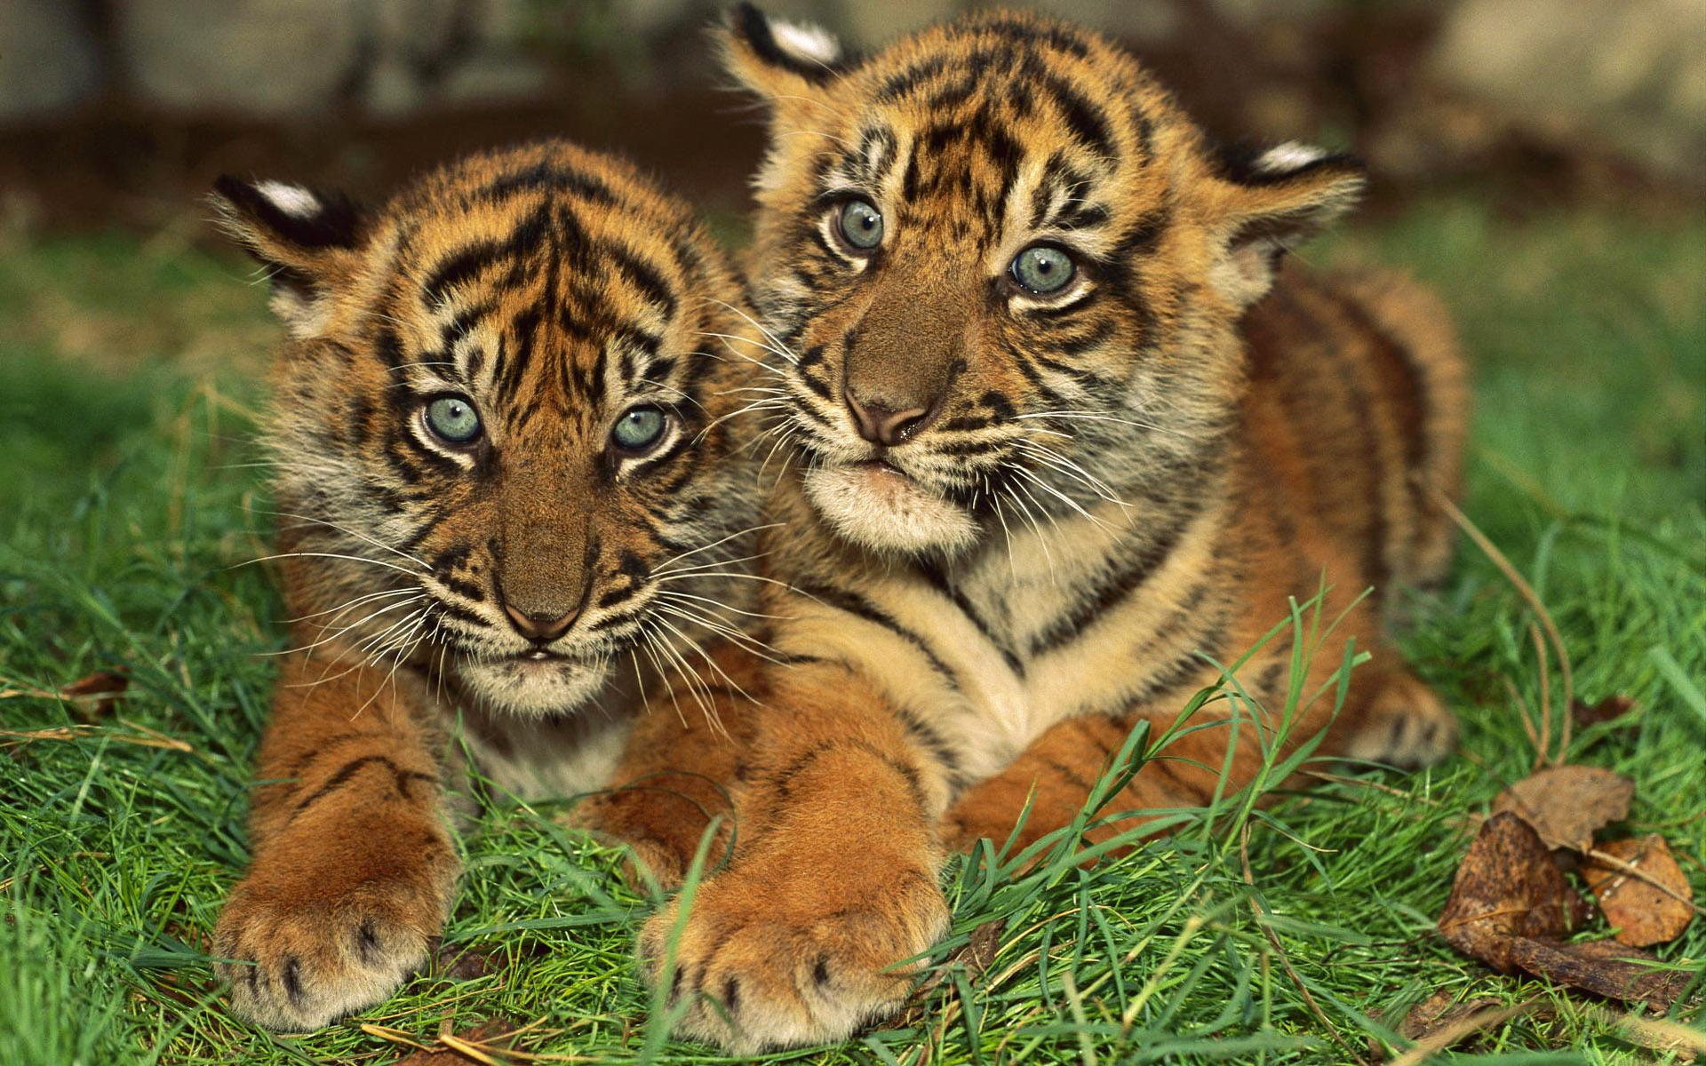
Two of the four cubs are albino tigers. Based on that, Kristin hypothesizes that both of the parents must be carrying a recessive gene for albinism. The cross would look like:
A a x A a
Don't hate me because I'm beautiful
Who fell into the bleach?
At least they have a future in the circus.....

Slide 4
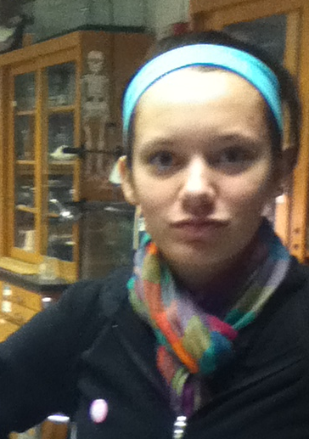
If Kristin's hypothesis is accurate the punnett square would look like..

Slide 5
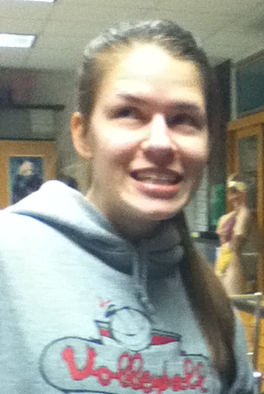
Your friend, Emily is unconvinced.
You are so dumb...you are really really dumb....
If your hypothesis is correct, then only ONE of the four kittens should be an albino.

Slide 6
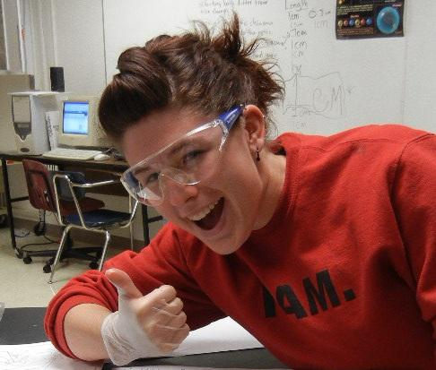
But isn't 1/4 pretty close to 2/4 ...maybe the difference is just due to chance....
Once I flipped a coin four times I got heads 3 times. Sometimes it just happens that way. Maybe you just got lucky and got an extra white kitten..

Slide 7
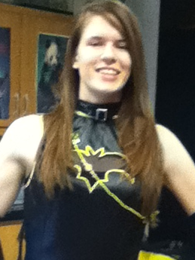
The only way to solve this problem and the argument is to do a statistical analysis.
We call this type of analysis a CHI SQUARE
The purpose is to determine whether the results are statistically significant.
What are the odds that your tigers are Aa x Aa?
Or could other factors be at work here?
I am so going to win this argument!

Slide 8

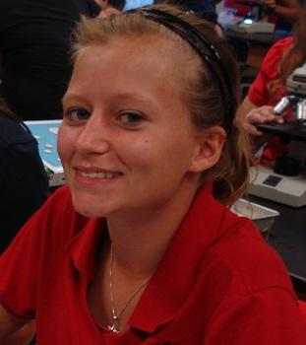
Here's how to do a chi square.
Summed for all classes means that you are looking at all the traits you observed - in this case, orange and white.

Slide 9

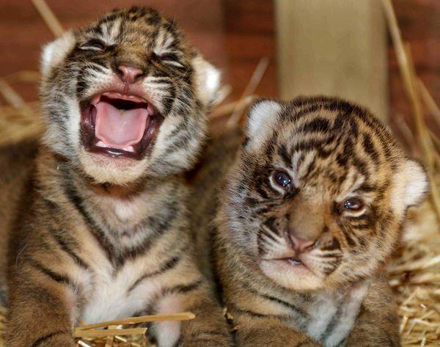


I do not like math!
To apply the formula, plug in your "observed" and "expected" numbers....this will give you

Slide 10
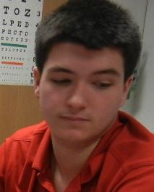
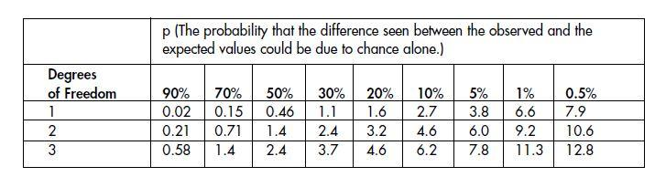
1.33? Is that good or bad? Who is right? Who is wrong?
What time is it?
= 1.33
To determine if this number is good or not, you must look at a chi square chart.
"Degrees of freedom" is one less than the original number of classes you looked at, which was 2 (orange & white)
So we will look at the first row (DoF = 1)

Slide 11
1.33 is between the 20% and 30% columns
Basically this means that the difference you observed between orange and white cubs can be expected to occur more than 20% of the time, just due to chance.
Scientists use 5% as the cut-off percent to reject a hypothesis. Results are always better with a large sample size.

Slide 12
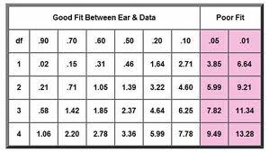
Well obviously, I was right. You can run and tell that..
If you find that you have a "poor fit", that means that you probably need to reject the hypothesis. In the tiger cub case, we did not have a poor fit.

Slide 13
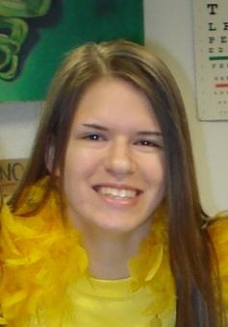
Poor fit.
Emily thinks she gets it now. So she looks at another case. She breeds two black mice together and finds that over the course of 3 years, the parents produce 330 brown mice, and 810 black mice. She hypothesizes that the parents are Bb (heterozygous). How can she prove this with a chi square?

Slide 14
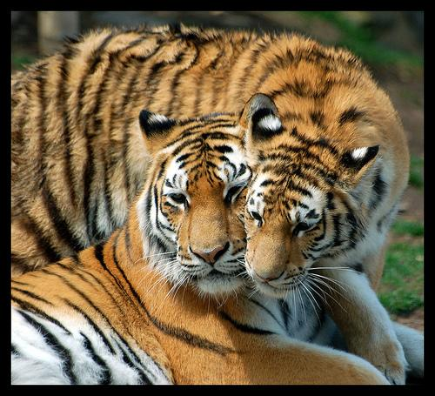
Online Chi Square Calculator at http://www.graphpad.com/quickcalcs/chisquared1.cfm
-- just plug in the observed and expected values

