Slide 1
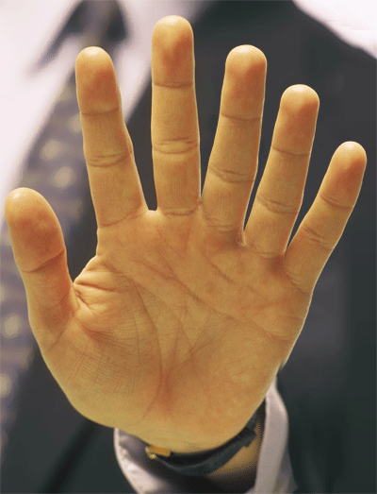
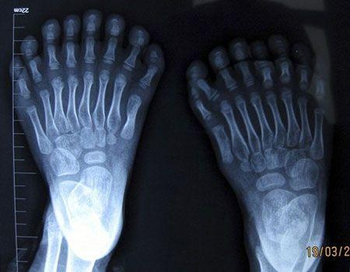
Chapter 11
Human Disorders

Slide 2
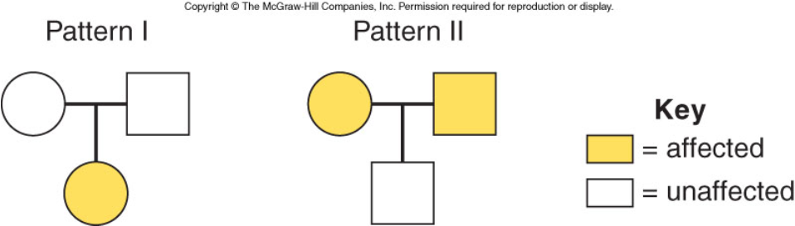
Pg 192
Autosomal Recessive vs Autosomal Dominance

Slide 3
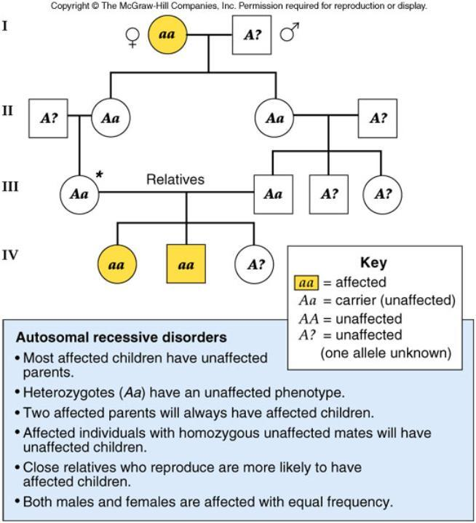
Figure 11.10

Slide 4
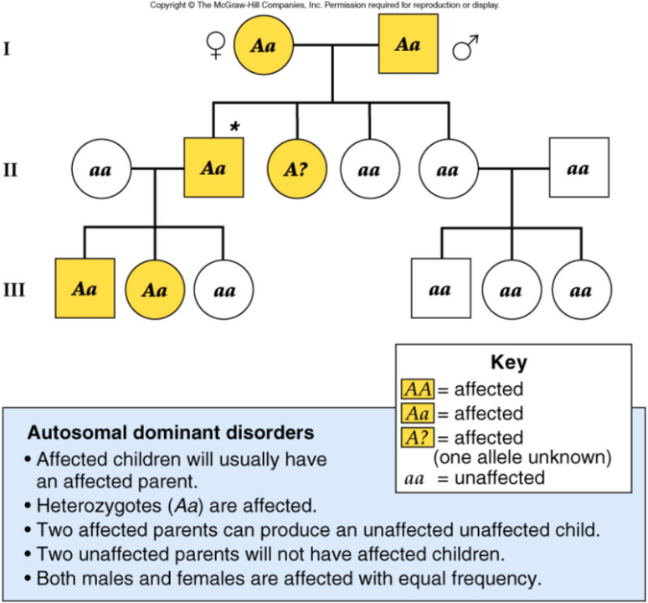
Figure 11.11

Slide 5
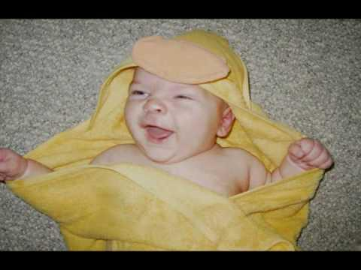
Tay Sachs
More common among Jewish populations
Young children begin showing signs of slowed development
Severe impairment and death
http://www.ntsad.org/pdf/NTSAD_2007_Annual_Report.pdf

Slide 6
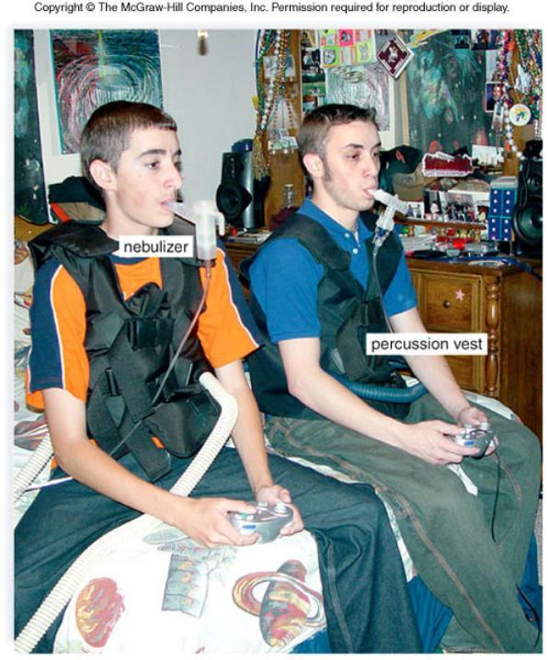
Cystic Fibrosis
More common in Caucasians
Mucus in respiratory tract, difficulty breathing
extreme salty sweat
Mucus may cause secondary infections

Slide 7

Phenylketonuria (PKU)
Lack enzyme for normal metabolism
Phenylalanine builds up and causes brain damage
Newborns are routinely tested
Changes in diet lead to normal life
Phenylalanine Hydroxylase is the enzyme needed, absent in those with PKU

Slide 8
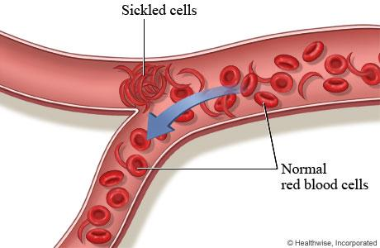
Sickle Cell Disease
More common in Africans (African-Americans)
Causes blood to be sickle shaped
Affects oxygen flow to organs, causing weakness, pain, anemia, etc
Heterozygotes are resistant to malaria
AA = normal
Aa = sickle cell trait
aa = sickle cell disease

Slide 9
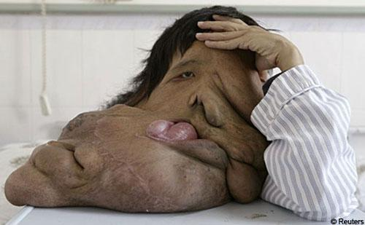
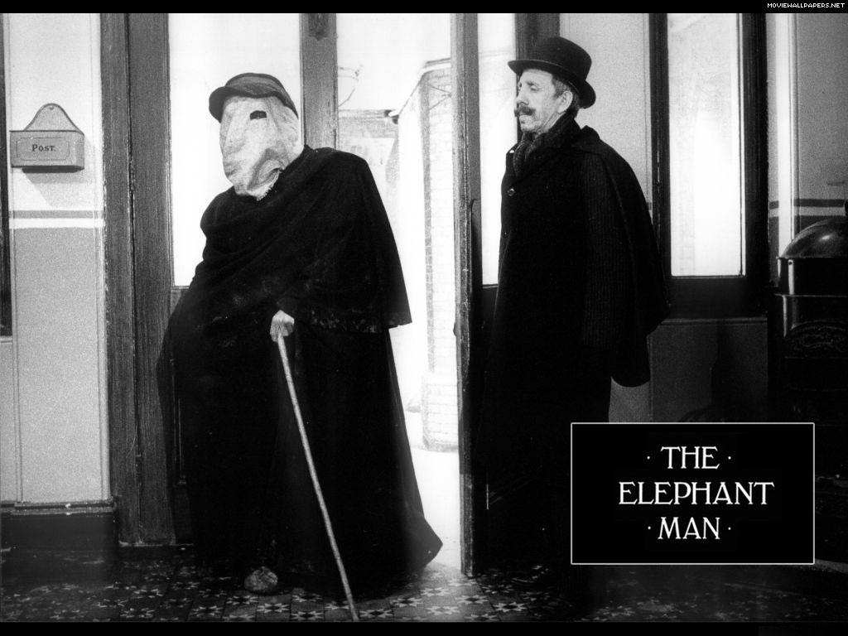
Neurofibromatosis
Tumors form under skin and Can cause skeletal deformities, blindness
"The Elephant Man"
Several years ago, research teams located the exact position of the NF1 gene on chromosome 17. The product of the NF1 gene is a large and complex protein called neurofibromin, which is primarily active in nervous cells as a regulator of cell division. Intensive efforts have let to the identification of the NF2 gene on chromosome 22. The NF2 gene product is a tumor-suppressor protein called merlin.

Slide 10
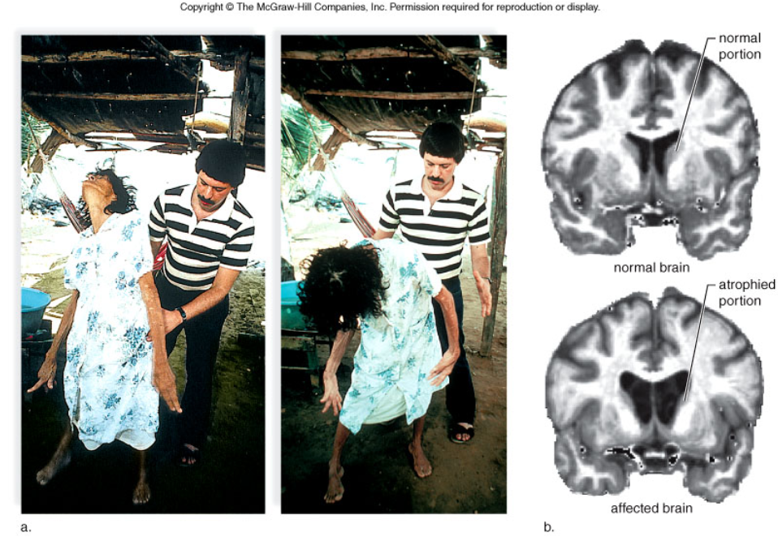

Huntington's Disease
HH = Huntington's
Hh = Huntingtons
hh = normal
Symptoms appear later in life, often starting with poor muscle control

Slide 11
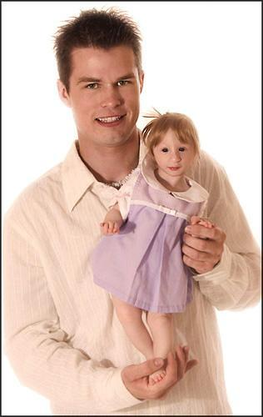

There are different types of dwarfism.
Achondroplasia is caused by a dominant allele.
Meet Kenadie
Two dwarfs can have a normal child. Dd x Dd
Primordial Dwarfism

