Slide 1
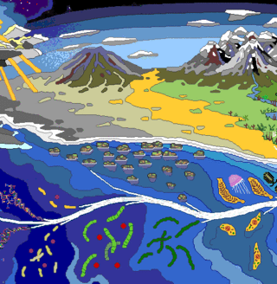
Origin and History of Life
Chapter 19

Slide 2
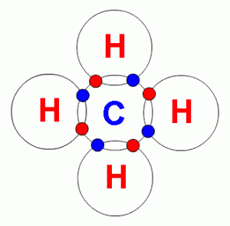
A. The Early Earth
1. The earth is about 4.6 BYA
2. Some chemicals present during early earth:
- water vapor
- nitrogen
- carbon dioxide
- hydrogen
- methane
- ammonia

Slide 3
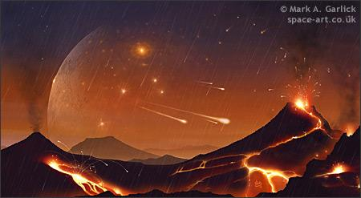
These chemicals exist within the "soup" of earth's early atmosphere. This atmosphere was inhospitable to life.
Also, with no atmosphere, the earth was being hit by asteroids and other space debris.

Slide 4
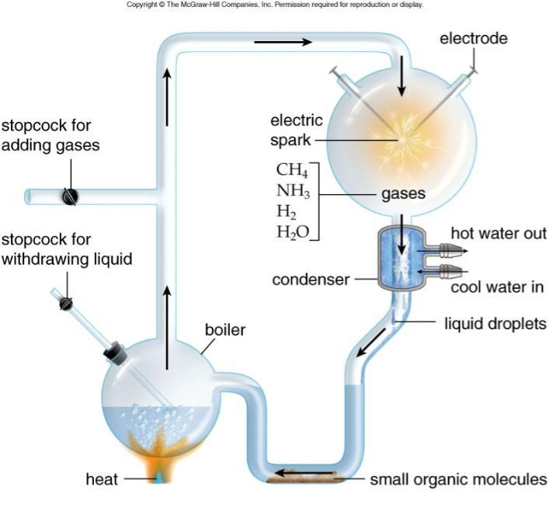
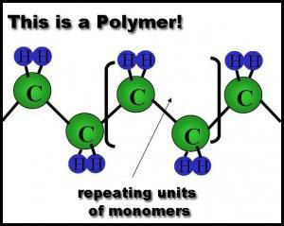
BMonomers Evolve
Oparin/Haldane
Miller /Urey
Virtual Miller/Urey

Slide 5
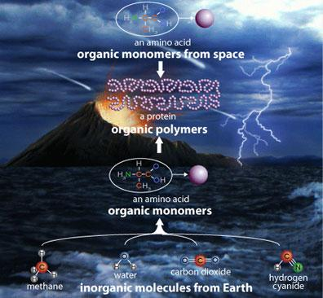

Slide 6
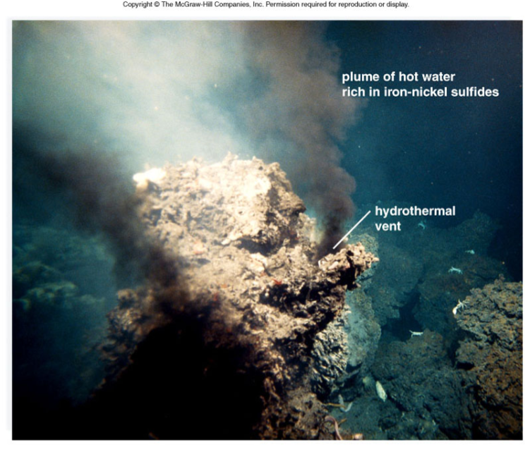
Vents like this one can convert N₂ to NH₃ (ammonia)
Ammonia is necessary for the formation or organic molecules

Slide 7
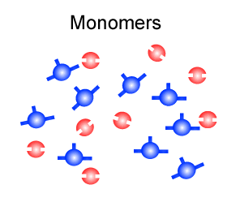
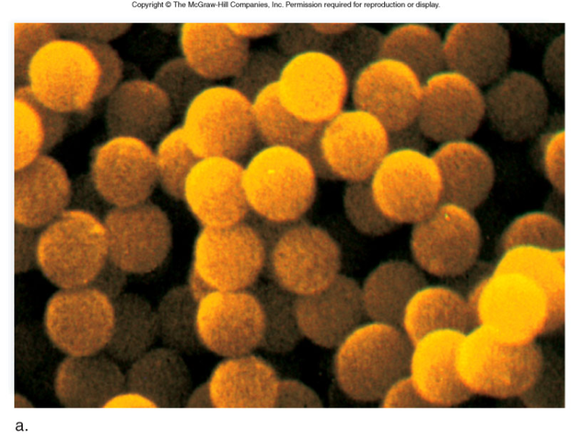
C. Polymers Evolve
Microspheres - cell like, composed of protein (repeating units of amino acids).

Slide 8
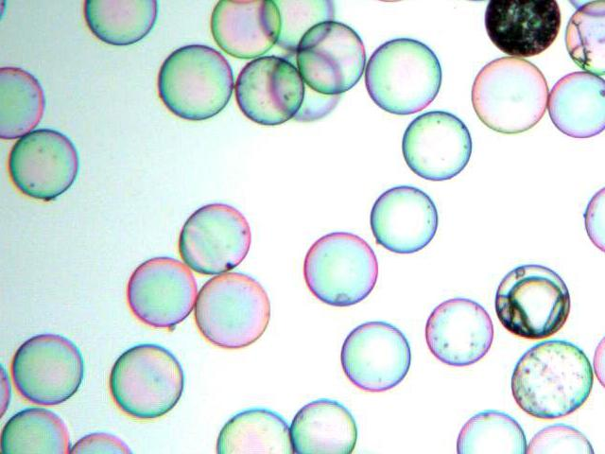
Fun Fact..
Glass microspheres are primarily used as a filler and volumizers, reflectors for highway safety, additive for cosmetics and adhesives, with limited applications in medical technology.

Slide 9
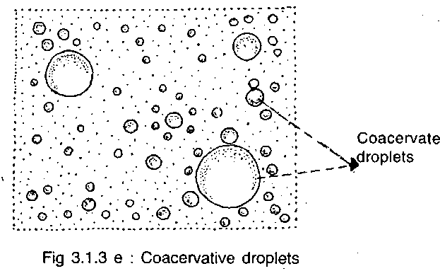
The Protocell Evolves
In water, organic chemicals do not necessarily remain uniformly dispersed but may separate out into layers or droplets. If the droplets which form contain a colloid, rich in organic compounds and are surrounded by a tight skin of water molecules, then they are known as coacervates.
Coacervates were famously proposed by Alexander Oparin as crucial in first theory of abiogenesis (origin of life)

Slide 10
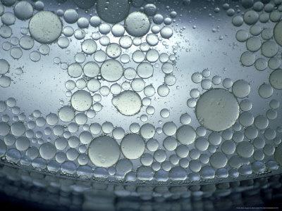
A coacervate is a tiny spherical droplet of assorted organic molecules (specifically, lipid molecules) which is held together by hydrophobic forces from a surrounding liquid.
Think of the way oil beads in water.

Slide 11
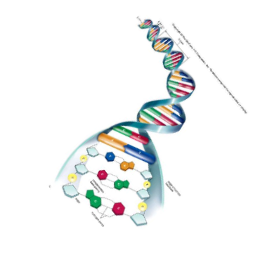
E. Self Replication System Evolves
DNA --> RNA --> Protein
Droplets of organic molecules are interesting, the fact that some even have a double membrane is even more exciting. To truly be a living organism, these structures must be able to reproduce.
How did DNA (or RNA) get inside a coacervate?

Slide 12
Hypotheses for Self Replicating Systems
1. RNA - First Hypothesis
- the first genes were RNA, which was used as a template to make DNA
2. Protein - First Hypothesis
- enzymes came first as they were needed to drive the synthesis of DNA
3. Polypeptide and RNA evolved simultaneously
- this hypothesis eliminates the "chicken and egg" question.

Slide 13
Once the protocell was capable of reproduction, it became a true cell

Slide 14
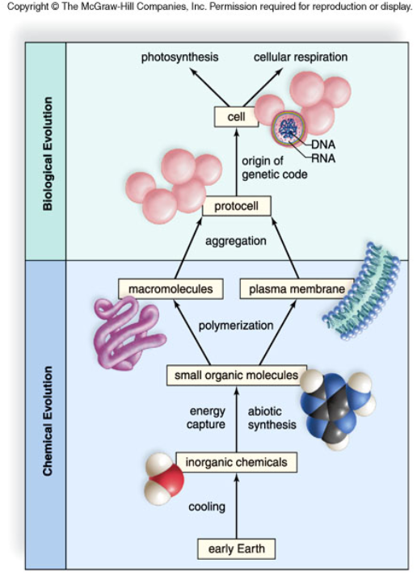
Quick Review of the Steps that Would Give Rise to the First Cell
1. Monomers Evolve
2. Macromolecules
3. Plasma membrane
4. Self Replication

Slide 15
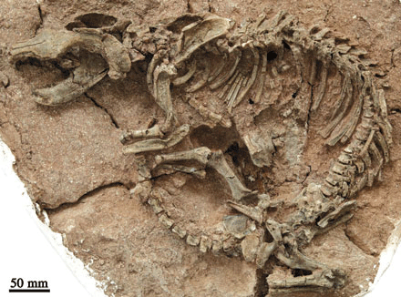
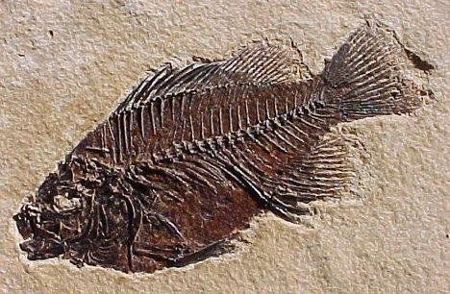
19.2 - The History of Life
A. Fossils Tell a Story
remains of past life
Paleontology - study of fossils and the history of life

Slide 16
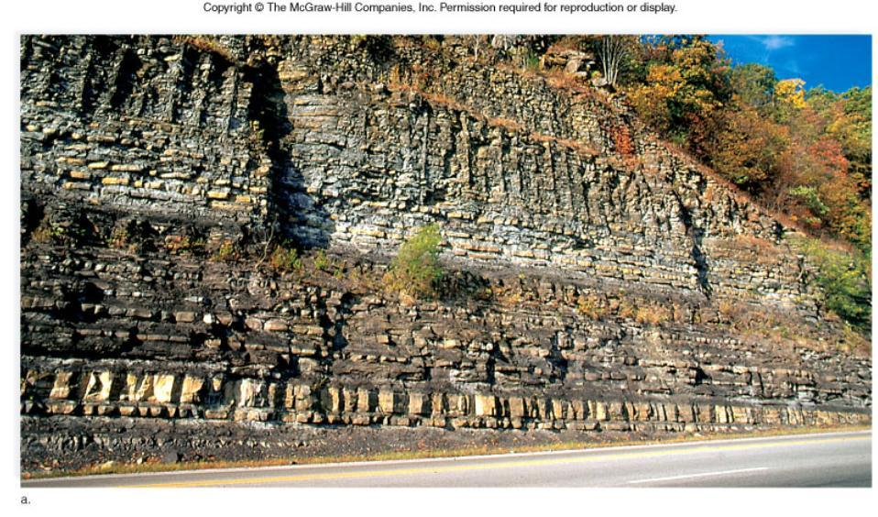
Sedimentation and Stratum - visible in layers of rock - sequence indicates age

Slide 17
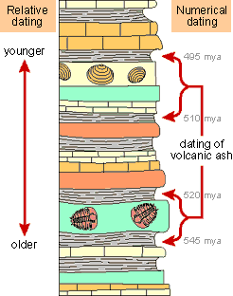
B. Relative Dating of Fossils
Geologists discovered that strata of the same age contain the same fossils
index fossils
Index fossils can be used for the relative dating of strata.

Slide 18
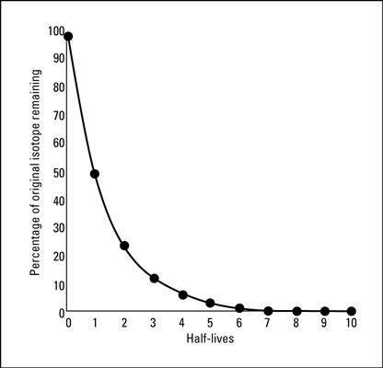
Absolute Dating of Fossils
1. Absolute dating relies on radioactive dating to determine the actual age of fossils. - also called numerical dating
2. Radioactive isotopes have a half-life, the time it takes for half of a radioactive isotope to change into a stable element.
M&M Activity on Half Life

Slide 19
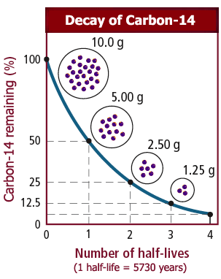
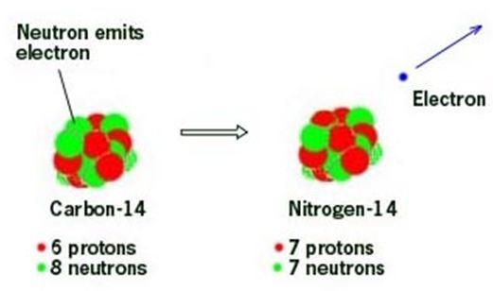
Carbon 14 (¹⁴C)is a radioactive isotope
The stable molecule is Carbon 12 (¹²C)
Half of Carbon 14 will change to Nitrogen every 5,730 years. The ratio of nitrogen to carbon 14 gives us an estimate of the age of the rock.

Slide 20
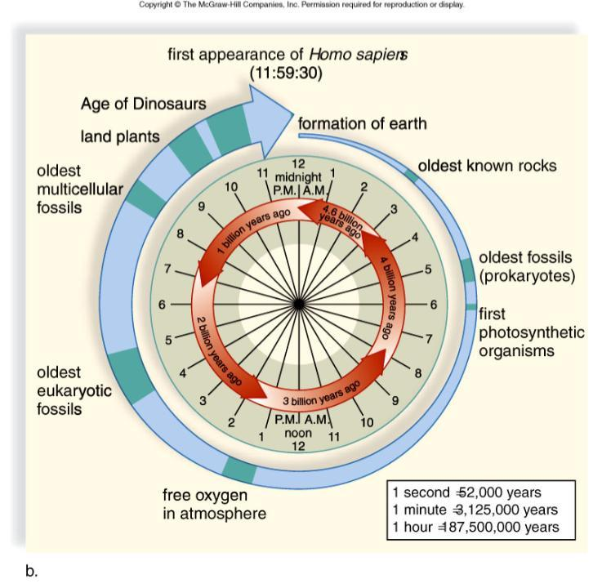
EARTH’s TIMELINE

Slide 21
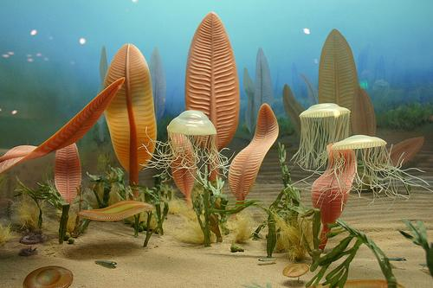
ERAS & PERIODS - Take a Tour First
1. Precambrian Era
-First cells
- Bacteria
- Algae
- Some invertebrates

Slide 22
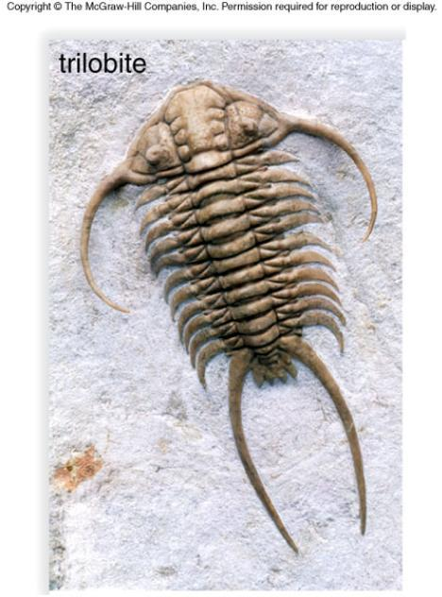
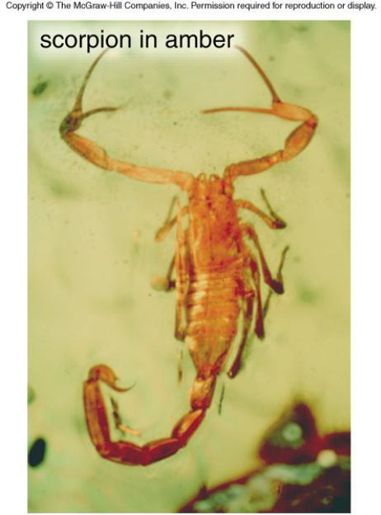
ERAS & PERIODS
2. Paleozoic Era
Cambrian (invertebrates)
Ordovician (arthropods)

Slide 23
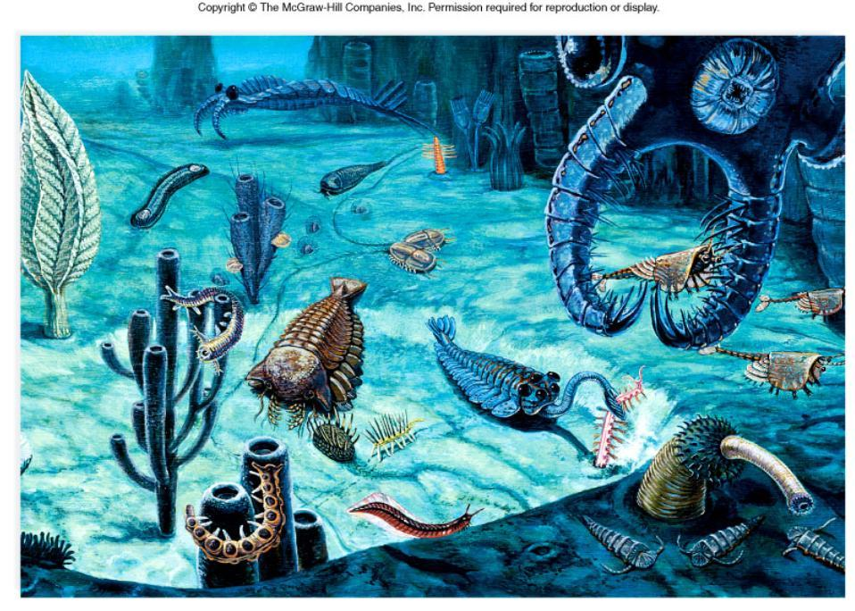
CAMBRIAN

Slide 24
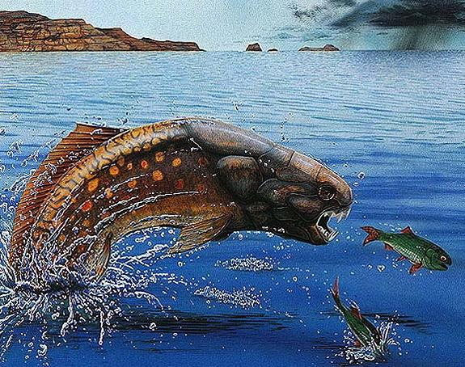
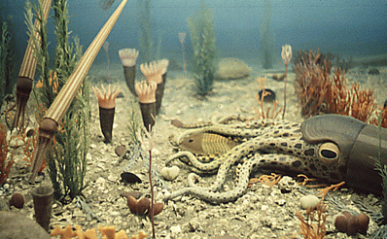
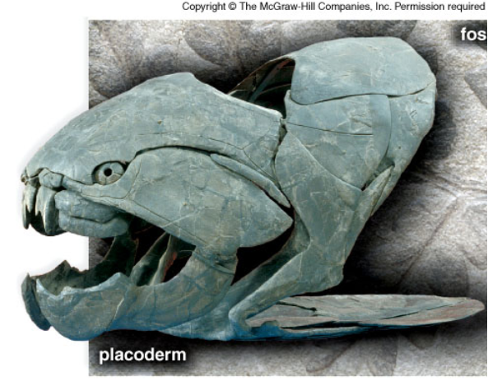
Silurian (plants)
Devonian (amphibians, fish)
Carboniferous (amphibians)
Permian (mass extinction)
Mass Extinctions mark an ERA change......next up: Mesozoic Era

Slide 25
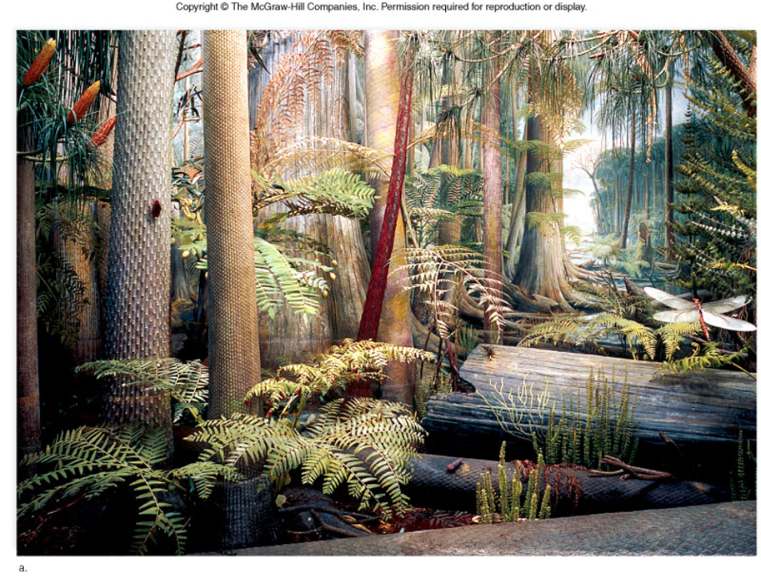
Carboniferous

Slide 26
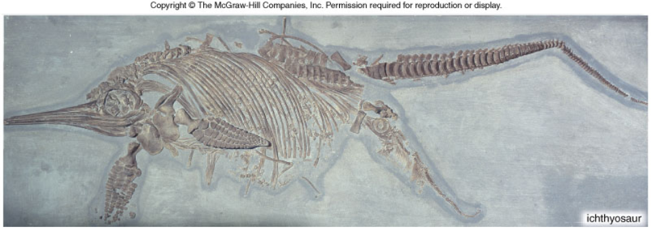
MESOZOIC ERA – THE AGE OF REPTILES
Triassic Period
First small mammals
Pangaea begins to separate
Dinosaurs

Slide 27
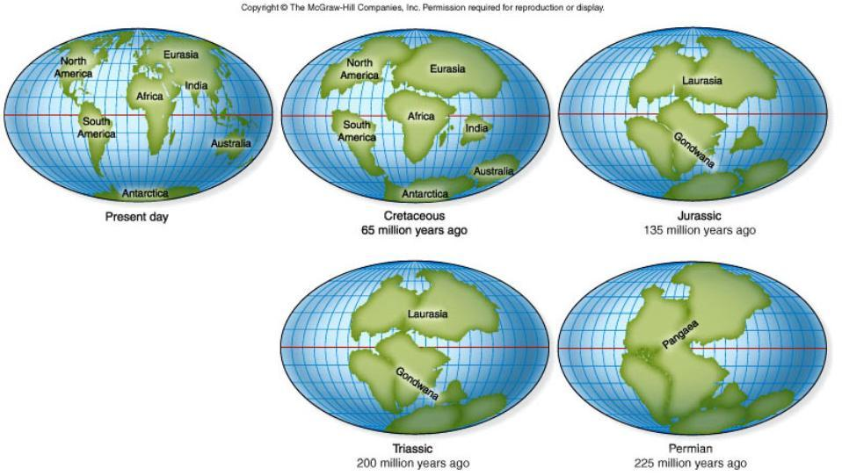
Figure 19.14

Slide 28
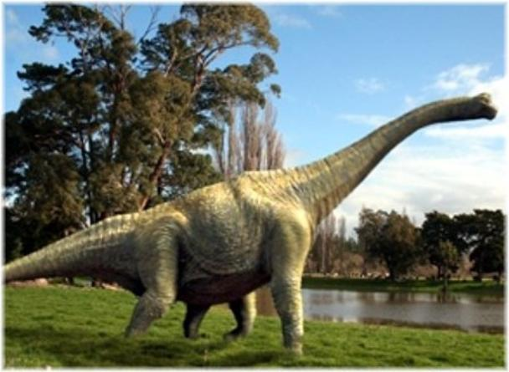
Jurassic Period (213 MYA)
Dinosaurs dominate earth
First birds

Slide 29
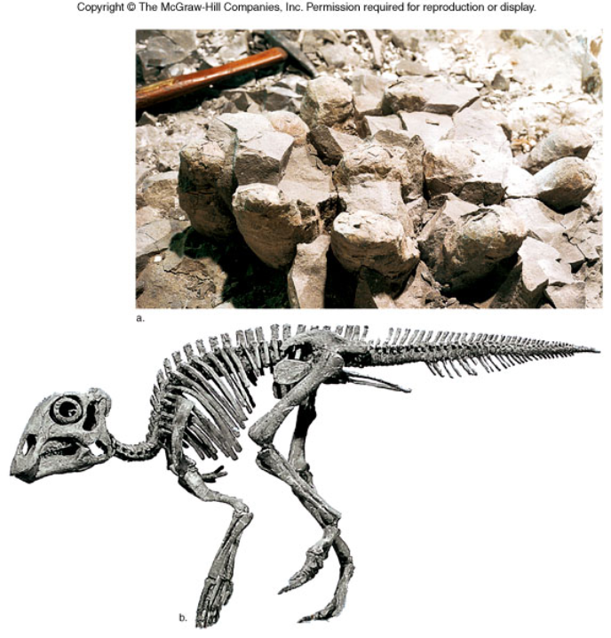
Figure 19A

Slide 30
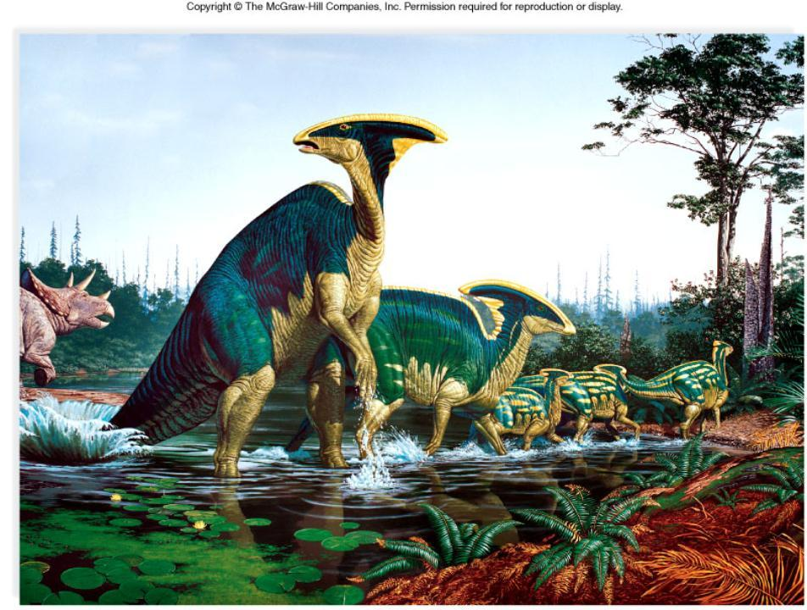
Jurassic Period

Slide 31
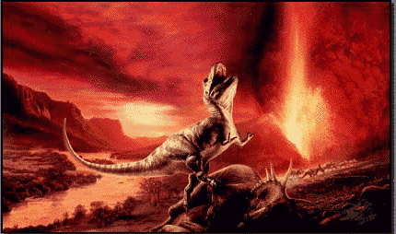
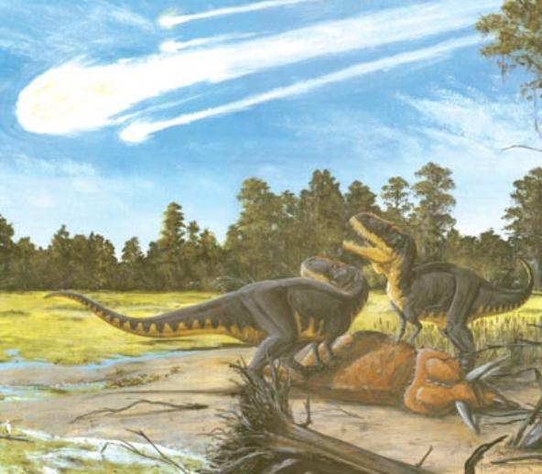
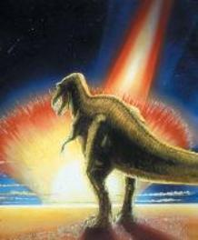
Cretaceous Period
Flowering Plants appear
Mass Extinction of dinosaurs

Slide 32
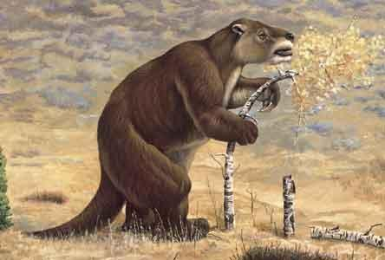
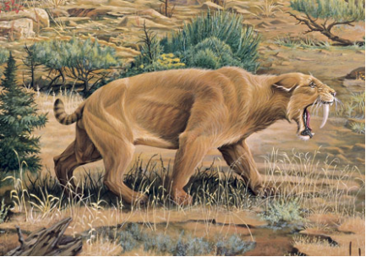
CENOZOIC ERA - The Age of Mammals
Tertiary Period (65 MYA)
Birds and mammals flourish
Continents move into current positions

Slide 33
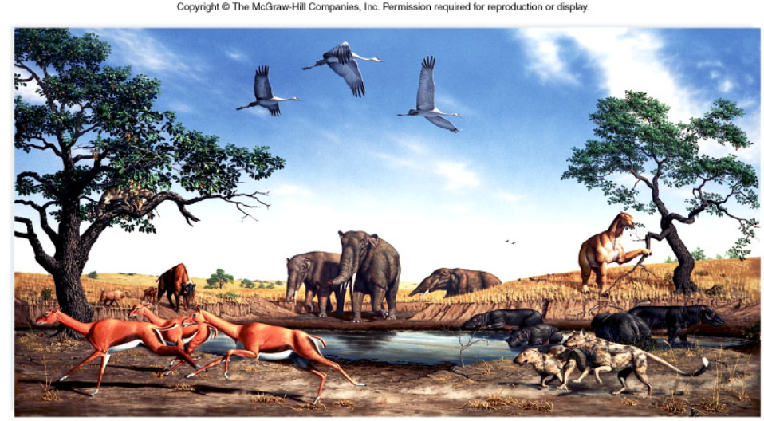
Cenozoic Era

Slide 34
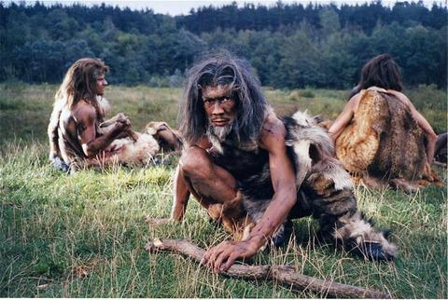
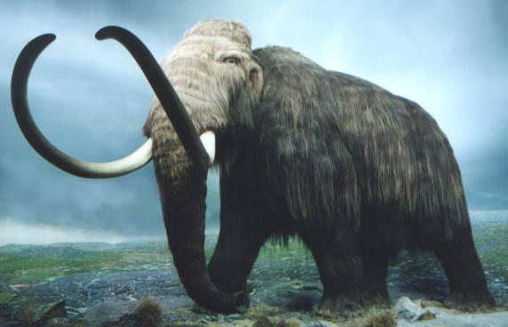
Quaternary Period
Extinction of the giant mammals (mammoth)
Ice Age
First Hominids

Slide 35
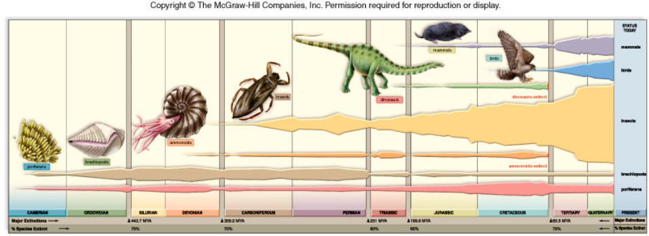
19.3 Factors that Influence Evolution
A. Continential Drift -- biogeography
B. Mass Extinctions (Permian, Triassic...)

Slide 36
Related Videos
Youtube - The Cambrian Explosion (13 Min)
Nova Science Now - Permian Mass Extinction
PBS - Extinction of the Dinosaurs
History - Armageddon: What Killed the Dinosaurs
Fox News - What Killed the Dinosaurs (3.15 min)

