Slide 1
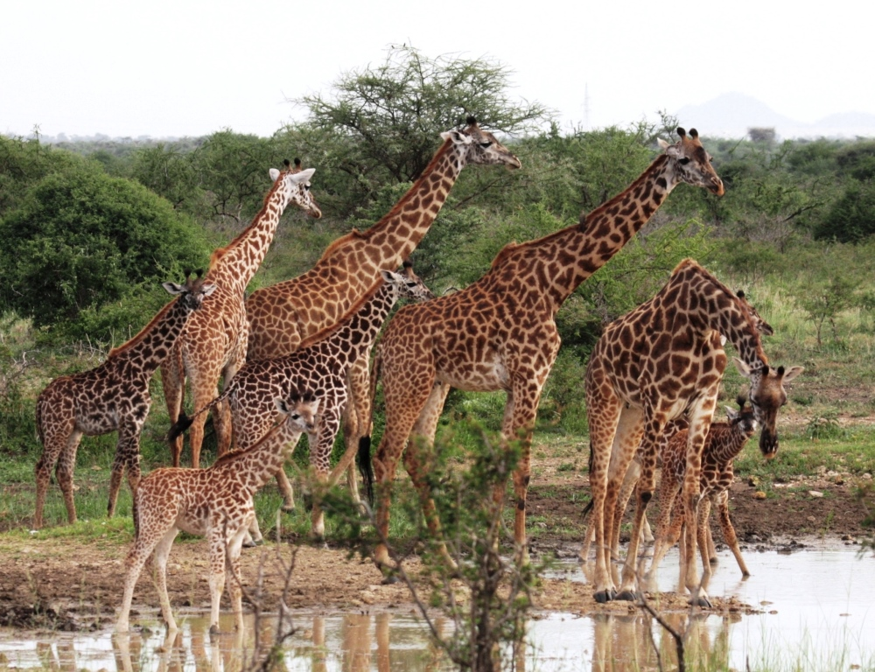
The Evolution of Populations
Natural selection acts to promote traits and behaviors that increase an organism’s chances of survival and reproduction, while eliminating those traits and behaviors that are to the organism’s detriment.
GIRAFFE!

Slide 2
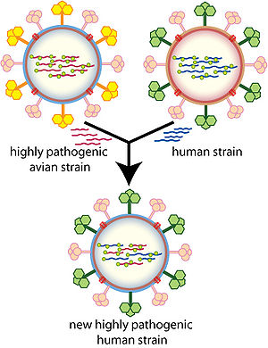
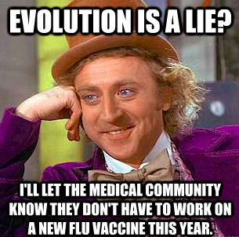
Modern Synthesis
Relationship between natural selection and genetics
How evolutionary processes can affect a population’s genetic makeup
Useful in many branches of biology and medicine

Slide 3
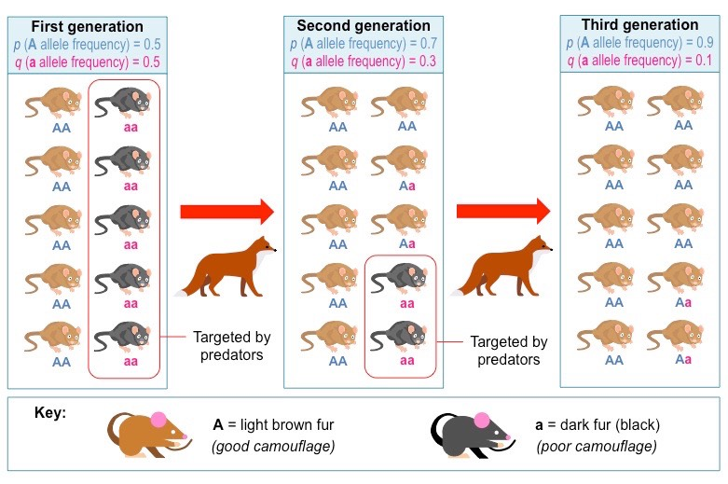
Allele (Gene) Frequency

Slide 4
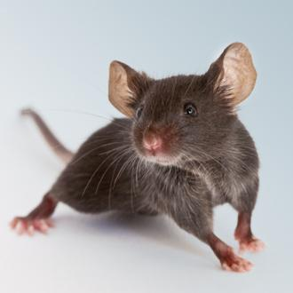
Quick Review of Mendelian Genetics
BB = Brown mouse Bb = Brown mouse (heterozygous) bb = Beige mouse (recessive)
What happens when a BB mouse is crossed with a bb mouse?
What happens when a Bb mouse is crossed with a bb mouse?
What happens when a Bb mouse is crossed with a Bb mouse?

Slide 5
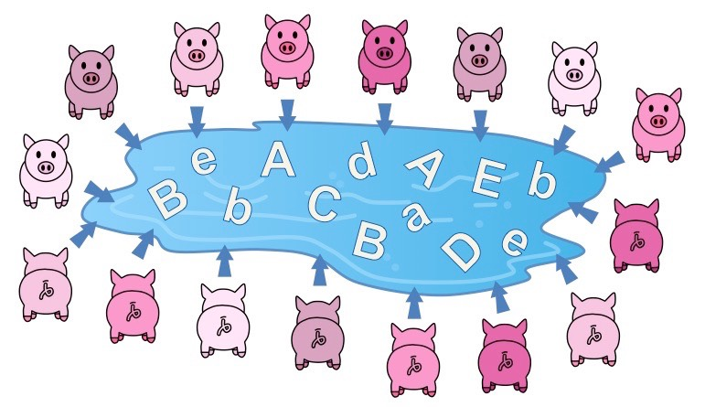
Gene Pool = the sum of all the alleles in a population

Slide 6
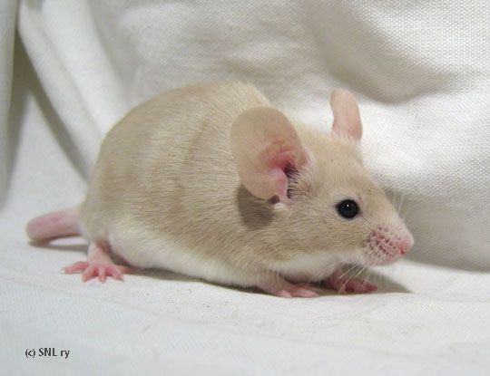
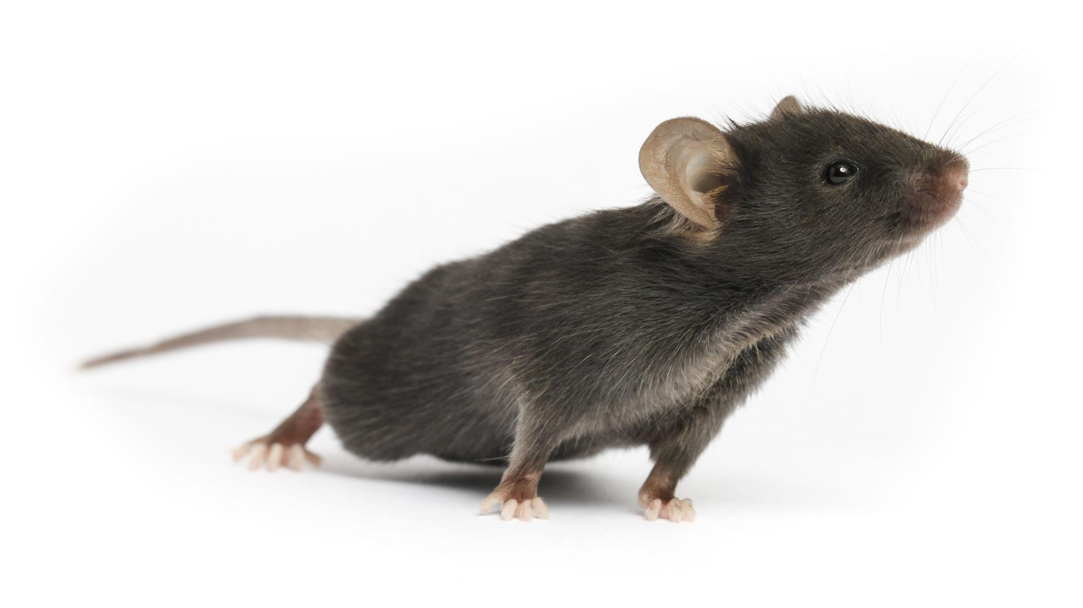
Hardy Weinberg Principle of Equilibrium
A formula can be used to determine the number of heterozygotes in a population based on the number of OBSERVED homozygotes (recessive).
Frequency of recessives
p² + 2pq + q² = 1.0
and
p + q = 1

Slide 7
Steps for solving the equation:
1. Determine the number of individuals that are homozygous recessive. Express this number as a decimal.
10 / 100 = .1
This number is q²
You will need this number for the next step.
10 out of 100 mice are beige

Slide 8
2. Take the square root of q² to determine q
3. To find p, use this part of the equation
p + q = 1
If q² = .1
then q = .316
p + .316 = 1
the p = .684

Slide 9
4. Now that you know both p and q, you can determine the number of individuals a that are homozygous dominant (AA)
p²
5. You can also find the number of heterozygotes (Aa):
2pq
p = .684
p² = .468
.468 f the 10 original population means that ~ 50 mice are AA
2pq =
2 * .684 * .316
= .432
.432 of the 100 original population means that ~ 40 penguins are Aa

Slide 10
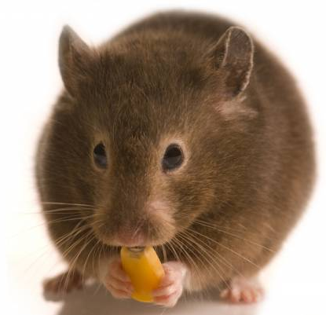
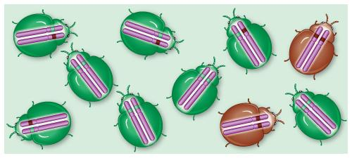
Still confused?
We will do some sample problems together!
Get out your calculators!
Hardy Weinberg and the Pocket Mouse
Hardy Weinberg Problem Set

Slide 11
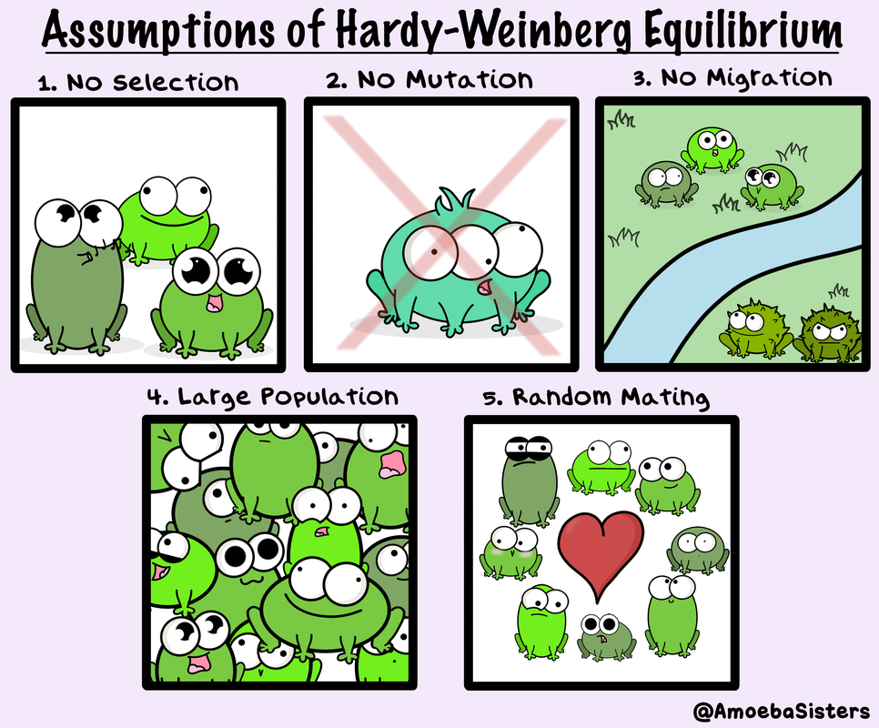

Slide 12
Changes to allele frequency within a gene pool (evolution) can result from five key processes:
Mutation: A random change in the genetic composition of an organism due to changes in the DNA base sequence
Gene flow: The movement of alleles into, or out of, a population
Sexual reproduction: New gene combinations and alter allele frequencies if mating is assortative
Genetic drift: The change in the composition of a gene pool as a result of a chance or random event
Natural selection: The change in the composition of a gene pool as a result of differentially selective environmental pressures

Slide 13
Five Fingers of Evolution

Slide 14
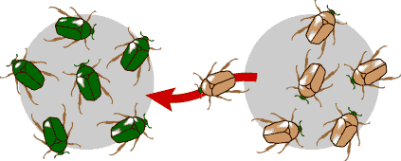
Gene Flow
- movement of alleles, migration
- increases variation - can prevent speciation

Slide 15
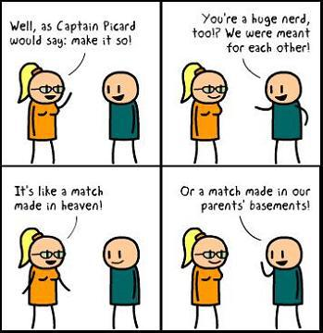
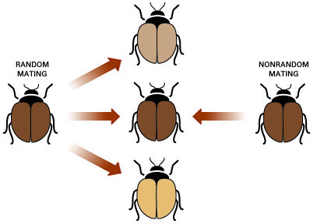
Sexual Reproduction - increases variation
Nonrandom mating (individuals choose) decreases diversity → speciation?

Slide 16
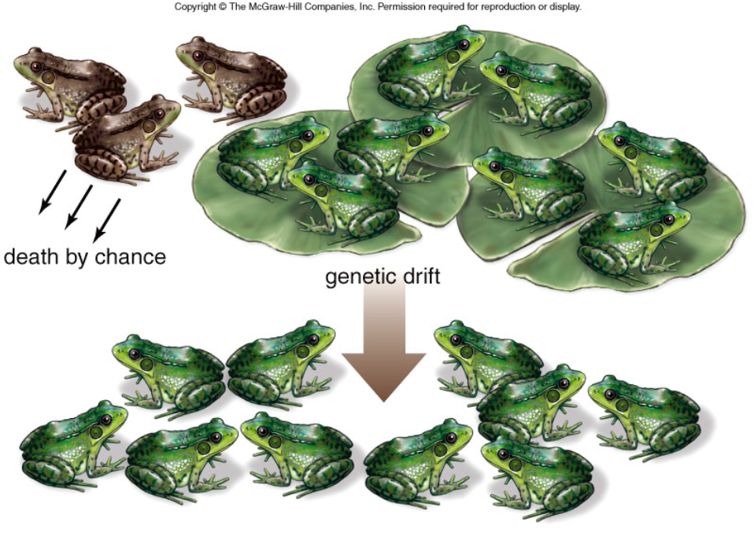
GENETIC DRIFT
Refers to changes in allele frequencies, usually in small populations Individuals die due to random chance.

Slide 17
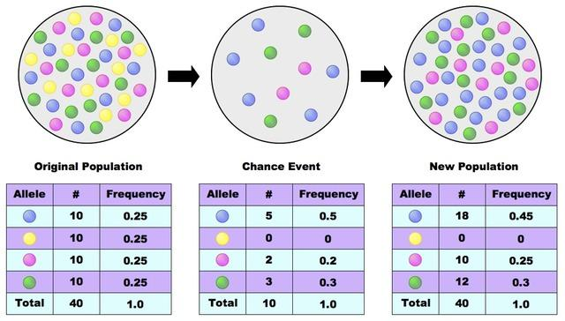

Slide 18
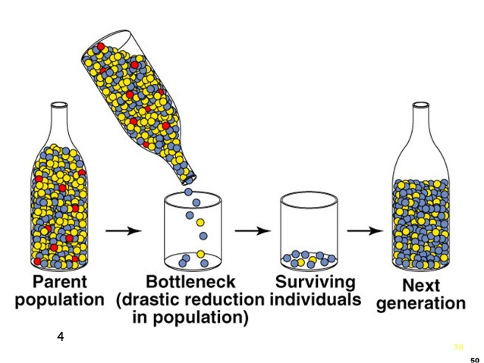
Bottleneck Effect
A form of genetic drift that reduces the population.
The population that regrows has less diversity.

Slide 19
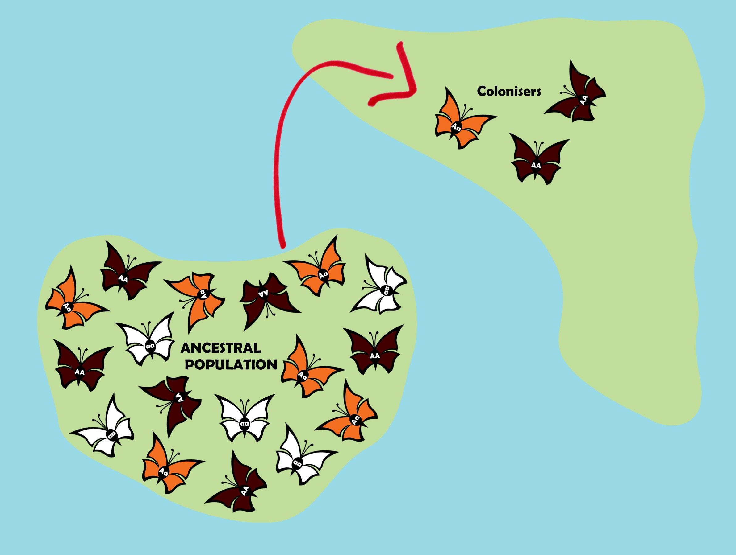
Founder Effect - a few individuals start a new population

Slide 20
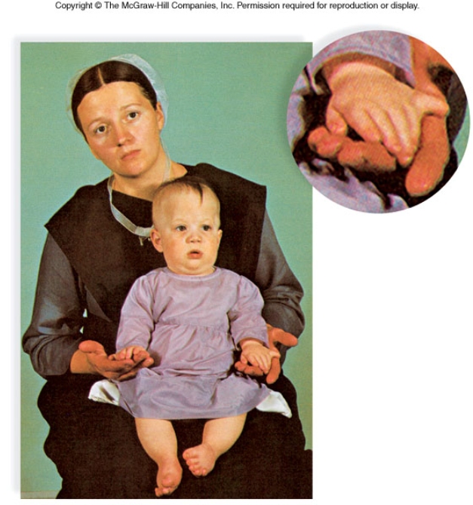
FOUNDER EFFECT
The founder effect is an example of genetic drift where rare alleles or combinations occur in higher frequency in a population isolated from the general population.
Dwarfism in Amish communities Due to few German founders

Slide 21
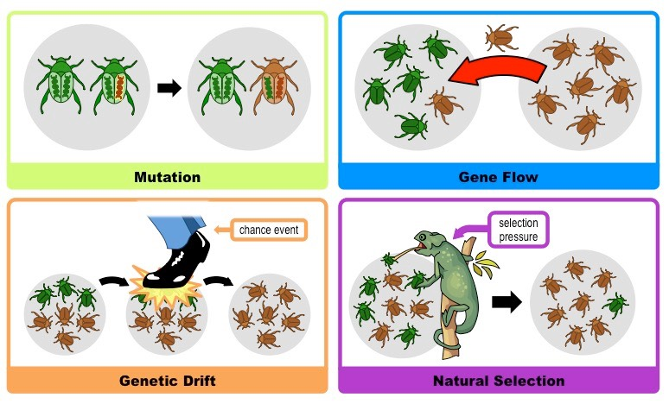

Slide 22
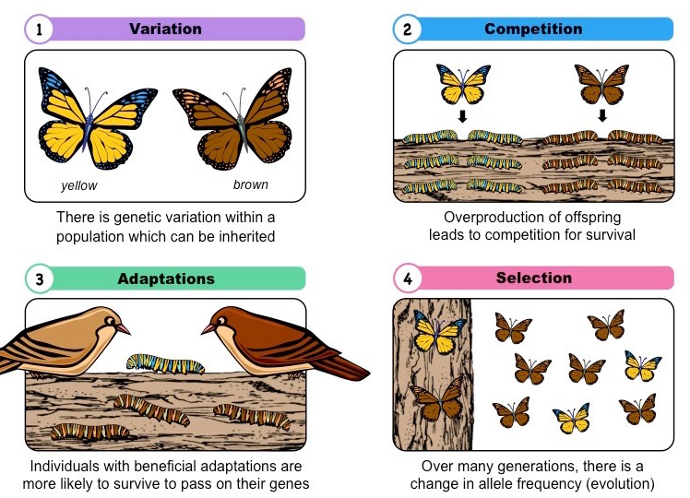
Types of Selection
Natural selection only acts on the population’s heritable traits: selecting for beneficial alleles and thus increasing their frequency in the population, while selecting against deleterious alleles and thereby decreasing their frequency—a process known as adaptive evolution

Slide 23
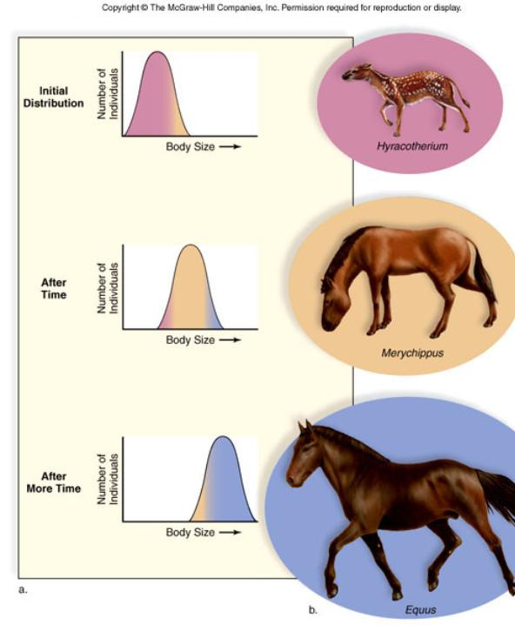
A. TYPES OF SELECTION
1. Directional Selection One phenotype is favored over another Causes a shift in the overall appearance of the species Ex: horses get larger

Slide 24
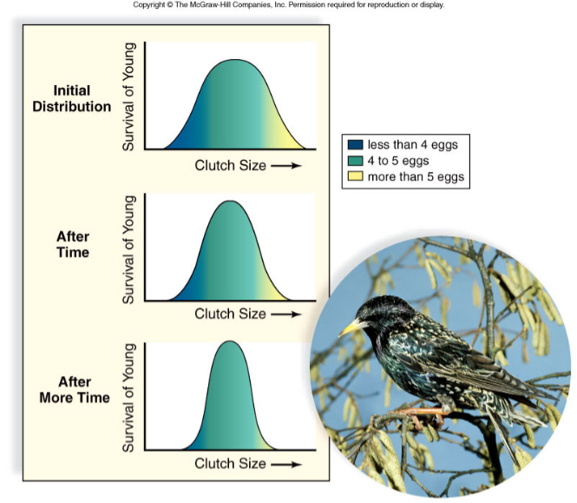
2. STABILIZING SELECTION
occurs when extreme phenotypes are eliminated and the intermediate phenotype is favored.

Slide 25
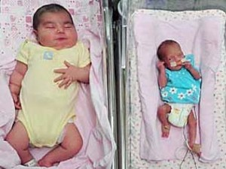
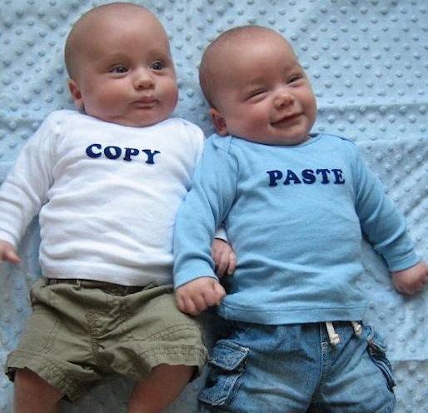
Human babies have an average size
Too big and they can't get through birth canal
Too small and they have low survivability

Slide 26
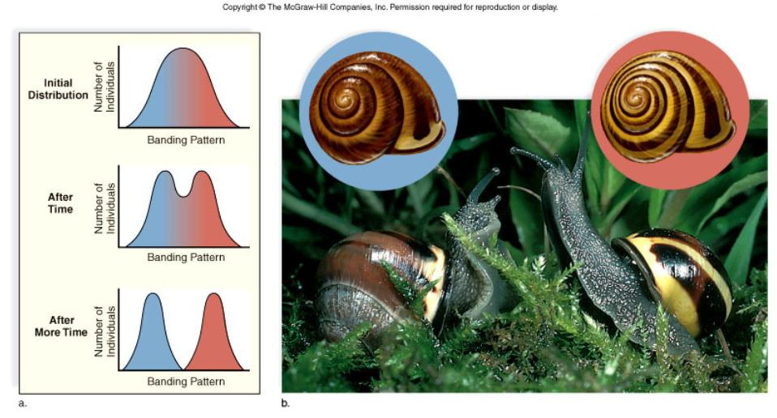
DISRUPTIVE SELECTION -- occurs when extreme phenotypes are favored and can lead to more than one distinct form.
***CAN LEAD TO SPECIATION***

Slide 27
