Slide 1
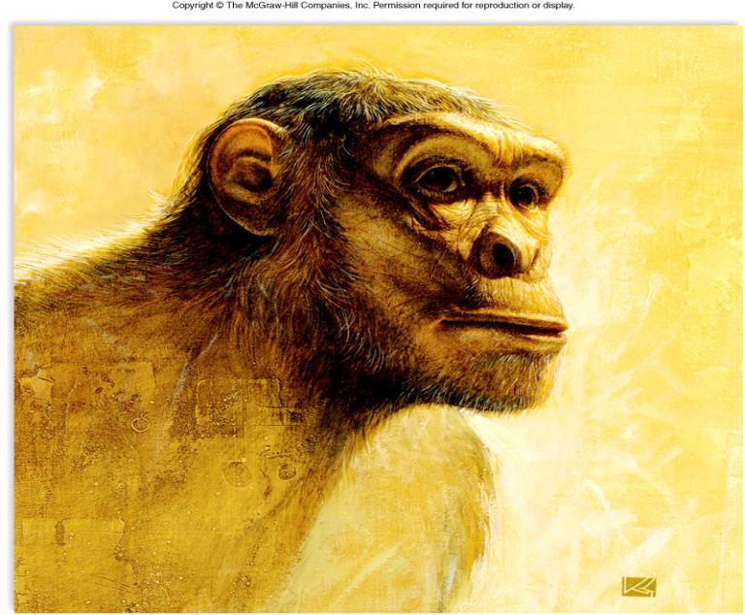
Chapter 32
Human Evolution

Slide 2
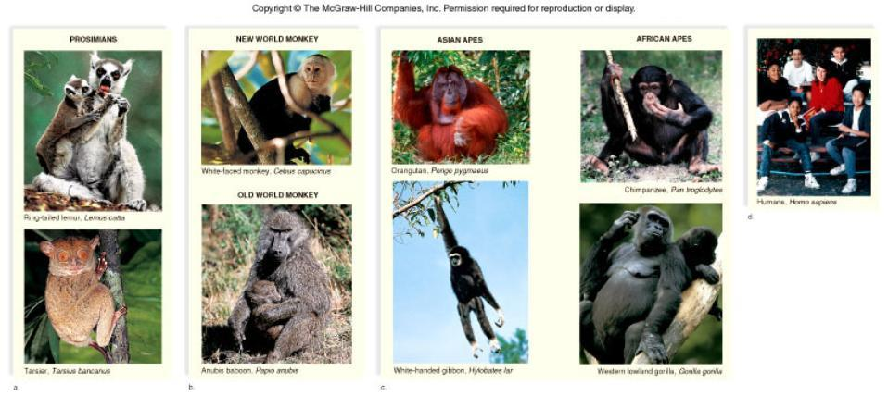
PRIMATE DIVERSITY
Study these pictures: You will need to be able to identify primates by sight. You will see more pictures of them throughout these slides.
Lemur, Tarsier, New World Monkey, Baboon, Gibbon, Chimpanzee, Orangutan, Gorilla, Human

Slide 3
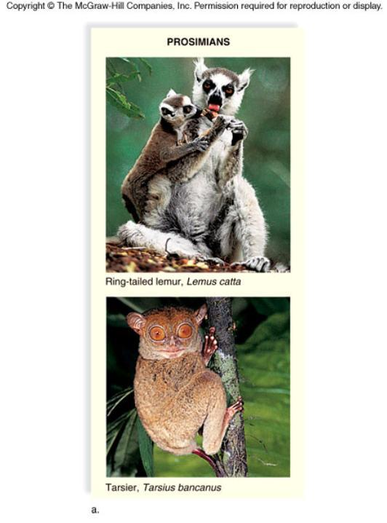
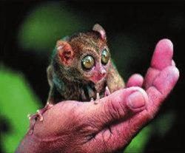
32.1 Evolution of Primates
A. Primate Characteristics
1. Primates differ from other mammals by being adapted for arboreal life (living in trees).

Slide 4
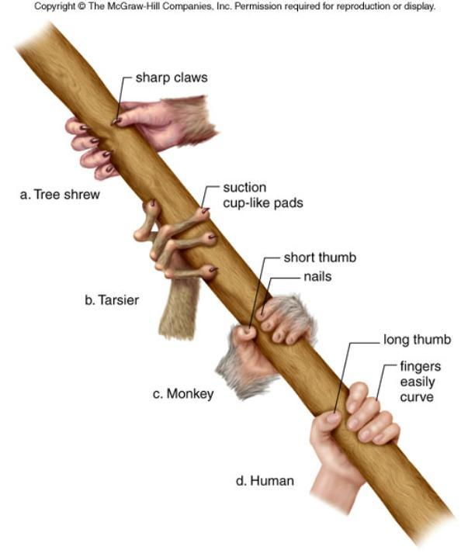
Comparison of Primate Hands
2. Forelimbs & Hindlimbs
a. five digits each.
b. flat nails replace claws and sensitive pads develop on the underside of fingers and toes.
c. Many primate hands have an opposable thumb; some also have an opposable big toe.
d. These features allow the free grasping of tree limbs and easy harvesting of fruit.

Slide 5
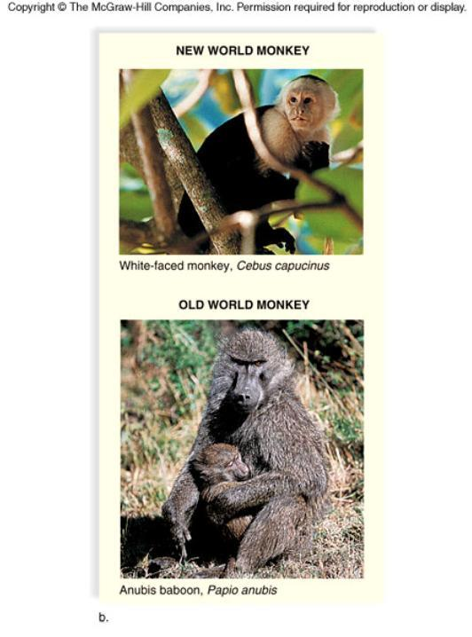
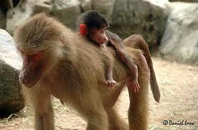
Binocular Vision
a. Primates have a reduced snout and the face is relatively flat.
b. The sense of smell is generally reduced.
c. The eyes are moved to the front of the face
d. Cone cells provide greater visual acuity and color vision but require bright light.

Slide 6
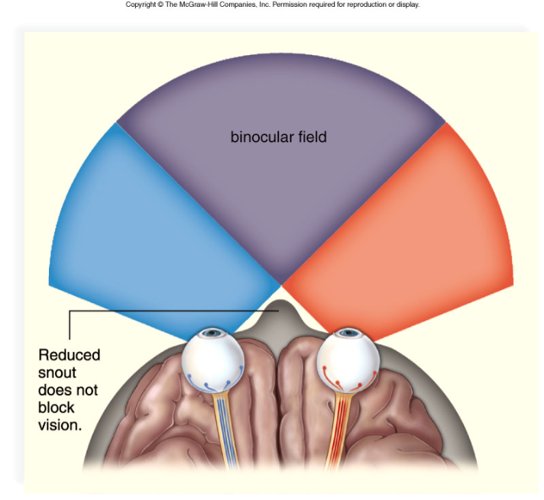
BINOCULAR VISION

Slide 7
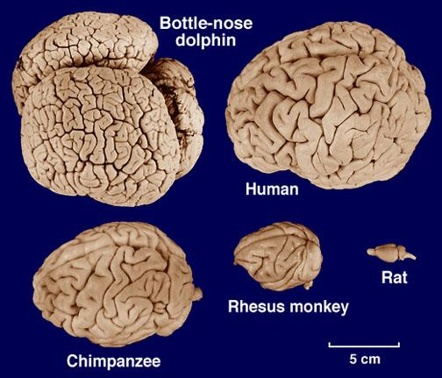
Large, Complex Brain
In primates, the frontal lobe is larger, allowing for more processing of information and learning.

Slide 8
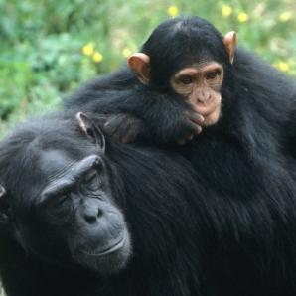
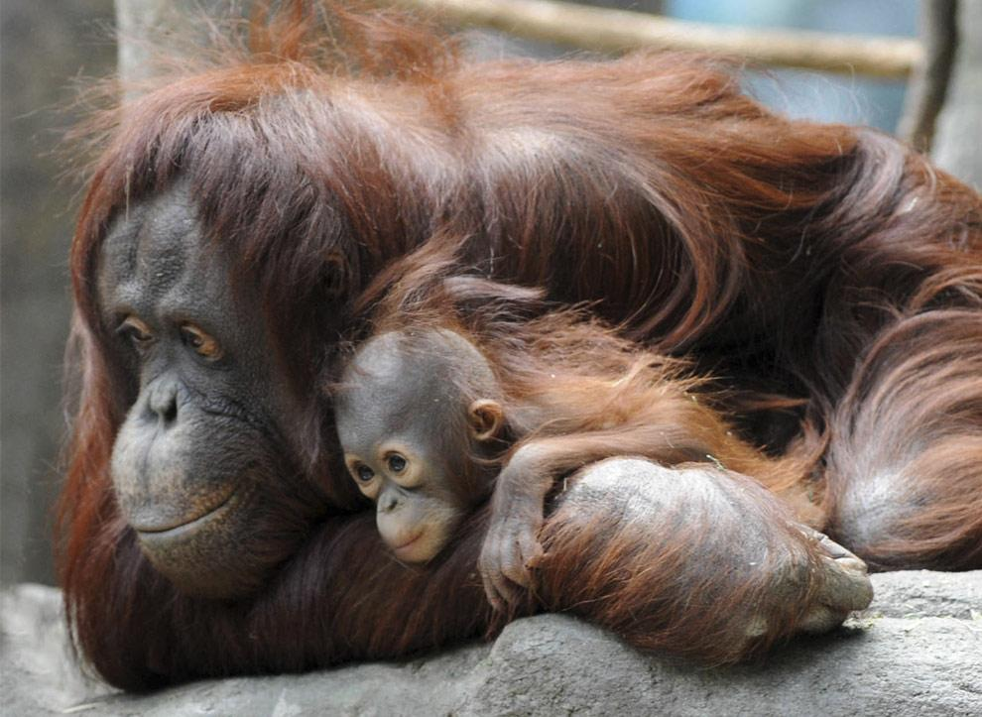
Reduced Reproductive Rate
a. Primates have more single births
b. The period of parental care is extended with an emphasis on learned behavior and complex social interactions.

Slide 9
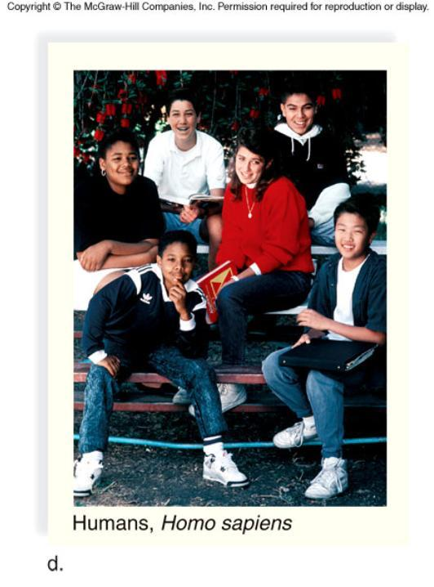

B. Sequence of Primate Evolution
1. All primates at one time shared one common ancestor; prosimians were an early group to diverge and African apes were the last group to diverge from our lineage.
2. Prosimians diverged first and are most closely related to the original primate.

Slide 10
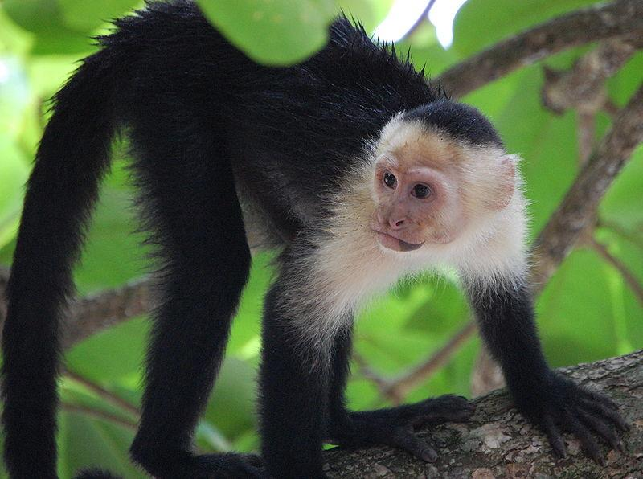
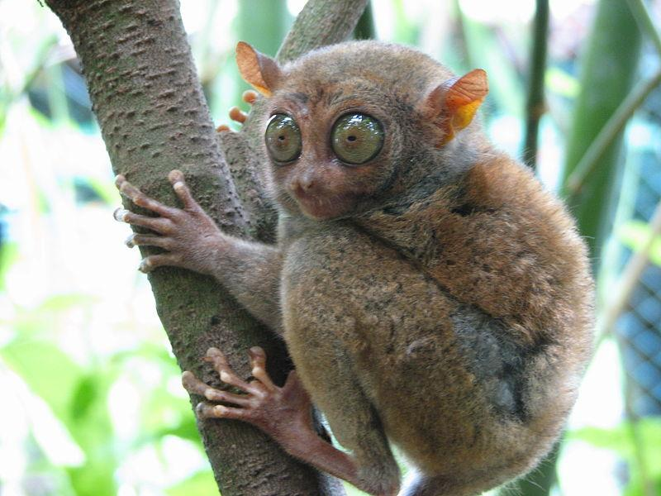
3. Anthropoids
a. Surviving anthropoids are classified into three superfamilies:
New World monkeys Old World monkeys Hominoids (apes and humans).
b. New World monkeys reside in South America and Old World monkeys evolved in Africa.c. New World monkeys (e.g., spider monkey and capuchin) have long prehensile tails and flat noses.

Slide 11
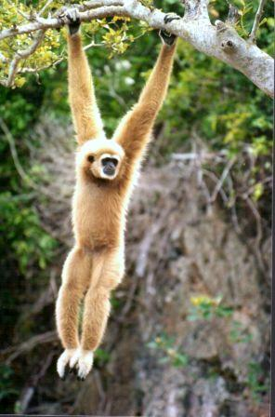
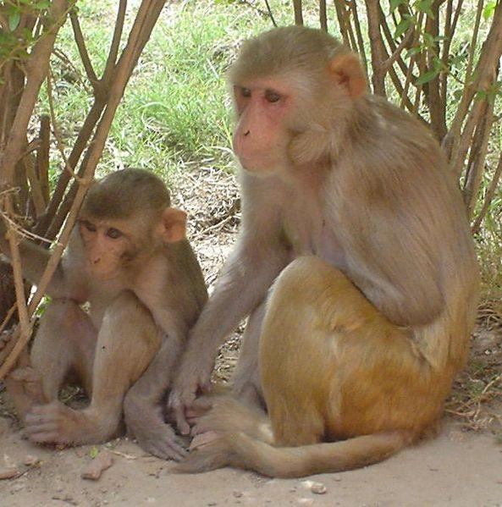
d. Old World Monkeys (baboon and rhesus monkey) lack prehensile tails and have protruding noses.
Gibbons are "old world monkeys" that live in Asia
This rhesus monkey has a tail, but it is not prehensile

Slide 12
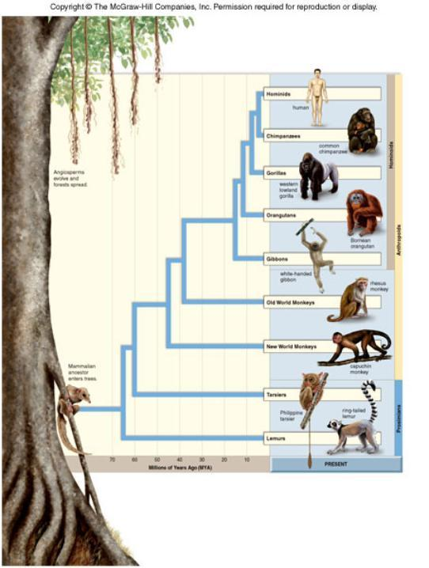
EVOLUTION OF PRIMATES
PRIMATE PHYLOGENY
This shows the different branches of the primate families

Slide 13
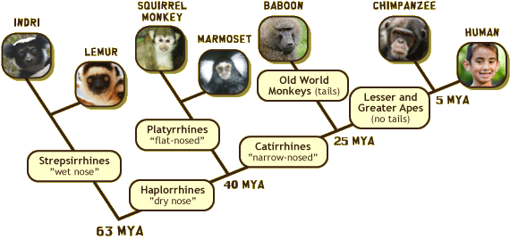
Recall that cladograms are used to indicate derived characteristics
Each circle on the diagram would be a characteristic that each group shares
Source: Wild Exporations

Slide 14
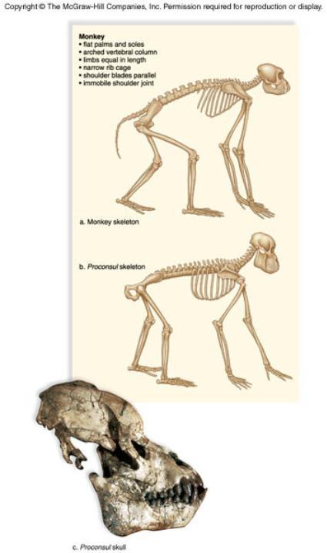
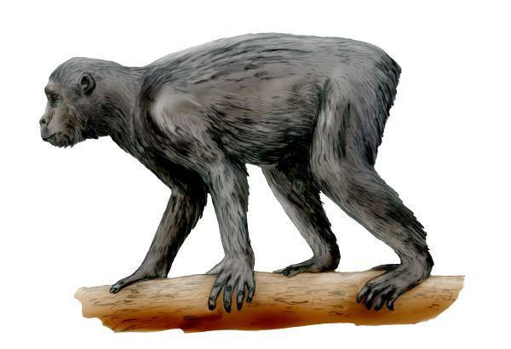
4. Hominoid Evolution
a. About 15 MYA, dozens of hominoid species arose.
b. Proconsul was one species that lived at this time, and it is believed to be the ancestral ape.

Slide 15
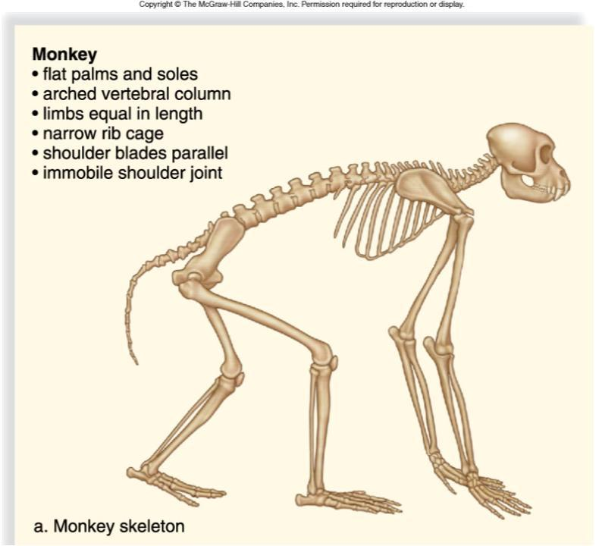
Figure 32.5a

Slide 16
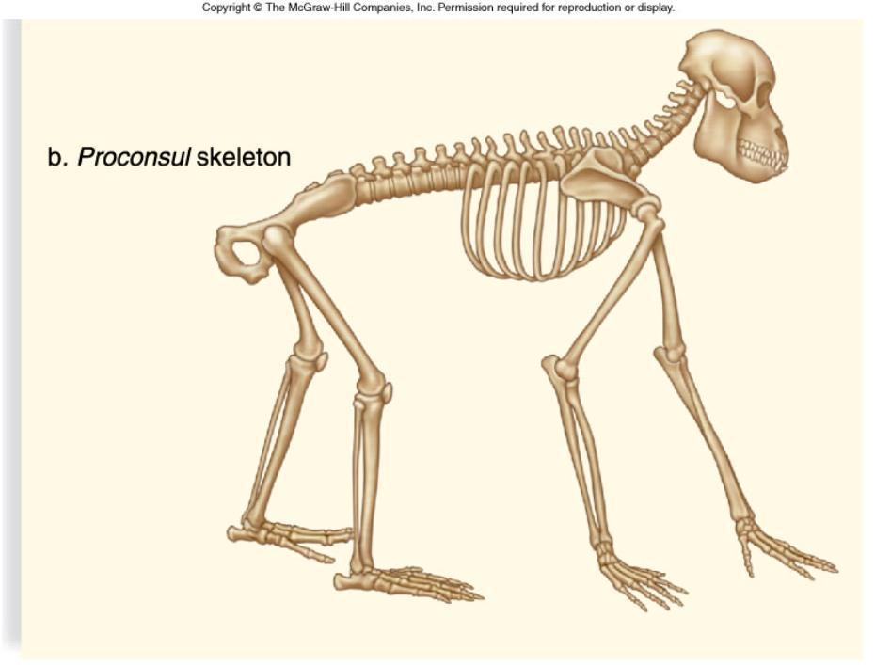
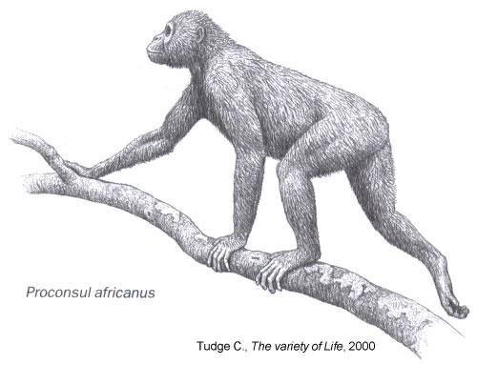
Figure 32.5b
lacks tail
rounded rib cage
teeth enamel; reduced canines
shorter back legs

Slide 17
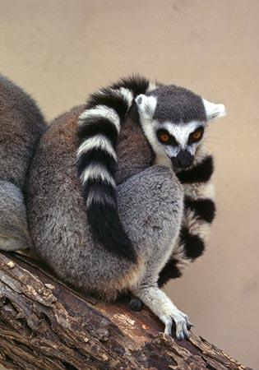
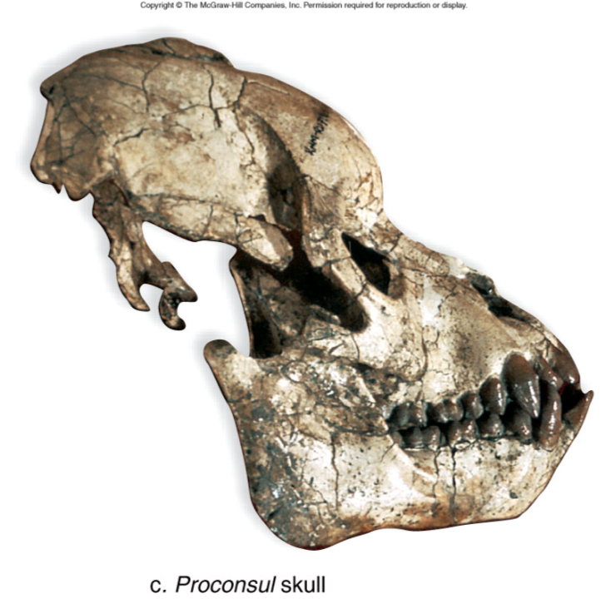
Lemurs are primates found only on the African island of Madagascar and some tiny neighboring islands. Because of its geographic isolation, Madagascar is home to many amazing animals found nowhere else on Earth. Lemurs may have floated there eons ago on "rafts" of vegetation and evolved in isolation over countless centuries. From National Geographic Animals

Slide 18
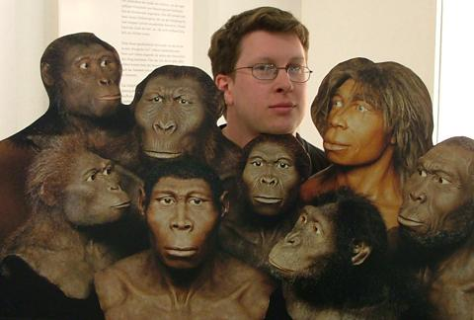
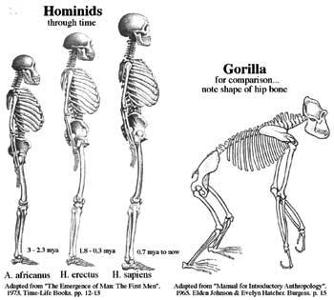
32.2 Evolution of Early Hominids
1. The designation hominid includes humans and several extinct species related to humans. (upright walkers)
2. Fossil and anatomical data indicate ancestors of African apes and the human lineage diverged about 7 MYA.
3. When such changes accumulate at a constant rate, it constitutes a molecular clock to indicate relatedness; these data indicate we diverged about 6 MYA.

Slide 19
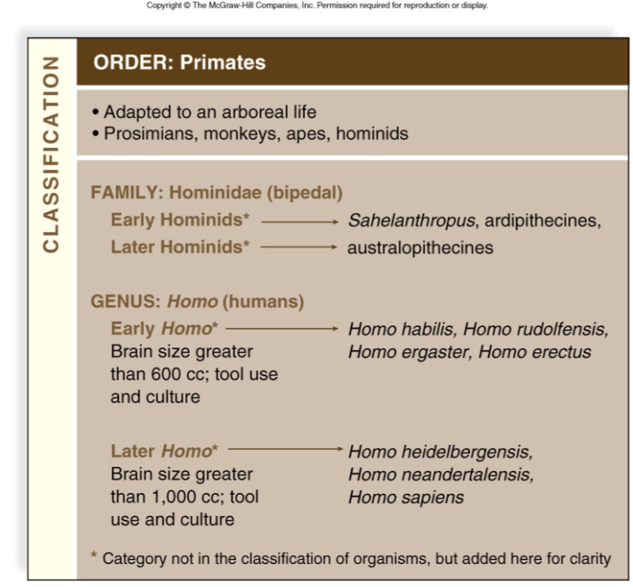
Pg 584

Slide 20
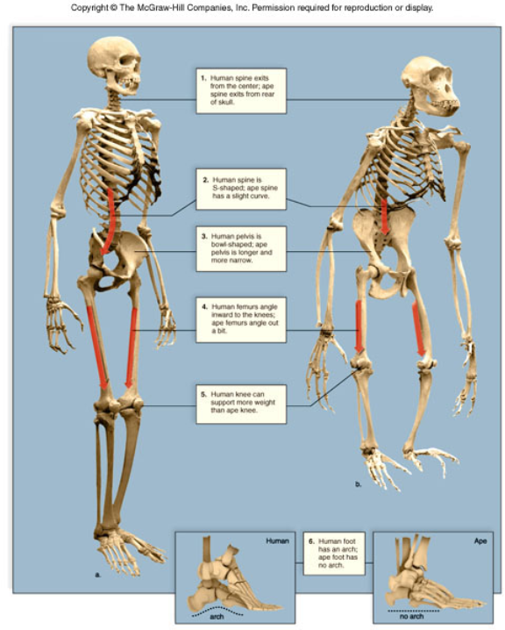
A. Comparing Humans to Chimpanzees
Compared to chimpanzees, in humans
The skull is in the midline of the body.
The longer curved spine places the center of gravity over the feet.

Slide 21
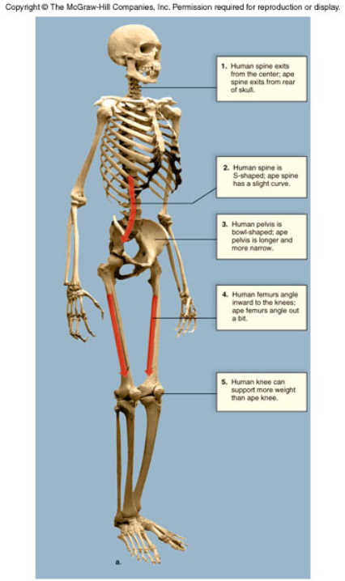
The broader pelvis and hip joints prevent swaying when walking.
A longer neck on the femur in humans causes the femur to angle inward at the knees.
The human knee joint is modified to support the body’s weight.
The human toe is not opposable but the foot has an arch for long distance walking

Slide 22
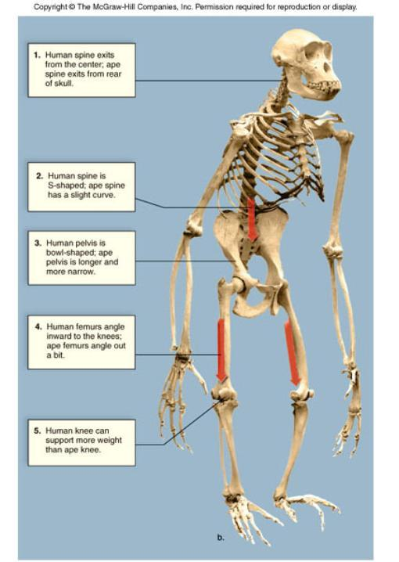
Chimpanzee
1. Spine exits from rear of skull
2. Spine is C -shaped
3. pelvis is long and narrow
4. femurs angle out
5. knee cannot support much weight
*all in all, they are not organized to walk upright

Slide 23
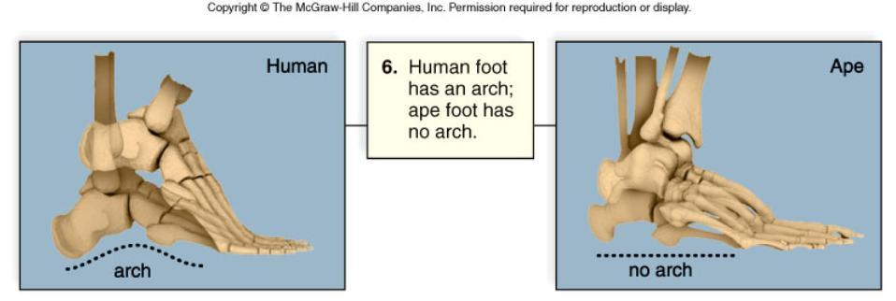
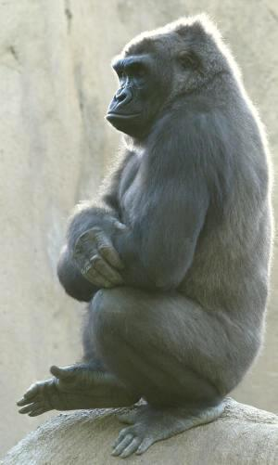

Slide 24
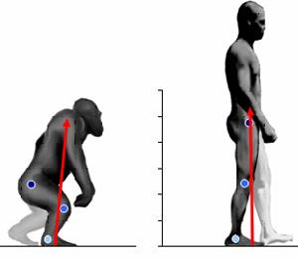
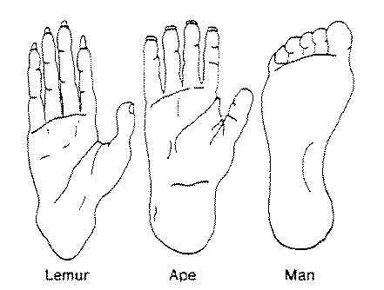
B. The Early Hominids
Until recently, science thought that the climate changed forests into savannas; there is little evidence of a shift in vegetation at 6 MYA.
Additional advantages of bipedalism include reduction of heat stroke and carrying food back to females.
While still living in trees, the first hominids may have walked upright on two feet (bipedalism) to collect overhead fruit.

Slide 25
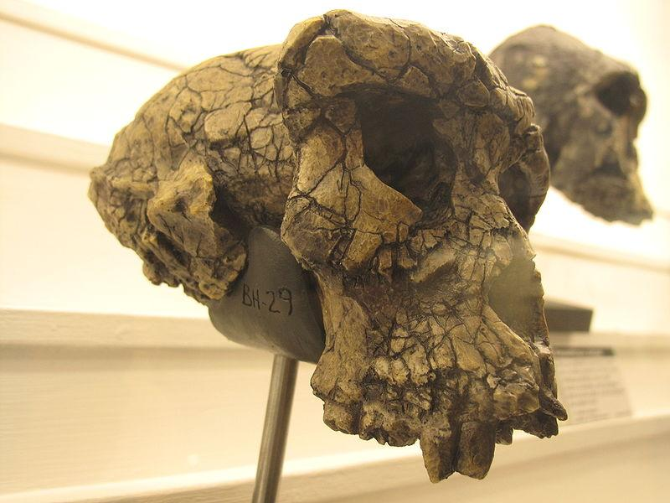
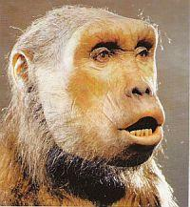
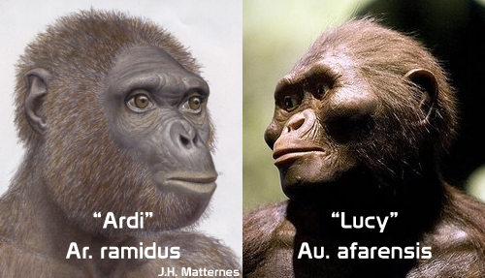
Early Hominid Fossils
The braincase of Sahelanthropus tchadensis has been dated at 7 MYA.
Skull fragments from Ardipithecus ramidus have been found; it was likely bipedal.

Slide 26
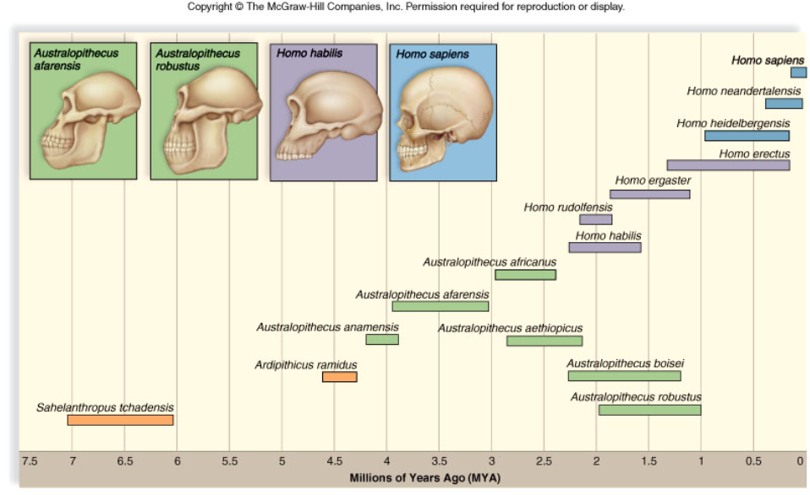
Figure 32.7

Slide 27
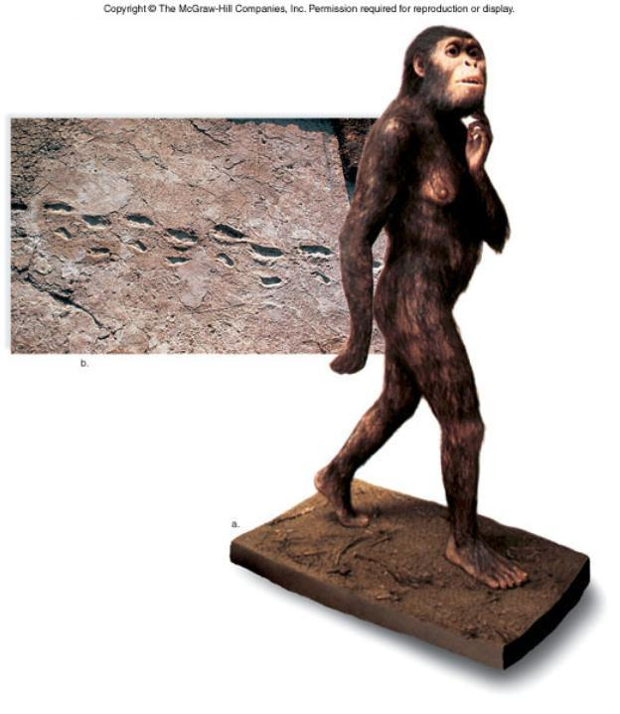
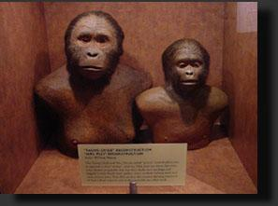
32.3 Evolution of Later Hominids
Australopithecines evolved in Africa 4 MYA.
Expanding fossil records show it is not an orderly sequence between forms.
Australopithecines evolved and diversified in Africa with gracile and robust forms with varied diets; they show adaptations to different ways of life.

Slide 28
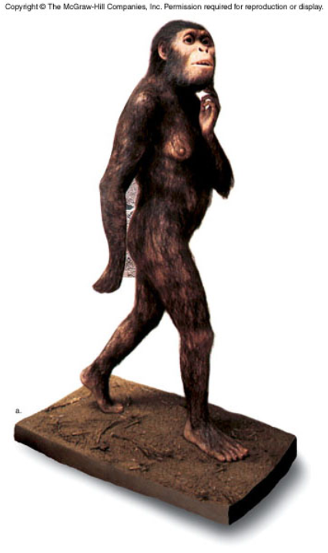
Australopithecines (genus Australopithecus) evolved in Africa 4 MYA.
Australopithecus africanus, date about 2.8 MYA.
Australopithecus robustus was a robust type; dated from 2 to 1.5 MYA.
Australopithecus afarensis is based on many skeletal fragments (Lucy) dated at 3.18 MYA.

Slide 29
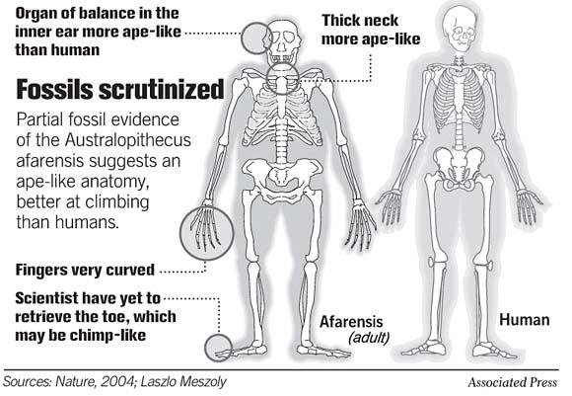
Africanus had a larger brain and is the best candidate as ancestor to early Homo.
Australopithecus afarensis is based on many skeletal fragments (Lucy) dated at 3.18 MYA.
Its brain was small at 400 cc.
This may have been ancestral to the robust types, A. aethiopicus and A. boisei, that later died out.

Slide 30
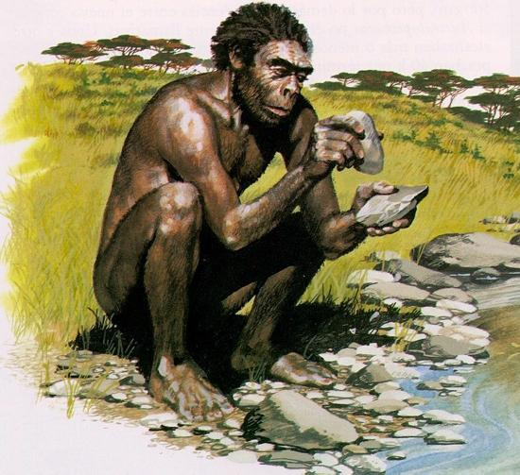
32.4 Evolution of Early Homo
1. Fossils are assigned to the genus Homo based on the following traits:
a. brain size 600 cc or greater;
b. jaw and teeth are human-like; and
c. tool use seems evident.

Slide 31
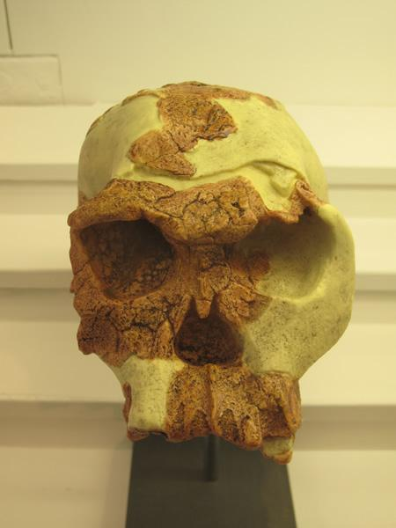
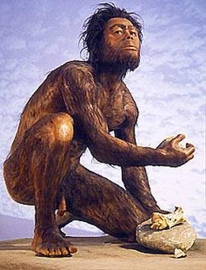
2. Homo habilis and Homo rudolfensis
The oldest fossils to be classified in the genus Homo are dated at around 2 mya.
H. habilis and H. rudolfensis had a brain size as large as 8oo cc
Cut marks on bones suggest the use of tools
Skulls indicate that this hominid may have had speechCulture is dependent on the ability to speak and transmit knowledge; it is thought that the advantages of a culture to these hominids may have hastened the extinction of the
austropithecines.

Slide 32
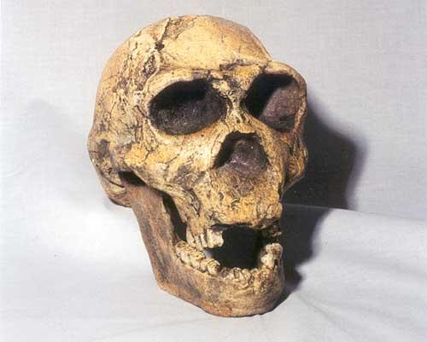
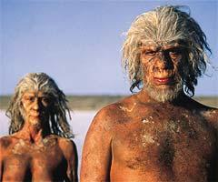
3. Homo ergaster and Homo erectus
Eugene DuBois, a Dutch anatomist, unearthed the first H. erectus bones in Java in 1891.
Fossils found in Africa, Asia, and Europe date between 1.9 and 0.3 million years ago.
The African and Asian types may be different species.
*H. ergaster and H. erectus are very similar, the locations of the fossils differ but they may be the same species
Homo ergaster was tall and muscular. Slim hips and long legs enabled this species to walk long distances. Their skin was smooth to cool themselves through sweating.

Slide 33
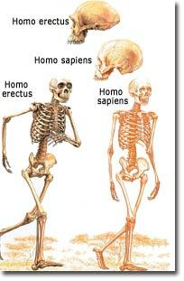
H. erectus had a brain capacity of 1000 cc, was taller than H. habilis, and had a striding gait.
H. erectus fossils found in Java and the Republic of Georgia at 1.9 MYA and 1.6 MYA indicates an early migration from Africa, followed by H. erectus evolving in Asia and spreading to other areas.
These are the first hominids to use fire, fashion more advanced tools, to be systematic game hunters, and possibly to use home bases.

Slide 34
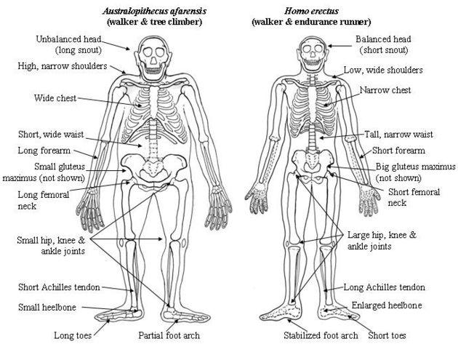

Slide 35

Fossil remains of Homo floresiensis were discovered in 2004 on the island of Flores in the South Pacific; it was the size of a three-year-old human being but with a braincase only one-third the size.
Researchers believe this species evolved from normal sized H. erectus, but underwent “island dwarfing.”
Flores has been described (in the journal Nature) as "a kind of Lost World", where archaic animals, elsewhere long extinct, had evolved into giant and dwarf forms through allopatric speciation, due to its location East of the Wallace Line.
The island had dwarf elephants and giant monitor lizards akin to the Komodo dragon, as well as H. floresiensis, which can be considered a species of diminutive human.
The discoverers have called members of the diminutive species "hobbits", after J.R.R. Tolkien's fictional race of roughly the same height.

Slide 36

Comparison of 3 hominid species

Slide 37

Hobbit Article at ScienceDaily
Becoming Human; Part 2/4

Slide 38


Slide 39

32.5 Evolution of Later Homo
Two contradicting hypotheses are suggested about the origin of modern humans
1. The multiregional continuity hypothesis proposes that modern humans originated separately in Asia, Europe, and Africa.
a. If valid, then a distinctive continuity in anatomy and genetic variation is expected in each location.
b. Evolution of modern humans would be essentially similar in several different places.

Slide 40

2. The out-of-Africa hypothesis states that modern humans originated only in Africa and after migrating into Europe and Asia, they replaced the archaic Homo species found there; current evidence leans toward this hypothesis.
a. All extant humans are descended from a few individuals from about 100,000 years ago.
b. Mitochondrial DNA analyses indicate a close genetic relationship among all Europeans; although the first analysis was flawed, the data tend to support the out-of-Africa hypothesis.

Slide 41

Figure 32.10

Slide 42

A. Neandertals1. Neandertals were named for Neander Valley in Germany where skeletons were dated as early as 200,000 years ago.2. Neandertals are classified as Homo neandertalensis.3. Classic Neandertal anatomy includes massive brow ridges; a nose, jaws, and teeth that protruded forward; a low sloping forehead; a lower jaw sloping back without a chin; a longer pubic bone; a slightly larger brain than that of modern humans; shorter and thicker limb bones; and heavier muscles in the shoulder and neck.
4. It is speculated that a larger brain than that of modern humans was required to control the extra musculature.5. The sturdy build of Neandertals was likely an adaptation to cold climate; they lived in Eurasia during the last Ice Age.

Slide 43

Figure 32.11

Slide 44
The Neandertals give evidence of being culturally advanced.
a. Most lived in caves, but those who lived in the open may have built houses.
b. They manufactured a variety of stone tools, including spear points, scrapers, and knives.
c. They used and could control fire, which probably helped in cooking frozen meat and in keeping warm.
d. They buried their dead with flowers and tools and may have had a religion.
Clips from Clan of the Cave Bear

Slide 45


Cro-Magnons
1. Cro-Magnons are the olderst fossils to be designated H. sapiens; they werefound in Eurasia 100,000 years ago.
2. Cro-Magnons are named for a fossil location in France and had a thoroughly modern appearance.
3. They had advanced stone tools and may have been the first to throw spears.
4. Cro-Magnons hunted cooperatively, and perhaps were the first to have had a language.
5. They may have been responsible for the extinction of large mammals during the late Pleistocene.
6. Cro-Magnon culture included figurines carved out of bone and antler, and cave paintings.

Slide 46

Figure 32.12

Slide 47

Homo sapiens

Slide 48

Figure 32.13
Human Variation
Some human variation evolved as adaptation to local environmental conditions: darker skin to protect from UV light, lighter skin for vitamin D production, etc.
A bulkier body also benefits in colder regions while hot climates favor a slight build and longer limbs.
Hair texture, eyelid fold, and other traits are not explained as adaptations.
Variation among modern populations is considerably less than among archaic human populations of 250,000 years ago.
Comparative studies of mDNA indicate that human populations had a common ancestor no more than a million years ago.

Slide 49

Figure 32.13a
Differences not necessarily adaptations
Possibly explained by genetic drift

Slide 50
the great majority of genetic variation, about 85%, occurs within ethnic groups, not among them.
Genetic Evidence for a Common Ancestry
The multiregional hypothesis suggests that different human populations came into existence as long as a million years ago, giving time for ethnic differences to accumulate despite gene flow.
The out-of-Africa hypothesis suggests that modern humans have a relatively recent common ancestor who evolved in Africa then spread to other regions.
Studies with mitochondrial DNA show that differences among human populations are consistent with their having a common ancestor no more than a million years ago.

Slide 51

Websites to Explore on Human Evolution
Becoming Human: http://www.becominghuman.org/
BBC Walking with Cavemen: http://www.bbc.co.uk/sn/prehistoric_life/tv_radio/wwcavemen/
ArchaeologyInfo, Human Evolution: http://www.archaeologyinfo.com/

Slide 52

Figure 32.6

Slide 53

Figure 32.6a

Slide 54

Figure 32.6b

