Slide 1
Chapter 1
Biology: The Study Of Life

Slide 2
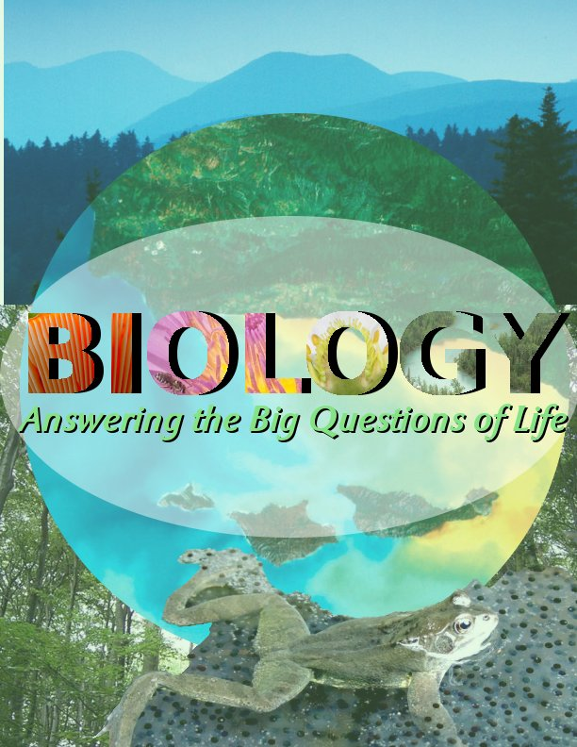
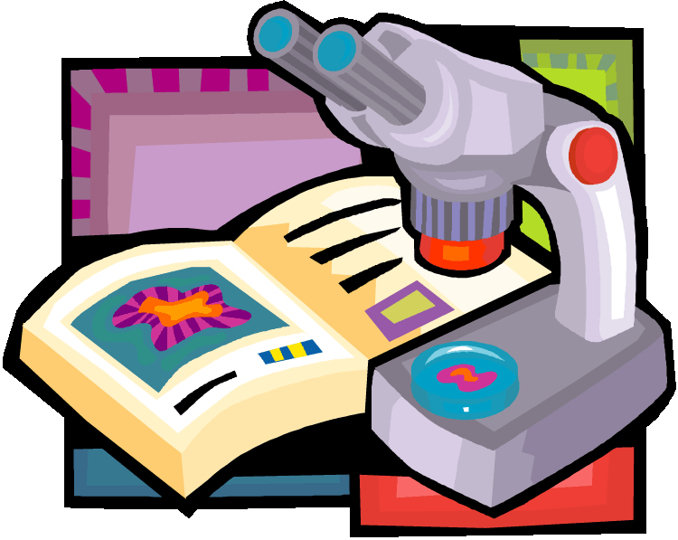
What is Biology?
Biology – the study of life
From Greek – bio meaning “life” & logos meaning “study of”
Anything that is alive is called an ORGANISM

Slide 3
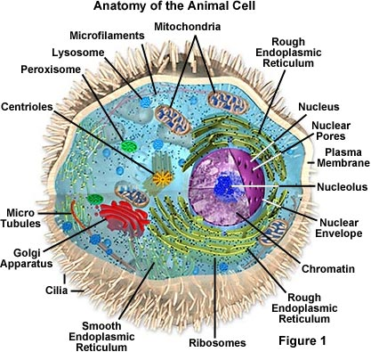
What makes something “alive?”
6 main characteristic of life:
All organisms are made of organized CELLS
All organisms can REPRODUCE
All organisms GROW and DEVELOP
All life can ADJUST, ADAPT, and EVOLVE
ALL 6 of these characteristics must be met for an organism to be considered living.
E.g. Viruses are not made of cells and do not grow so therefore are not considered alive.

Slide 4
(1) Organization Of Cells
A CELL is the smallest possible unit of life
Many organisms, such as bacteria, are UNICELLULAR and are made of only ONE cell.
Other organisms such as animals and plants are MULTICELLULAR and are made of MANY cells.

Slide 5
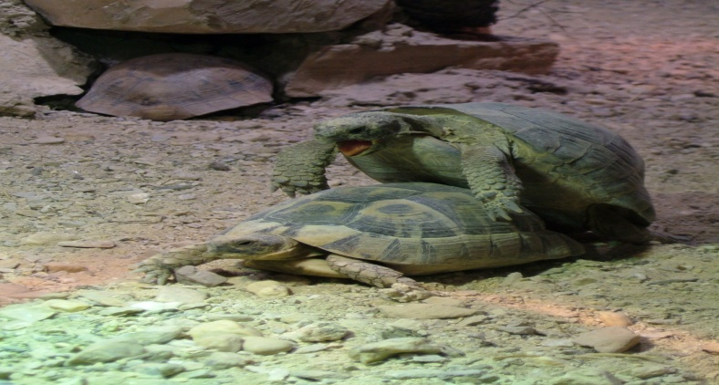
(2) Reproduction
Organisms don’t live forever.
Reproduction is not required for the survival of a single individual it is required for the survival of the SPECIES as a whole.
A SPECIES is a group of organisms that can interbreed and produce fertile offspring in nature.
Without reproduction a species will eventually go EXTINCT.

Slide 6
Asexual vs. Sexual Reproduction
ASEXUAL reproduction – a single parent makes an identical offspring
Cloning, binary fission, budding, mitosis
SEXUAL reproduction – two parents combine DNA to make a unique offspring
Internal/External Fertilization

Slide 7
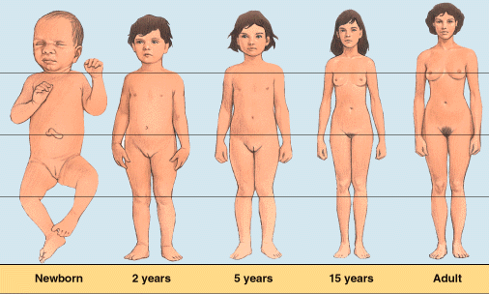
(3) Growth and Development
All life begins with a single cell.
Over the course of an organism’s life, the organism will GROW in size and DEVELOP (change) into a mature form.
E.g. A fertilized chicken egg will grow and develop into an adult chicken

Slide 8
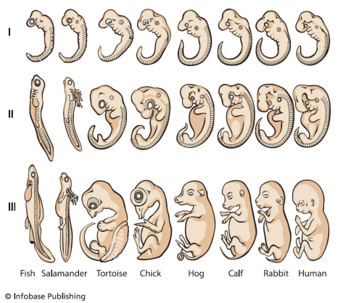

Slide 9
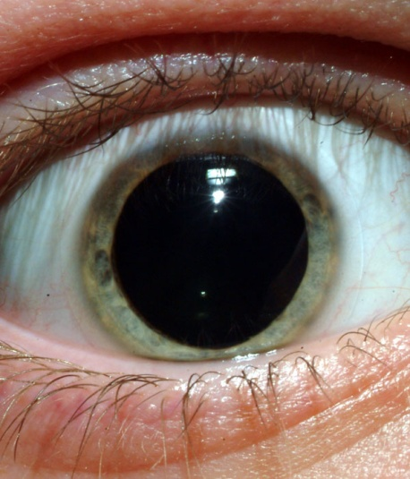
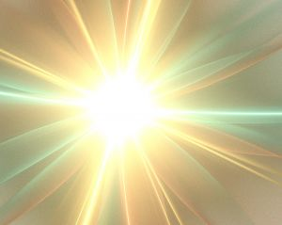
(4) Organisms Adjust
All life can ADJUST or react to their surroundings.
Possible things that an organism can adapt to:
Light
Temperature
Other Organisms

Slide 10
Stimulus & Response
A STIMULUS is anything in an organism’s environment that causes the organism to react.
E.g. Loud noise, smell of food, predator
A RESPONSE is a reaction to a stimulus.
E.g. Flinching at the sound of a noise, moving toward food, running from sight of predator

Slide 11
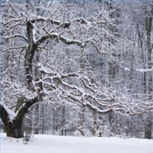
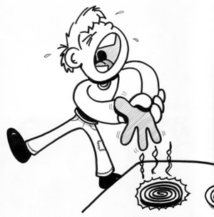
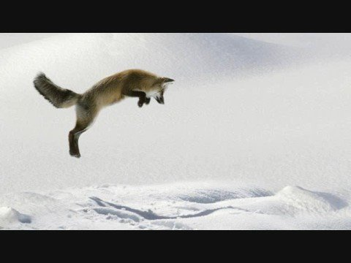
Examples of Stimulus & Response
STIMULUS: Cold dry weather
RESPONSE: Trees lose leaves
STIMULUS: Touch a hot stove
RESPONSE: Jerk hand away
STIMULUS: Fox sees a rabbit
RESPONSE: Fox kills and eats rabbit

Slide 12
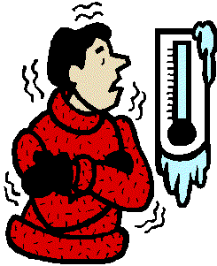
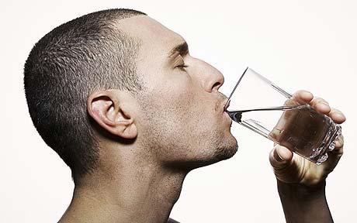
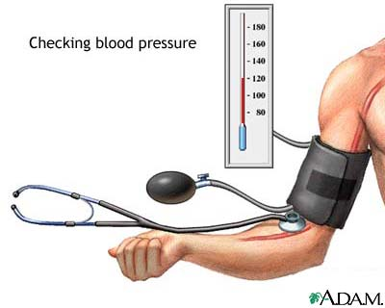
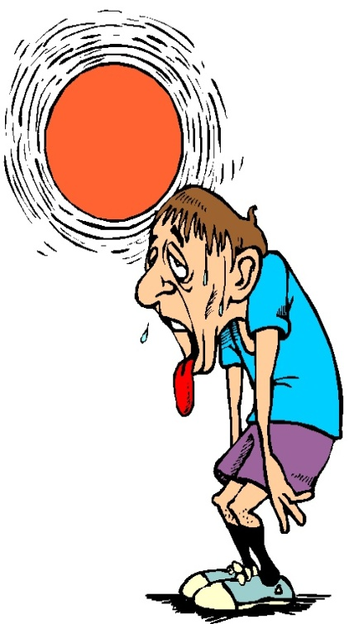
Homeostasis
All living things must maintain an internal balance in their bodies.
HOMEOSTASIS is the maintenance
of an internal balance in all organisms
EXAMPLES:
Sweating (too hot)
Shivering (too cold)
Keeping the same blood pressure
Balance of water and nutrients

Slide 13
(5) Obtain and Use Energy
Living things must obtain energy from their environment
Photosynthesis (energy from sunlight)
Eating (ingestion or absorption)
Living things must process energy for life functions
Cell respiration

Slide 14
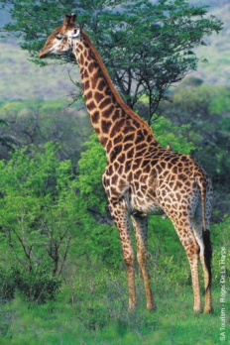
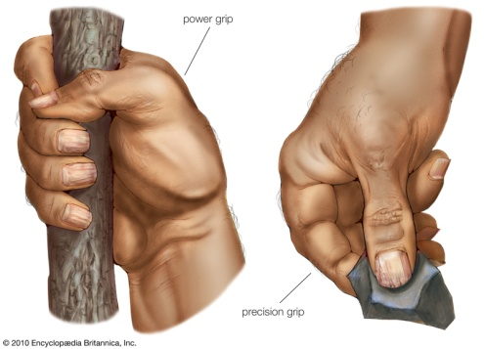
(6) Adaptations and Evolution
All organisms have ADAPTATIONS to help them survive.
An ADAPTATION is any inherited structure or behavior that helps an organism survive.
Adaptations are inherited from previous generations and can be passed on to offspring.
The gradual changes in a species through adaptations over time is called EVOLUTION.

Slide 15
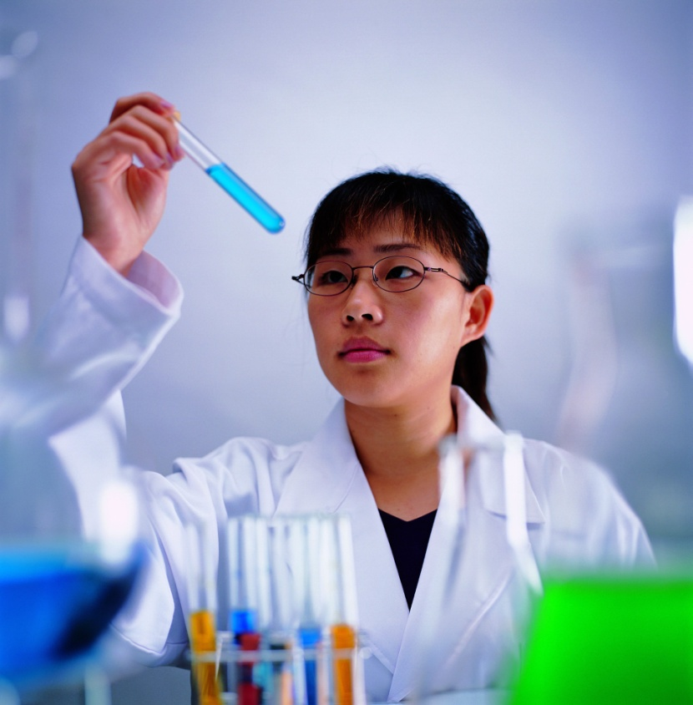
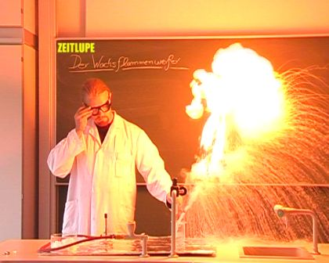
Methods of Biology
The common steps that all scientists use to investigate or do an experiment is called the SCIENTIFIC METHOD.

Slide 16
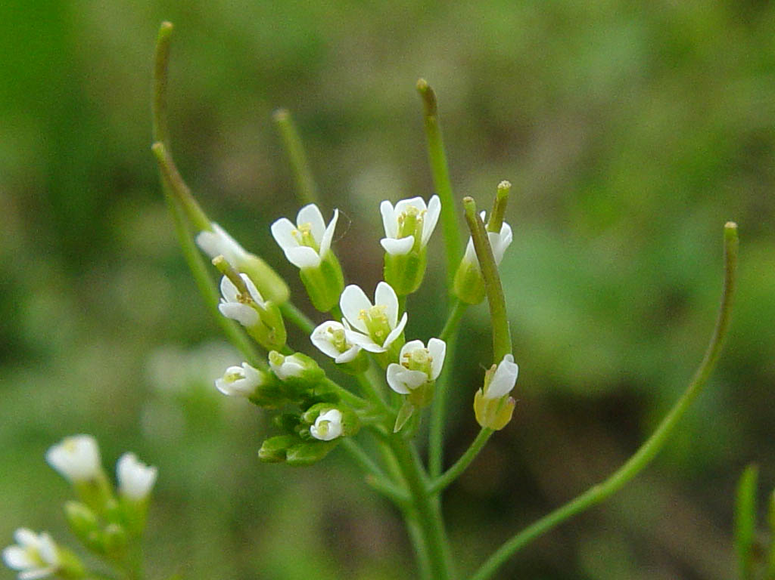
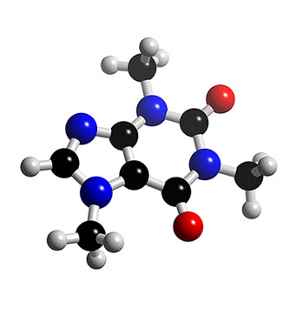
1. Choose A Problem
The first step of the SCIENTIFIC METHOD is to CHOOSE A PROBLEM; this often takes the form of a question.
E.g. What effect does caffeine have on the growth of the Arabidopsis plant?
?
Caffeine
Arabidopsis

Slide 17
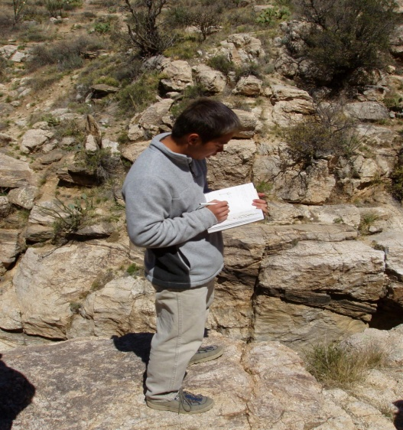
2. Research Your Problem
Before continuing with the experiment a scientist should RESEARCH THE PROBLEM
Ways to research:
Make and record observations
Talk to experts
Go to the library or browse the internet

Slide 18
3. Develop A Hypothesis
A HYPOTHESIS is a prediction that can be formally tested; it is based on your observations and research.
An educated guess about what will happen
E.g. Caffeine will cause an increase in the growth of the Arabidopsis plant.

Slide 19
4. Design An Experiment
An EXPERIMENT is an investigation that tests a hypothesis by collecting data under controlled conditions.
A controlled experiment often has 2 groups: The CONTROL group and the EXPERIMENTAL group
VS.
WITH caffeine
NO caffeine
CONTROL Group
EXPERIMENTAL Group
(nothing changed)
(one variable changed)

Slide 20
Design An Experiment
The CONTROL is the part of the experiment that is the standard against which the results are compared.
E.g. Group of 10 plants WITHOUT caffeine added
The EXPERIMENTAL group is the group that has ONE variable changed.
E.g. Group of 10 plants WITH a measured amount of caffeine added

Slide 21
Independent Variable
The ONE thing that is CHANGED in an experiment is called the INDEPENDENT VARIABLE
E.g. Independent variable is the amount of caffeine added to the plants
Caffeine
Independent Variable

Slide 22
Dependent Variable
The DEPENDENT VARIABLE is the MEASURED result caused by the independent variable.
The dependent variable DEPENDS on the independent variable
E.g. The dependent variable is the measured growth of the plants

Slide 23
Ind. Vs. Dep. Variable
The DEPENDENT VARIABLE is the result of the INDEPENDENT VARIABLE being manipulated.
E.g. More caffeine (Ind. Var.) = more plant growth (Dep. Var.)
Independent Variable: scientist CHANGES
Caffeine
Dependent Variable: scientist MEASURES
Growth

Slide 24
5. Test Your Hypothesis
In order to TEST YOUR HYPOTHESIS the experiment that was designed must now be conducted.
E.g. Allow both the control group and experimental groups of Arabidopsis plants to grow for a period of 5 days and record the height of every plant each day in a data table
 | Day 1 | Day 2 | Day 3 | Day 4 | Day 5
Caffeine | 1.4in | 2.2in | 3.9in | 5.0in | 8.5in
Control | 1.2in | 1.9in | 2.7in | 4.1in | 6.5in

Slide 25
6. Organize Your Data
DATA is defined as any information that is obtained from an investigation
The DATA that has been collected must then be ORGANIZED
Usually the DATA will be put into a chart or graph to provide visual results that can be more easily interpreted

Slide 26
Effects of Caffeine on Arabidopsis Plant Growth

Slide 27
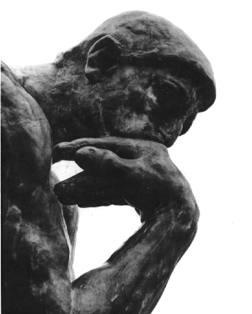
7. Draw Conclusions
The data that has been collected in the experiment must then be ANALYZED and the scientist must come to a CONCLUSION
The CONCLUSION must indicate whether the hypothesis was accepted or rejected
E.g. Looking at the data, the hypothesis that caffeine will increase Arabidopsis growth is confirmed

Slide 28
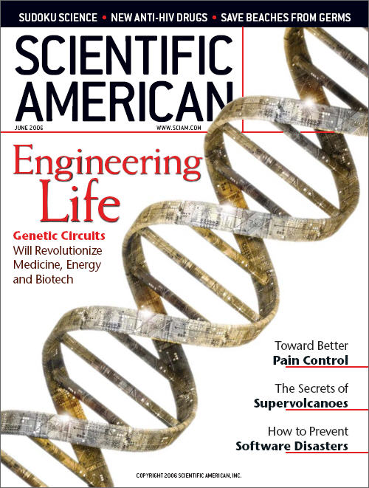
Draw Conclusions
Once a conclusion has been drawn a scientist will then PUBLISH the results to share with other scientists
Other scientists can try to replicate the results by repeating the same procedure

Slide 29
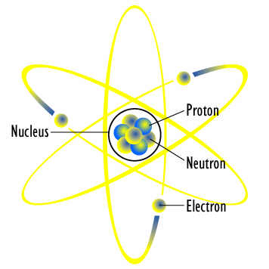
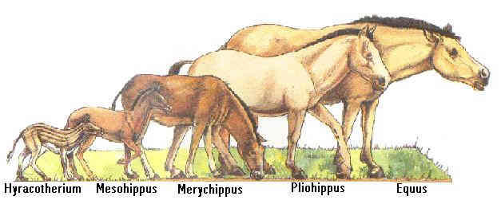
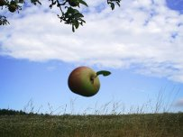
Hypothesis Becomes A Theory
A hypothesis that is supported many different times by many different scientists will become a THEORY
A THEORY is NOT a guess!! A THEORY is CONFIRMED by scientific observations.
E.g. Theory of Gravity, Atomic Theory, Theory of Evolution

Slide 30
International System of Measurement (SI)
All scientists use the same system of measurement called the INTERNATIONAL SYSTEM OF MEASUREMENT (SI).
Meter (length)
Gram (mass)
Liter (volume)
Second (time)
Celsius degree (temperature)
Scientists around the world communicate quantitative data using the SI system

