Slide 1
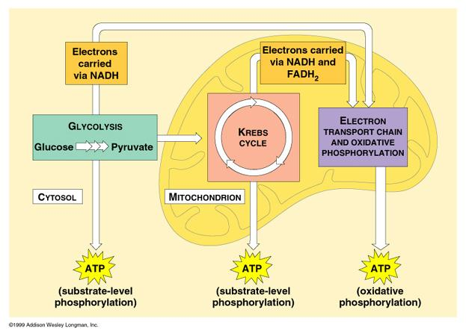
Cellular Respiration

Slide 2
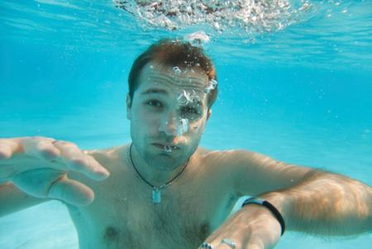
Cellular Respiration
Have you ever wondered why exactly you need to breathe? What happens when you stop breathing?

Slide 3
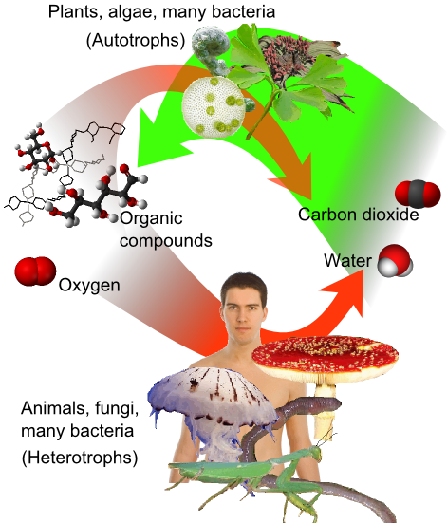
Cellular respiration is the set of the metabolic reactions and processes that take place in the cells of organisms to convert biochemical energy from nutrients into adenosine triphosphate (ATP), and then release waste products.

Slide 4
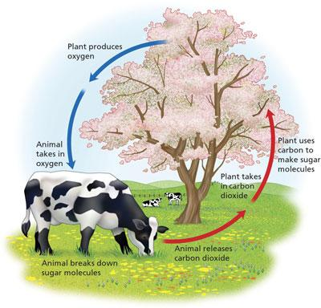
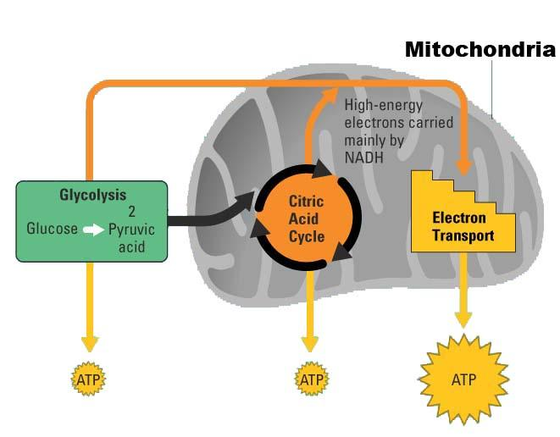
C₆H₁₂O₆ + 6O₂ -->6 CO₂ + 6H₂O + 36 ATP

Slide 5
Respiration occurs in the presence of oxgen - AEROBIC
Without oxygen, another path is taken ....this path is called fermentation, or
anaerobic respiration

Slide 6
There are three stages
1. Glycolysis
2. Kreb's Cycle (Citric Acid Cycle)
3. Electron Transport Chain

Slide 7
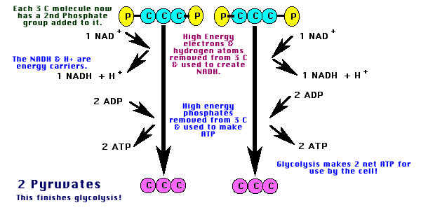
GLYCOLYSIS
can occur without oxygen
GLYCOLYSIS = "glyco - lysis " is the splitting of a 6 carbon glucose into two pyruvates, each having 3 carbons
net yield of 2 ATP per glucose molecule net yield of 2 NADH per glucose molecule

Slide 8
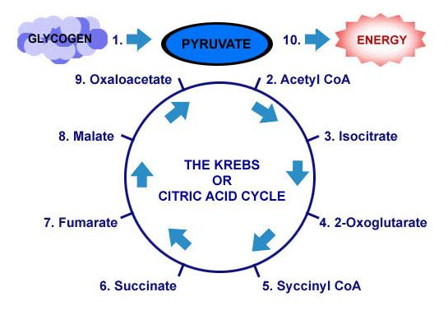
2. Citric Acid or Krebs Cycle
It is not necessary to know the individual steps
a) occurs in the mitochondria b) an aerobic process; will proceed only in the presence of O2

Slide 9
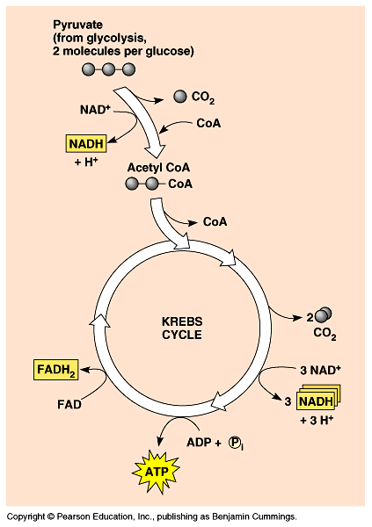
net yield of 2 ATP
net yield of 6 NADH and 2 FADH2 --> sent to ETC
e) in this stage of cellular respiration, the oxidation of glucose to CO₂ is completed.
(this is why we exhale carbon dioxide)

Slide 10
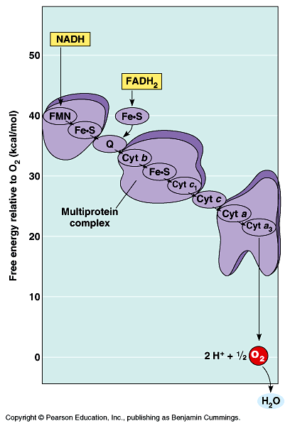
3. Electron Transport System:
a) consists of a series of enzymes on the inner mitochondrial membrane
b) electrons are released from NADH and from FADH2 and as they are passed along the series of enzymes, they give up energy which is used to fuel a process called chemiosmosis
which drives ATP synthesis

Slide 11
c) net yield of 32 or 34 ATP per glucose molecule
d) 6 H₂O are formed when the electrons unite with O₂* at the end of electron transport chain.
* Note: This is the function of oxygen in living organisms!
Without oxygen to serve as the final electron acceptor, the process shuts down.

Slide 12
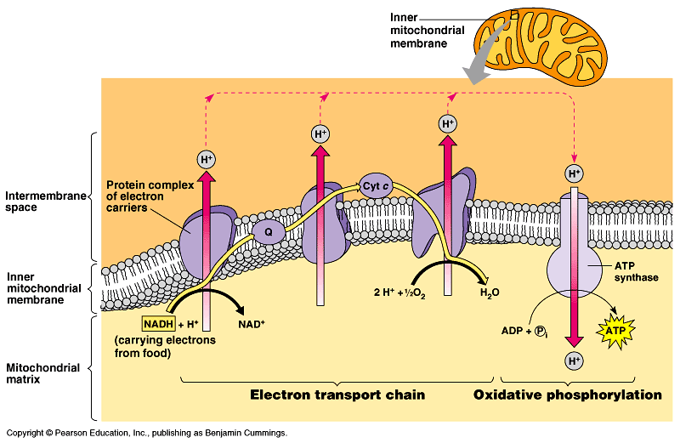
Does this picture look familiar?
You've seen this before in photosynthesis.
Animation of the ETC McGraw Hill Animation

Slide 13
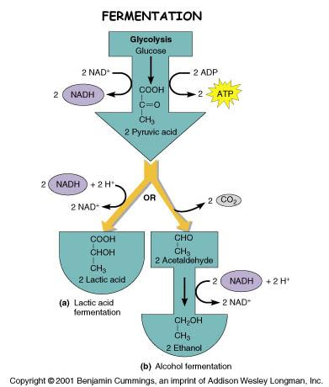
Fermentation
This happens when the Krebs cycle cannot occur due to lack of oxygen
Byproducts of fermentation include lactic acid and alcohol
Lactic Acid in muscle cells can cause muscle cramps.

Slide 14
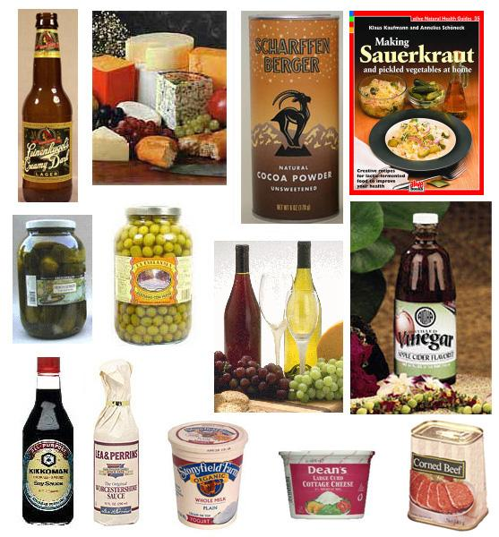
Fermentation is used in making food products and alcohol products.

Slide 15
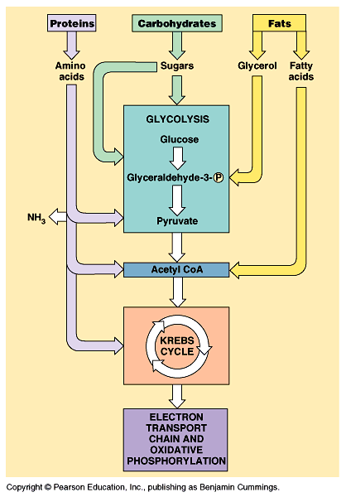
What are the 3 stages of cellular respiration?
1.
2.
3.

Slide 16
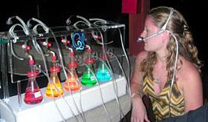
Food for thought
1. What is the purpose of cellular respiration?
2. Where does cellular respiration occur within the cell?
3. What is the waste product of cellular respiration?
Would you go to an oxygen bar?

Slide 17
4. Compare Photosynthesis to Respiration
a. Where does each occur?
b. What are the products of each?
c. What compounds are needed to start the processes?
d. What is the function of the electron transport chain in each process
e. Describe the role of ATPase in both processes.

Slide 18
Self Test
1. In order to produce energy, cells start with glycolysis. If oxygen is NOT present after glycolysis, what process occurs next? a) Electron Transport Chain b) Krebs Cycle c) Fermentation 2. If oxygen IS present after glycolysis, what process occurs next? a) Electron Transport Chain b) Krebs Cycle c)Fermentation
3. A process that does NOT require oxygen is known as what? a) Aerobic b) Anaerobic
4. In glycolysis, glucose is broken into 2 molecules of __________________ acid
5. Where does the Kreb's cycle occur? _________________
6. What gas is a waste product produced in the Krebs cycle? ____

Slide 19
7. What enzyme is used in the electron transport chain to create ATP?
a. citric acid b. pyruvate c. ATPase
8. Where does glycolyis occur?
a. cytoplasm b. mitochondria c. chloroplast
9. Which process produces the largest amount of ATP?
a. fermentation b. Krebs Cycle c. ETC
10. The oxygen required by cellular respiration is reduced and becomes part of which molecule?
a. ATP b. CO₂ c. H₂0

Slide 20
The Mystery of the Seven Deaths
Case Study: http://sciencecases.lib.buffalo.edu/cs/files/cellular_respiration.pdf
In this case study, students learn about the function of cellular respiration and the electron transport chain and what happens when that function is impaired. Students play the role of medical examiner as they analyze the autopsy results to determine the cause of the mysterious deaths of these seven victims.
Explain the overall purpose of cellular respiration.
Describe the intermediate metabolites of cellular respiration.
Explain the function and importance of the electron transport chain.
Describe the role of oxygen in cellular respiration

