Slide 1
Chapter 6
6.3 Organic Molecules

Slide 2
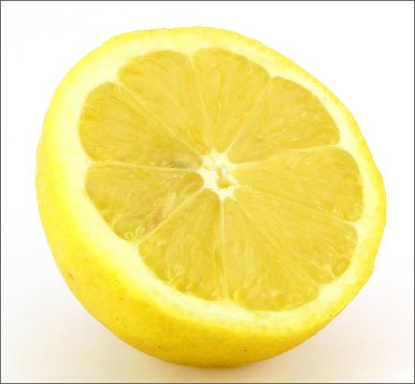
Acids and Bases
pH measures how acidic or basic a solution is
The pH scale ranges from 0 – 14
Less than 7.0 = ACIDIC
More than 7.0 = BASIC
7.0 = Neutral (pure water/distilled)
The pH scale is logarithmic
6.0 is 10X more acidic than 7.0
5.0 is 100X more acidic than 7.0
4.0 is 1000X more acidic than 7.0

Slide 3
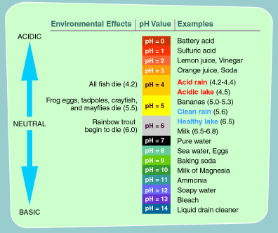

Slide 4
Organic Molecules
There are 4 ORGANIC MOLECULES that are essential for all life
Carbohydrates
Lipids
Nucleic Acids
Proteins
Monomer: simple building blocks
Polymer: groups of monomers

Slide 5
Carbohydrates
CARBOHYDRATES are sugars!
They are composed of the atoms:
Carbon (C), Oxygen (O), and Hydrogen (H)
CARB + O + HYDRATE
The building blocks of carbohydrates are MONOSACCHARIDES (monomer)
Monosaccharide: simplest sugar
Glucose, Fructose, Galactose, Ribose

Slide 6
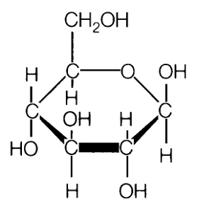
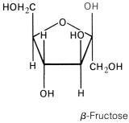
Glucose
Fructose

Slide 7
Disaccharides
Two monosaccharides combine to form DISACCHARIDES
Glucose + Fructose = SUCROSE (table sugar)
Glucose + Galactose= LACTOSE (milk sugar)

Slide 8
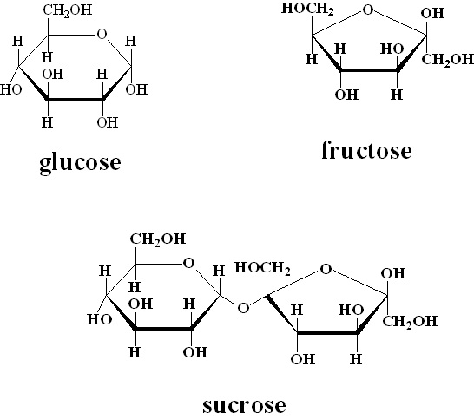
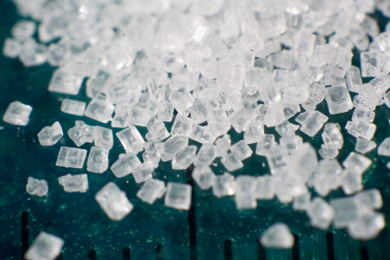
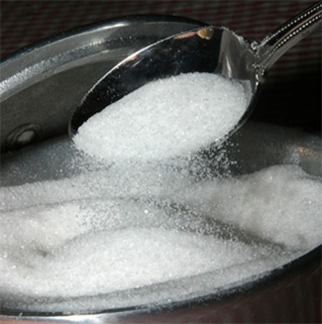

Slide 9
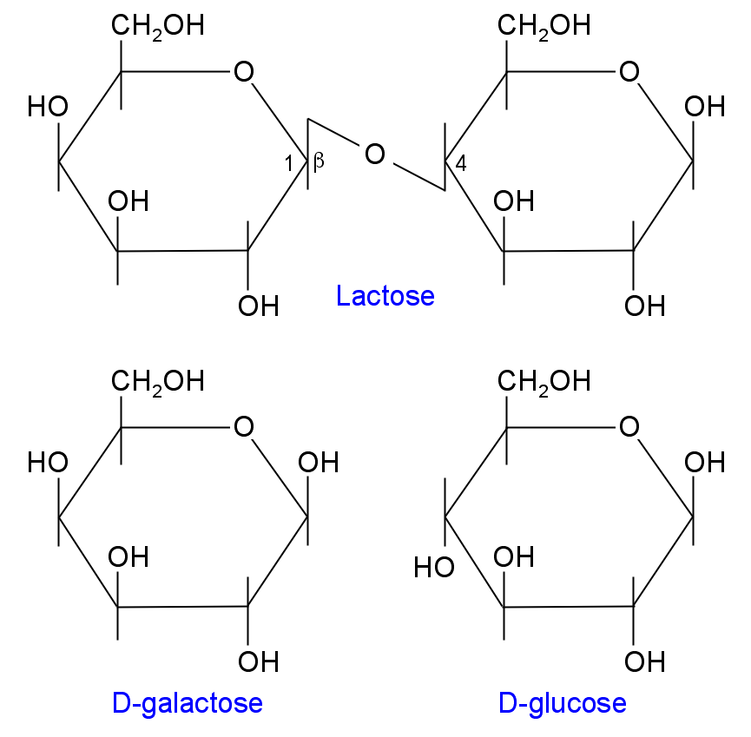
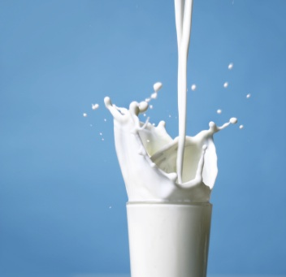
Lactose
Milk

Slide 10
Polysaccharides
Many monosaccharides combine to form POLYSACCHARIDES (polymer)
Polysaccharide: repeating monosaccharides
Starch – energy storage (plants)
Potatoes, corn, crackers
Glycogen – energy storage (animals)
Cellulose – structural molecule (plant cell walls)
Corn kernels, celery, lettuce
Chitin – structural molecule (fungus cell wall & insect exoskeletons)

Slide 11
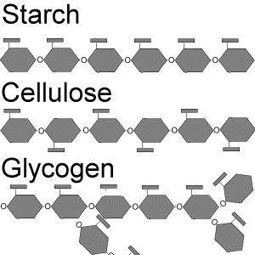

Slide 12
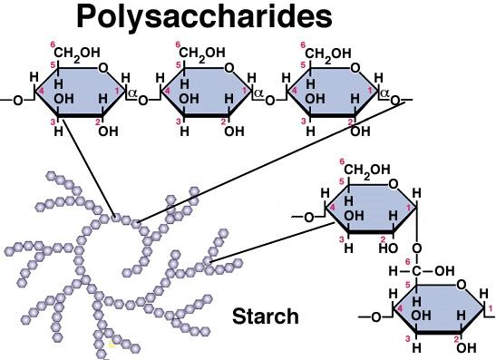

Slide 13
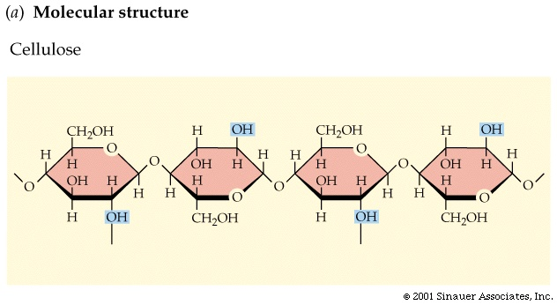

Slide 14
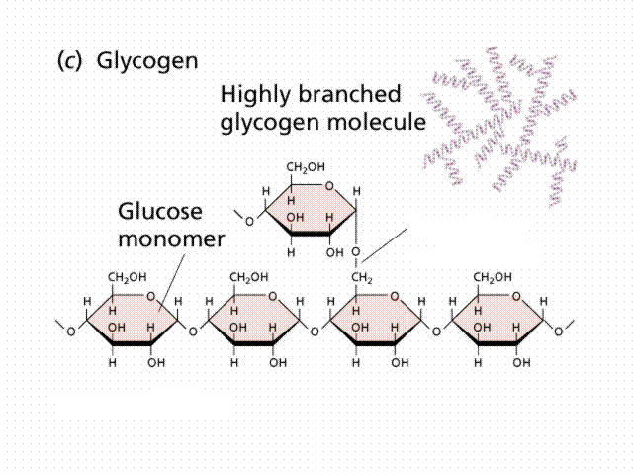

Slide 15
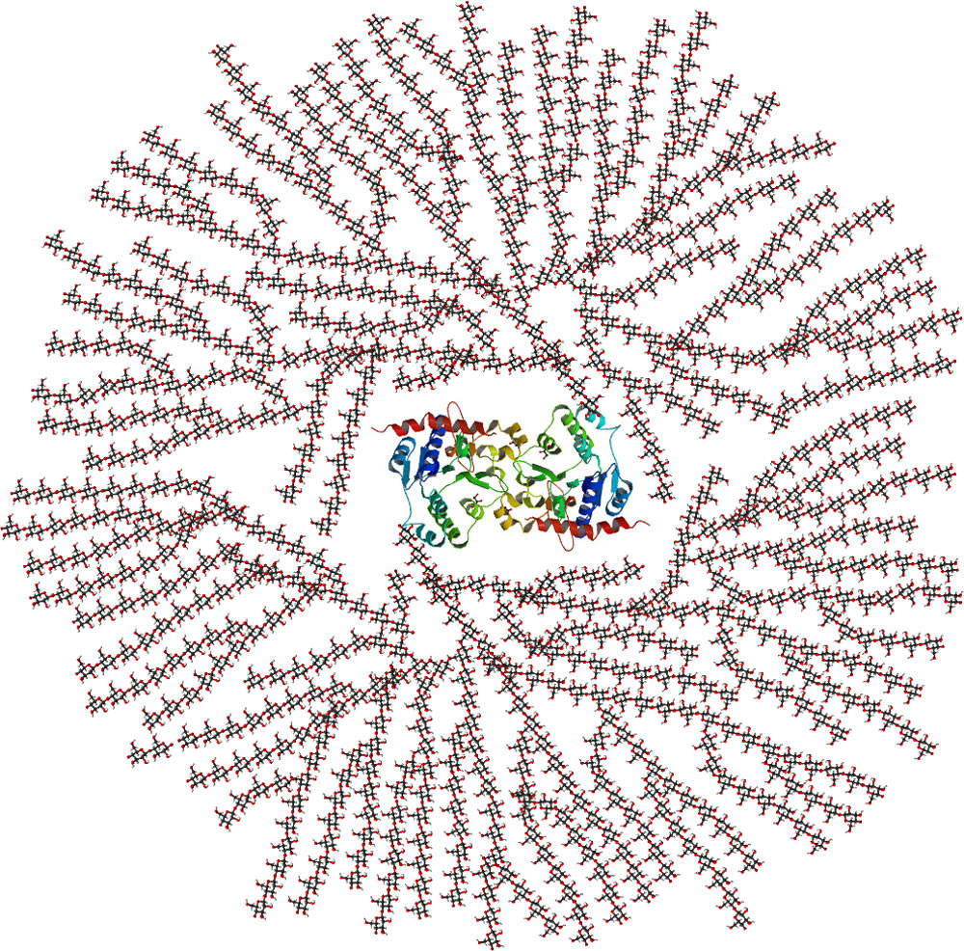
Glycogen
Molecule
w/ glycogenin
protein center

Slide 16
Carbohydrates
Carbohydrates provide us with QUICK ENERGY
4 kilocalories per gram
Foods: grains, fruits, vegetables, sweets
Carbohydrate Test: Iodine will turn blue-black color to test for carbs

Slide 17
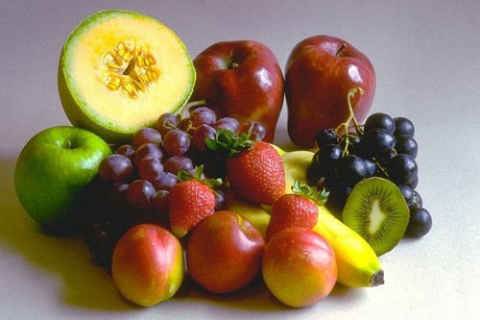
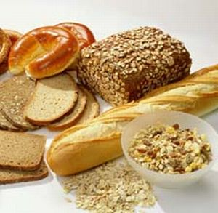
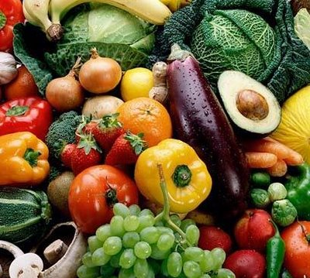
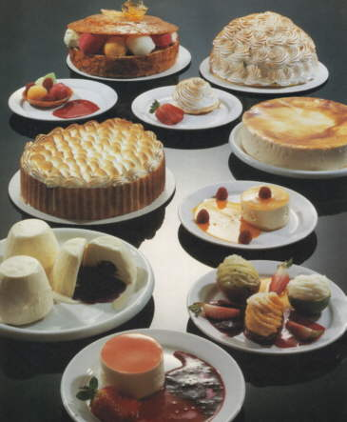

Slide 18
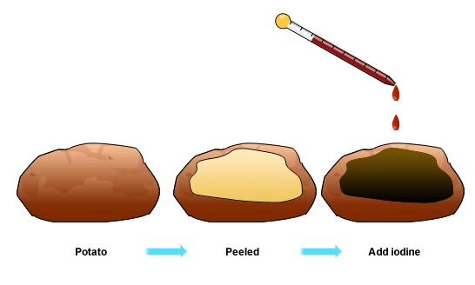
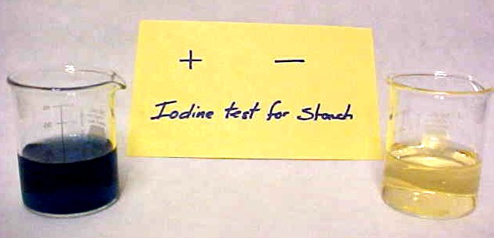

Slide 19
Lipids
LIPIDS are fats, oils, and waxes!
Lipid structure:
Glycerol (monomer) + 3 fatty acids (monomer) = triglyceride (polymer)
Lipids are INSOLUBLE in water
Don’t mix (dissolve) in water

Slide 20
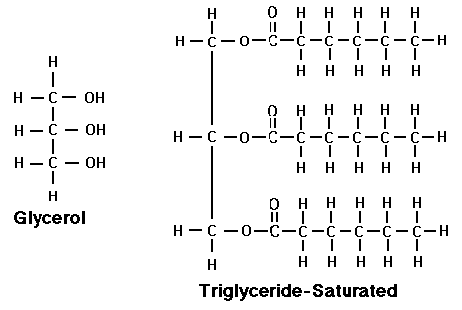
Fatty acid
Fatty Acid
Fatty Acid

Slide 21
Lipids
Lipid Functions:
Long-term energy storage and insulation
9 kilocalories per gram
Major component of the plasma membrane
Phospholipid bilayer
2 Types of Fats:
Saturated Fats: BAD (dairy, meat, lard, butter)
Unsaturated Fats: GOOD (nuts, avocadoes, oils)
Brown paper bag test:
Greasy spot = lipids
Wendy’s bag with fries

Slide 22
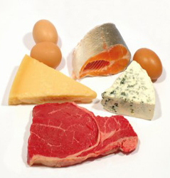
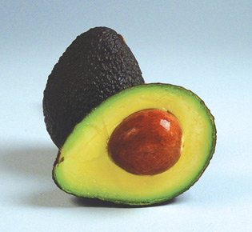
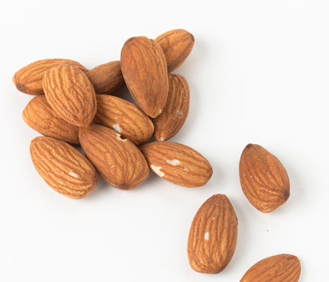

Slide 23
Nucleic Acids
NUCLEIC ACIDS are the molecules that make DNA and RNA!
Nucleic acids are made of NUCLEOTIDES (monomer)
Nucleotide Structure:
Simple Sugar
Phosphate Group
Nitrogen Base (A, C, T, G, U)

Slide 24
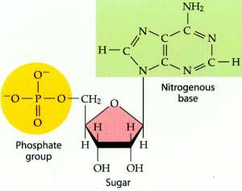

Slide 25
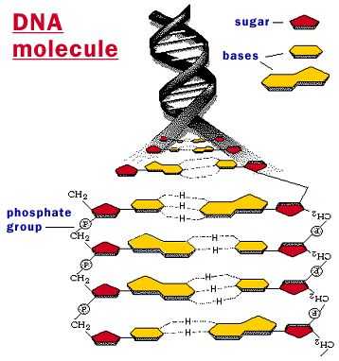

Slide 26
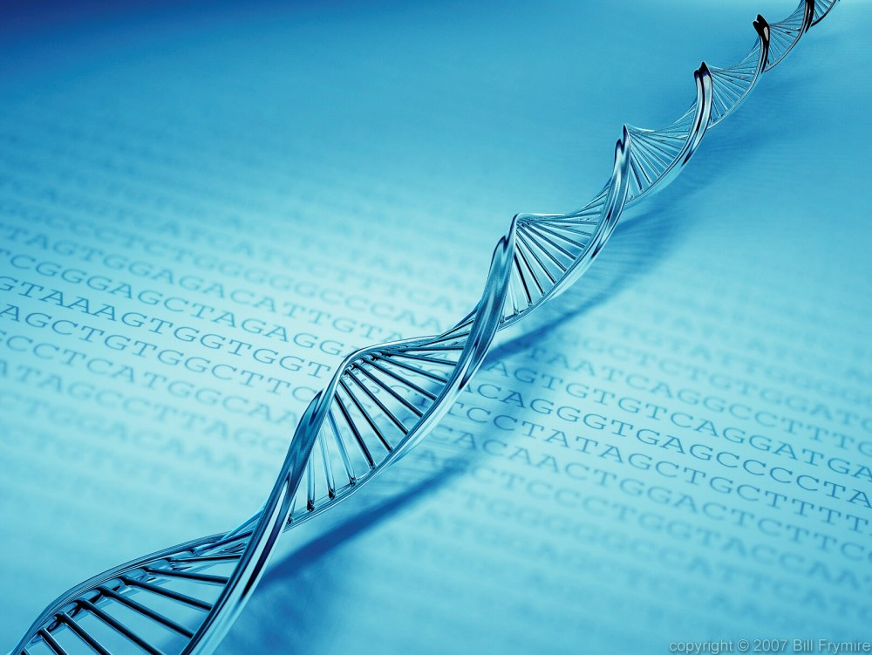
Nucleic Acids
The function of nucleic acids is to store genetic information in the form of a code
Found in the nucleus of the cell
Nucleic acids are found in all foods because all organisms contain DNA

Slide 27
Proteins
Proteins provide structural support and carry out chemical reactions in the body!
Proteins are made of long chains of amino acids (monomers)
Amino acids are bonded together with PEPTIDE BONDS
Polypeptide (polymer)
Polypeptide = protein
4 kilocalories per gram

Slide 28
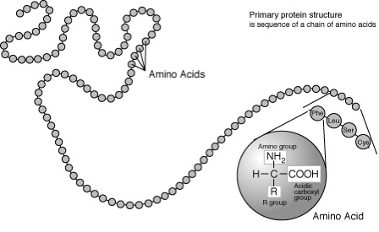
Polypeptide

Slide 29
Enzymes
ENZYMES are a type of protein that speed up chemical reactions in the body
Enzymes can either break molecules apart or join molecules together
E.g. Break food down; assemble chains of DNA
Enzymes work by lowering the amount of energy needed to start the reaction (activation energy)

Slide 30
Enzymes
The molecule that an enzyme interacts with is called a SUBSTRATE
Enzyme-substrate reaction
Enzymes are very SPECIFIC in how they work
Each enzyme interacts with ONE specific substrate
Like a lock and key or a puzzle piece
Enzymes are conserved (not used up) in the reaction
They can be reused continuously
Enzyme – doesn’t change
Substrate – is changed by the enzyme

Slide 31
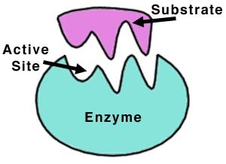

Slide 32
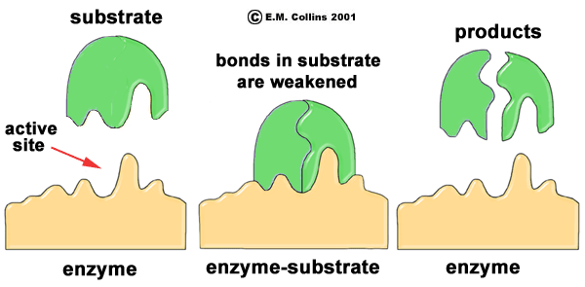

Slide 33
Enzymes
Many enzymes work best at a certain temperature or a specific pH
If enzymes are heated too much they will denature (fall apart) and stop working altogether

