Slide 1
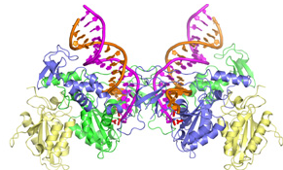
Enzymes

Slide 2
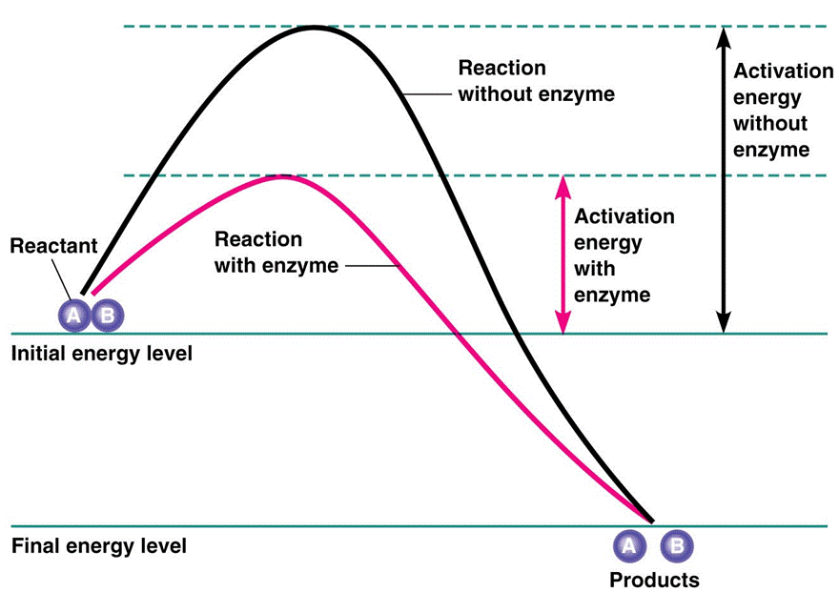
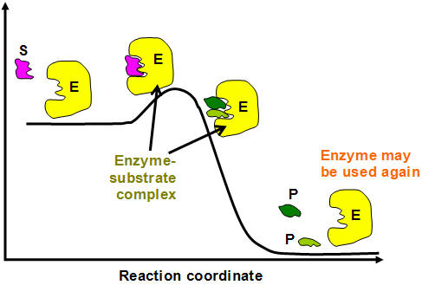
Enzymes are proteins made of amino acids
Are catalysts (lower the activation energy of a reaction)
Are reusuable
Are specific
Have a 3-D shape

Slide 3
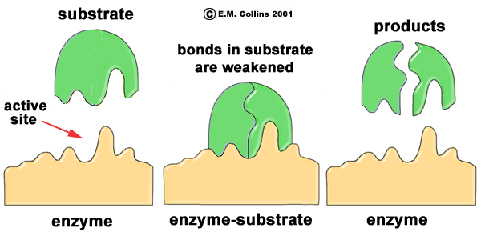
Enzymes have active sites

Slide 4
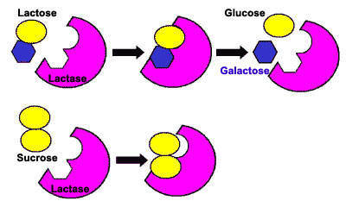
Examples:
Catalase → breaks down hydrogen peroxide (waste produced in cells) into
2H₂O₂ → 2H₂O + O₂
Lactase → breaks down lactose in milk
Protease → breaks down proteins
Lipase → breaks down lipids

Slide 5
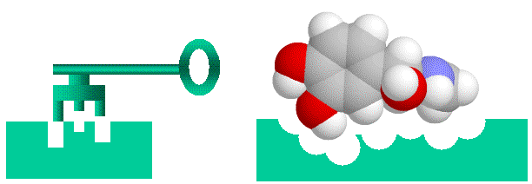
How do enzymes work?
Active sites on enzymes = places to which a specific substrate binds
Enzyme-substrate complexes form (when substrates attach to active sites on the enzyme) to break apart or put together substances at a fast rate
E + S → ES → E + P
One model of enzyme action
Lock & key model → substrate and the enzyme fit together perfectly
Enzyme video

Slide 6
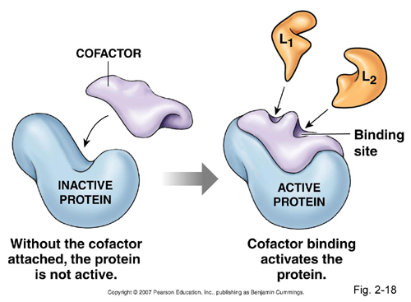
Factors affecting enzyme action
Temperature – enzymes work best at certain temperatures - 37°C is best for human enzymes in the body
pH – enzymes work best at certain pH; basic, neutral, and/or acidic environments (ex. Amylase in saliva at pH 7, pepsin in the stomach at pH 2-3, & trypsin in the intestines at pH 9)
Substrate & enzyme concentration – how fast reactions take place depends on how much of the substrate and enzymes is available
Coenzymes and cofactors – helpers
such as vitamins and minerals

